Slide 1


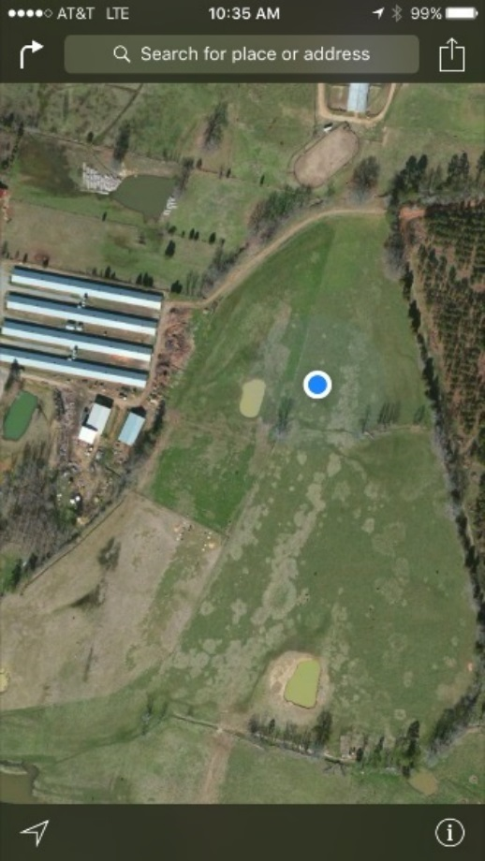
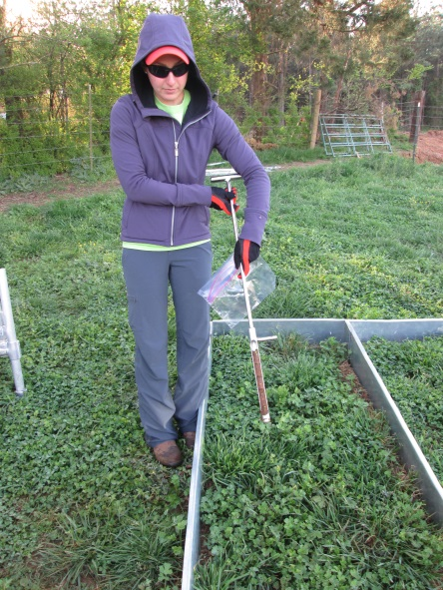
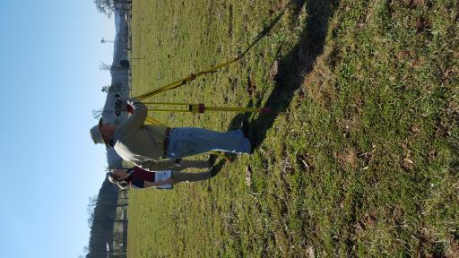
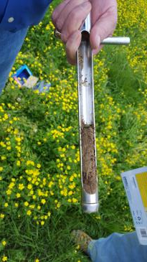
Nutrient Permitting – Year 1 Pilot Monitoring Results and Alternative Permitting Strategy
May 3, 2017

Slide 2
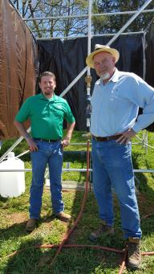
Today’s Outline
Background on Nutrient Permitting in the Coosa Basin
Pilot Monitoring Project – Export Poultry Litter
  Study Set Up
  Sampling Results Year 1
Alternative Nutrient Permitting Strategy
Notes:
Demand and supply exists for a trade

Slide 3

Nutrient Permit Issues in the Coosa Background
2008 - Lake Weiss TMDL (USEPA)
2010 – 1 mg/L TP limits in NPDES permits (GAEPD)
2011- Partnership and GAEPD Correspondence
2011 - 319 Grant Awarded to Evaluate Nutrient Trading
2012-2013 – Nutrient Trading in the Coosa Basin: A Feasibility Study
Dec. 2013 – Review with GAEPD
2014 – Pilot Nutrient Trading Monitoring Plan
Oct. 2014 – Review with GAEPD
2015-2017 – Implement Monitoring Plan
Notes:
Feasibility Study looked at financial, technical and legal issues associated with nutrient trading. No obvious NPSP source of TP in review of EPD monitoring data (any one sub-watershed). Poultry litter has high TP, often applied for N fertilization, which is more soluble. End result is TP overapplied. Demand and supply exists for a trade now.

Slide 4
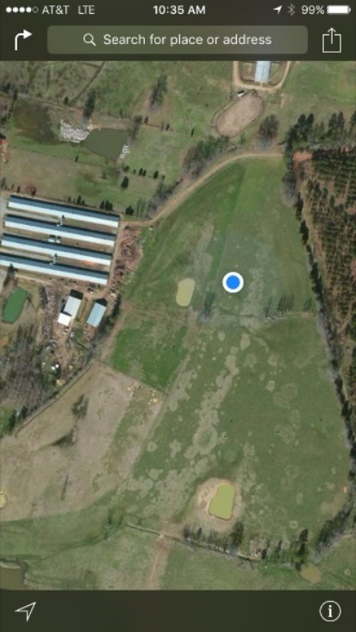
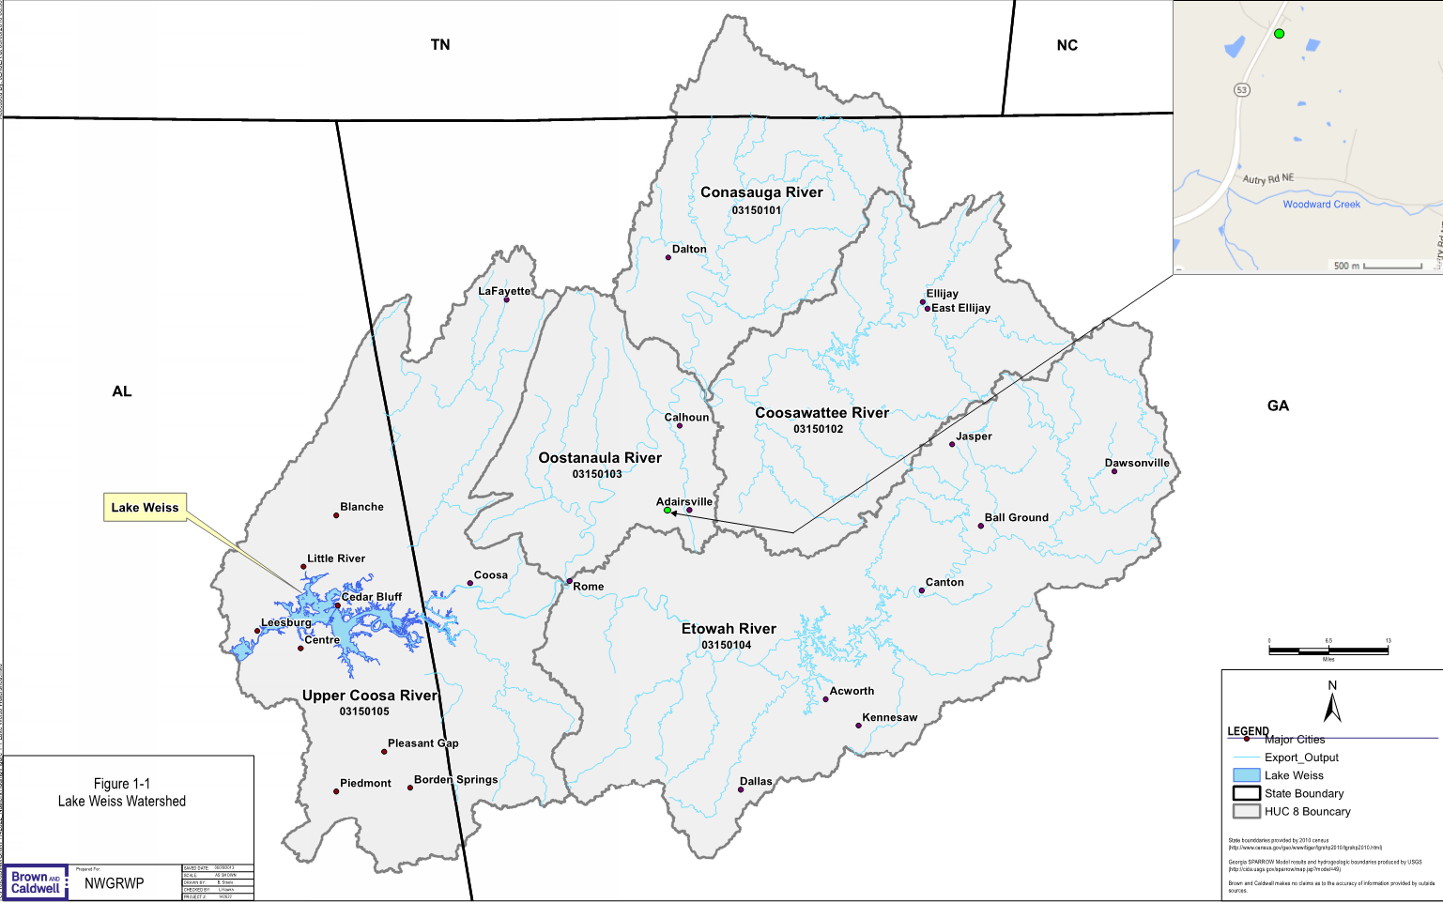
Nutrient Trading Background
Why Poultry Litter Export?
Notes:
Lake Weiss impaired due to nutrient enrichment. Large majority of TP comes from NPSP, EPA models show 70%. EPD has been monitoring Coosa to update their models. EPD model assumes all TP from poultry litter runs off site because of soil saturation. TMDL requires 30% TP reduction at state line, with no requirements of how that can be achieved. Feasibility study shows

Slide 5
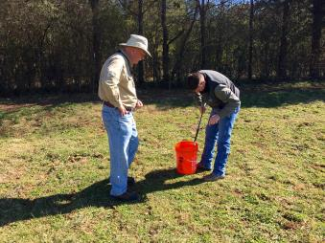
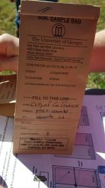
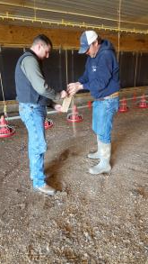
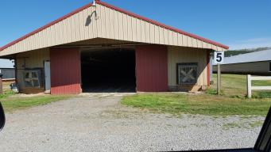
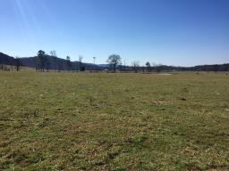
Pilot Monitoring Project
Site Evaluation

Slide 6
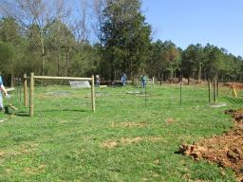
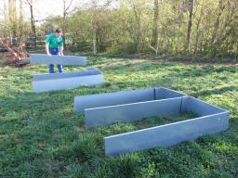
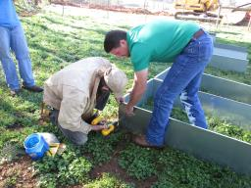
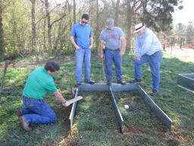
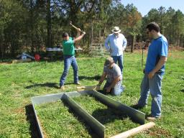
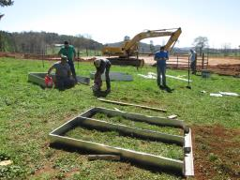
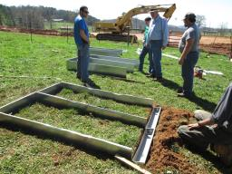
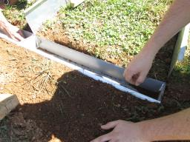
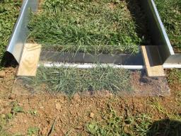
Pilot Monitoring Project
Plot Set Up

Slide 7
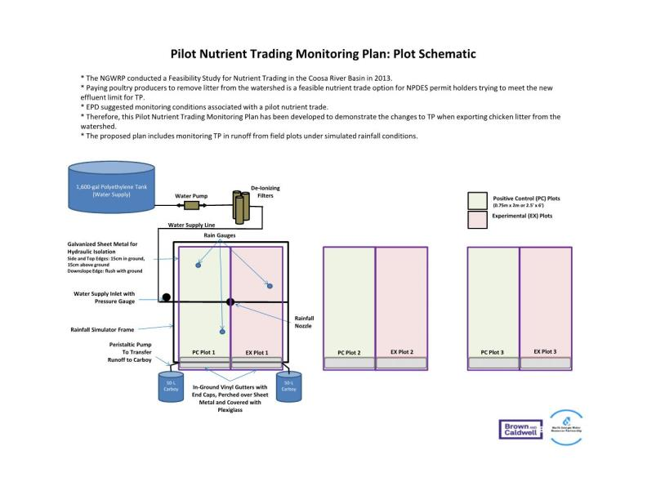
Field Plot Layout
SSSSSSS

Slide 8
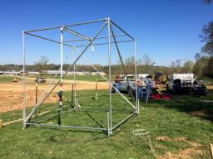
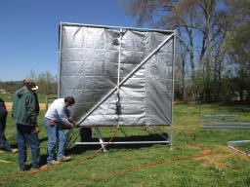
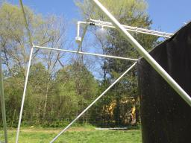
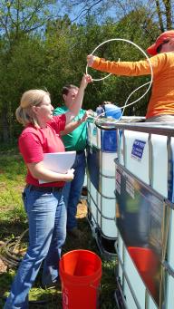
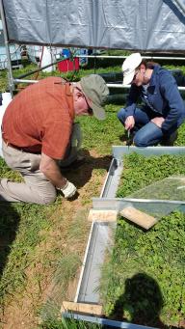
Pilot Monitoring Project
Simulated Rainfall Equipment Set Up

Slide 9
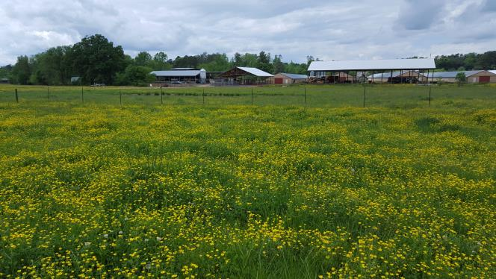
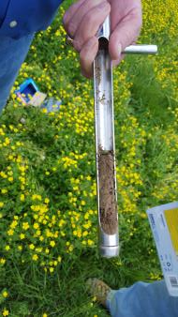
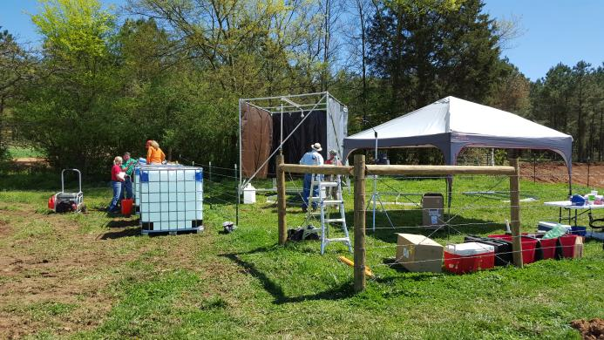
Pilot Monitoring Project
Final Set Up

Slide 10

First Year Results
Phosphorus Availability
Soil Samples
Runoff Samples

Slide 11

Phosphorus in Soil
Three primary pools:
  Solution pool – dissolved in water contained in the soil – easily available to plants, or for being carried away in runoff. Generally a very small fraction of the Total P in soil.
  Active pool – in solid form, but easily dissolved or released to become available to plants or runoff. May be organic or inorganic.
  Fixed pool – in solid form and bound very tightly. Can exist for years without being available to plants or runoff. Usually comprises the vast majority of Total P in soils, but may have little effect on soil fertility.

Slide 12
Phosphorus Availability
Various factors affect phosphorus availability
  Soil texture – some soil types (e.g., clays) can hold much more P than others (e.g., sand)
  Soil pH – P is most available to plants at pH of 6.5 70 7.5. Outside of this range, P becomes strongly bound to certain metals in the soils
  Soil temperature – higher temperatures increase microbial action, which increases P availability
  Organic content – more organic matter leads to higher P availability
  Rainfall/irrigation – water movement over soil can wash out P
  Plant growth – harvest/removal of crops is a primary process by which P is removed from soils
Even small amounts of phosphorus runoff can impair waterbodies

Slide 13
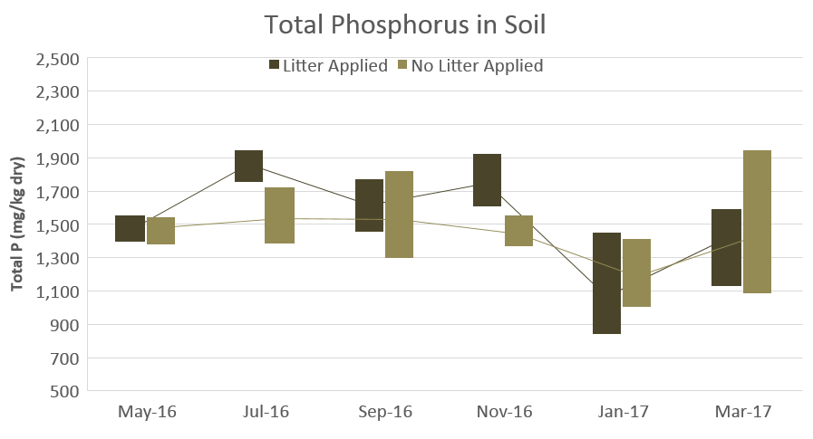
First Year Results - Soils
Notes:
Explain the chart: each “box” contains measured values for all three plots – min at the bottom end, max at the top end, the third value somewhere in between. The lines connect the mean values for the three plots. Thus, smaller boxes show less variation among plots.
Total Phosphorus sampled because it incorporates all forms of P found in soils (but much of TP may not be readily available to plants)
Measured ranges for Positive Control plots and Experimental plots are similar because (1) the study site was chosen for its high (“saturated”) P levels, and (2) until the start of this study, the Experimental plot area also received poultry litter annually.
Note the range of values – generally between about 1,000 and 2,000 mg/kg of P.

Slide 14
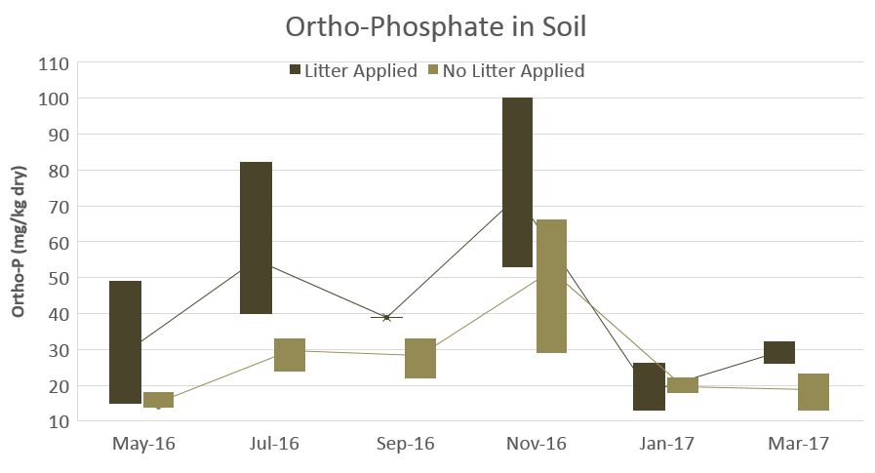
First Year Results - Soils
Notes:
Note the measured range of values – generally between about 10 and 100, about two orders of magnitude below the TP range we saw.
Ortho Phosphorus generally represents the solution pool and the active pool, which is most readily available for plants. Thus, there is about 100 times more total phosphorus in the soil of the test plots than what is accessible for plant growth.
The higher concentrations for the Positive Control plots in the first four months of sampling represent the additional available phosphorus contributed by the litter application at the beginning of the project. Note the general pattern in both sets of plots with higher available P during the warmer months of the year (July and September).
Note the higher Ortho-P in the November samples, which may be the result of plant senescence in the fall and the release of P from decaying plant matter.
Generally similar ranges in the January and March 2017 samples suggest that one year has not been sufficient to begin depleting the legacy P in the Experimental plots. Other researchers have found that legacy P in soils may take decades to abate after fertilizing is stopped.

Slide 15
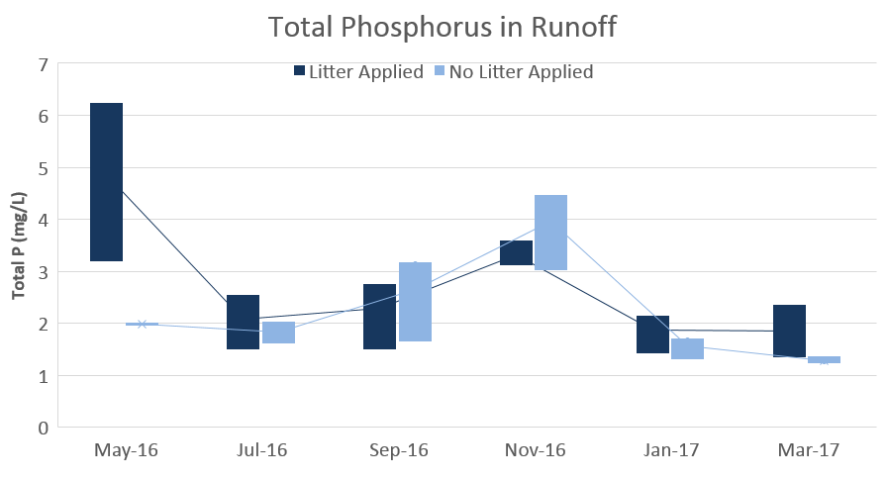
First Year Results - Runoff
Notes:
Total Phosphorus was sampled because incorporates all forms of P
We RECOMMEND also measuring Ortho-P in Year 2 because it is the form most available to algae growth. This would make the runoff monitoring more parallel with the soil monitoring
1st event after litter application, see spike in TP, but then substantial drop back to levels comparable to Experimental plots. May be attributed to (1) plant uptake, (2) initial soluble P carried away in runoff, (3) binding of P to soils particles.
As with Ortho-P in soil samples, the increase in the November samples may be the result of plant senescence and release of above-ground P.
Note that P concentrations in the runoff are high from all of the plots. Most surface water quality criteria are much less than 1 mg/L, in some cases as low as 0.01 mg/L.
Some of the variability among the sampling dates may be due to effects of natural rainfall between monitoring events. Values measured in samples collected via simulated rainfall could differ substantially based on antecedent rainfall timing and volume.
Measured soil pH levels were generally between 6 and 6.5. If soil pH were closer to 7 (as a result of lime application, or even a higher rate of litter application since litter is slightly alkaline), Ortho-P in soil and runoff could be higher.

Slide 16
Conclusions
Results preliminary, may take years to see results
High TP in soils by design, mimic field conditions
Using historic litter application rates, once a year
Spike in runoff TP after litter application, expect annually
TP in runoff is very high relative to water quality standards and generally accepted “background” levels for streams and lakes
Submitted 319 grant for 2 additional years of monitoring
Recommend the addition of Ortho-P monitoring of runoff

Slide 17

New Seed Grant
Alternative Nutrient Permitting Strategy
Scope of Work in process
Joint Strategy with Coosa-North Georgia and Savannah-Upper Ogeechee Water Planning Regions
Coosa Basin TP TMDL requires 30% reduction
Savannah Harbor DO TMDL due to nutrients
Nonpoint source emphasis; reaching limits of cost effectiveness of point source permit compliance

Slide 18
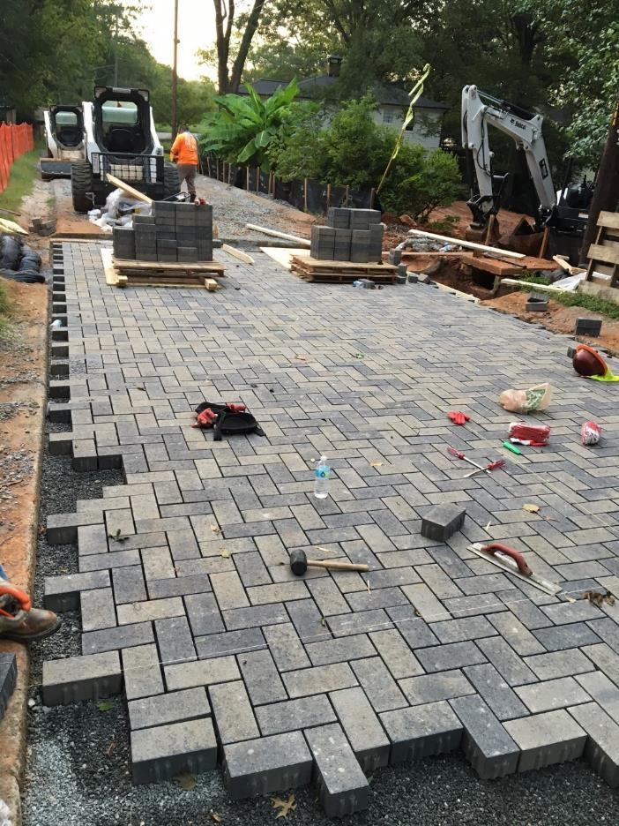
Alternative Nutrient Permitting Strategy
Goals:
  Evaluate alternative methods to improve water quality in the Water Planning Regions beyond traditional point sources
Alternative Strategies may include:
  Nutrient Trading
  In-lieu fees
  Water quality BMPs such as stream buffers, wetlands, land acquisition/conservation easements
  Green Space Planning

Slide 19
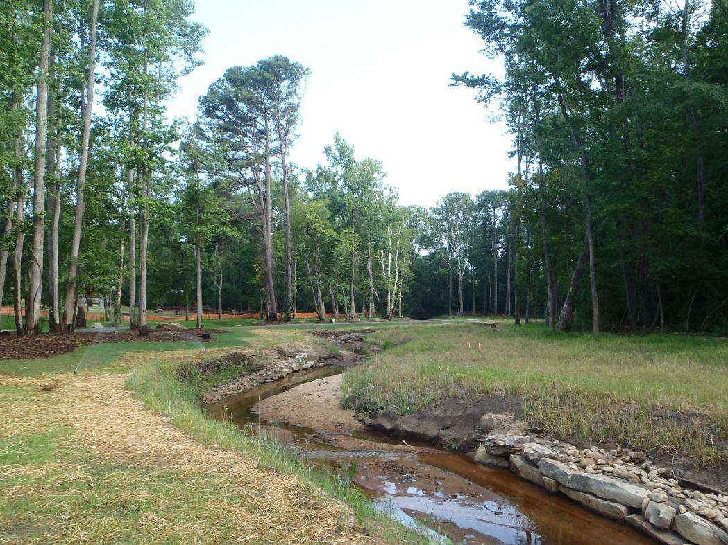
Alternative Nutrient Permitting Strategy
Next Steps
Finalize scope and schedule with GAEPD
Alternative Nutrient Strategies Examples
Draft Alternative Nutrient Strategies
Stakeholder Meetings in both Water Planning Regions – include public utilities, forestry, NRCS, agriculture, environmental groups, etc.
Final Alternative Nutrient Strategies

Slide 20


Questions?
Contact Information
Laurie Hawks Jerry Crawford
Brown and Caldwell City of Calhoun
lhawks@brwncald.com JCrawford@calnet-ga.net
678-231-6433 706-602-6078

