Slide 1

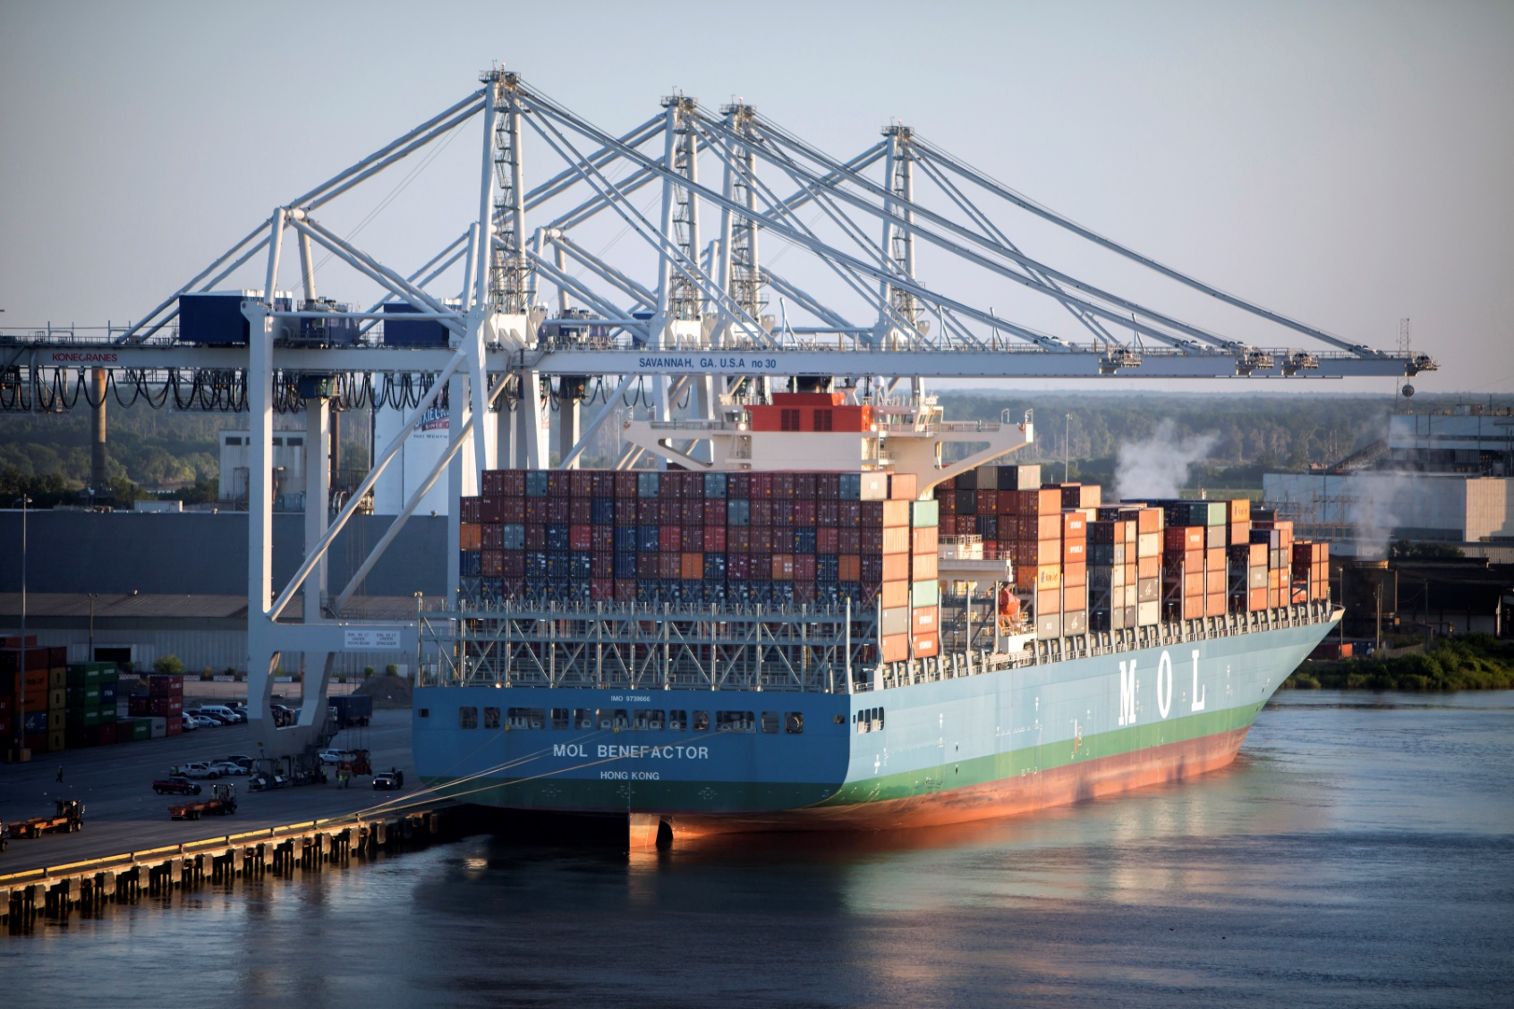
North Georgia Water Resources Partnership
May 2017

Slide 2

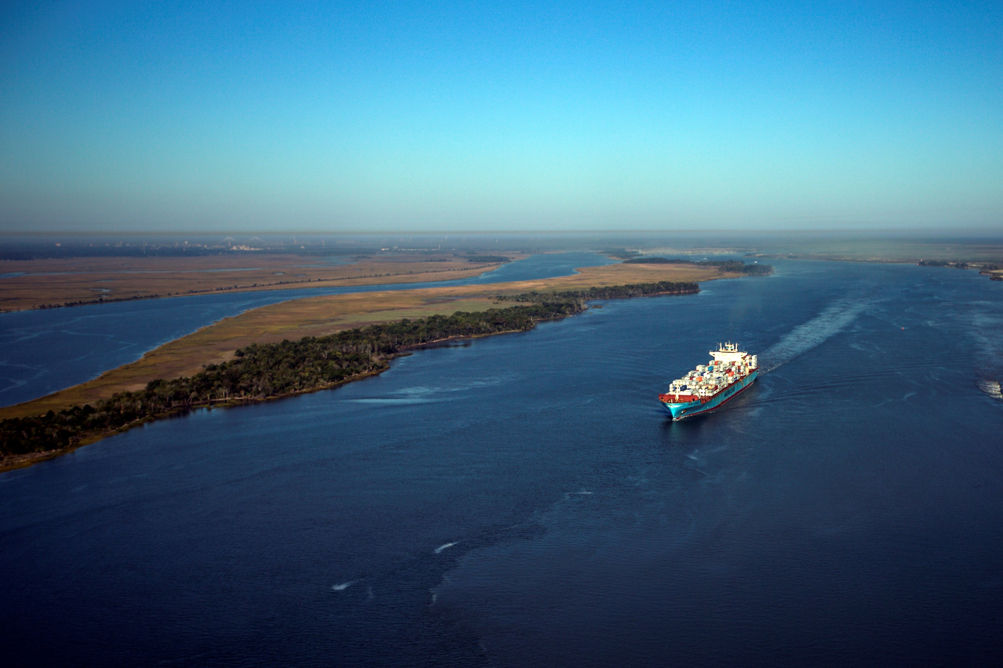
… develop, maintain, and operate ocean and inland ports within Georgia ; foster international trade and new industry for state and local communities ; promote Georgia's agricultural, industrial, and natural resources ; maintain the natural quality of the environment

Slide 3
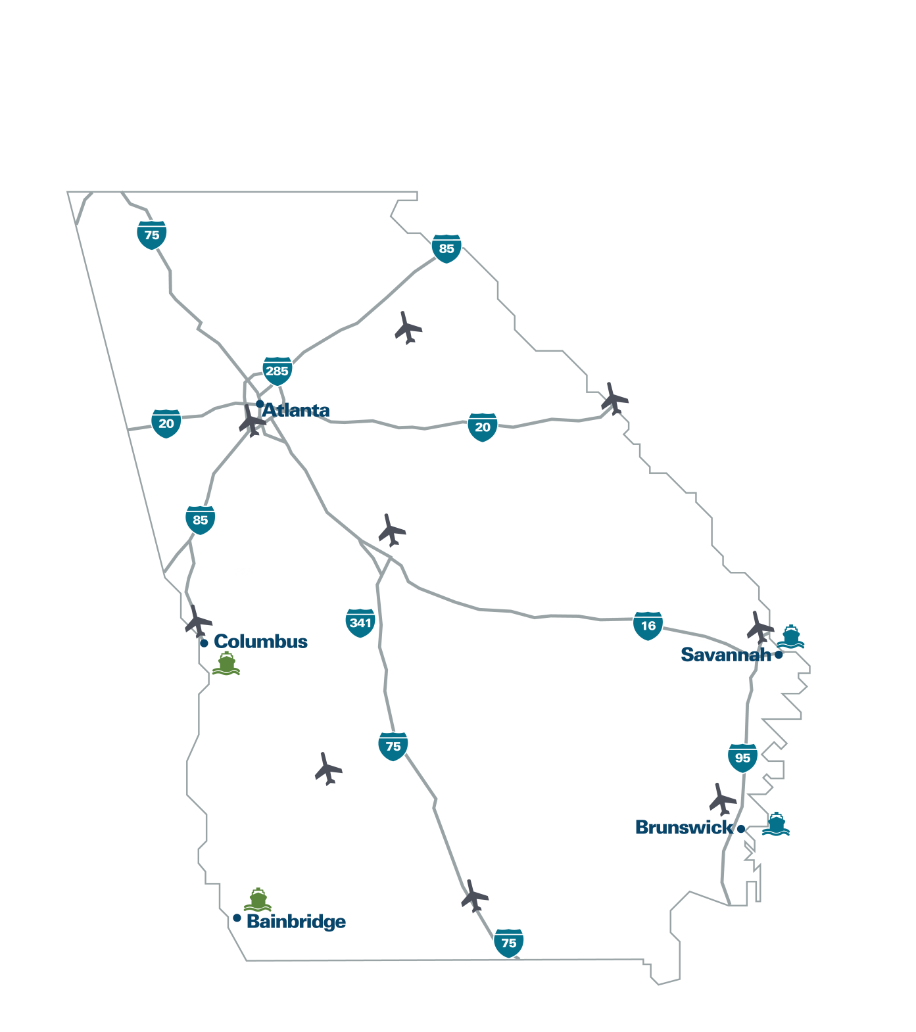
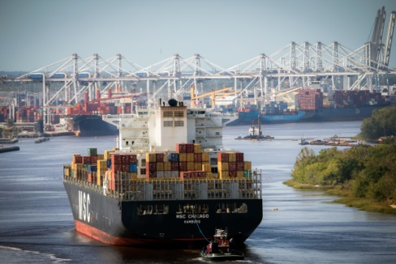
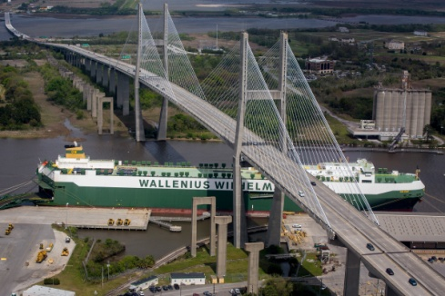
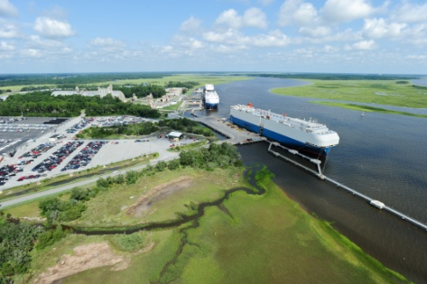
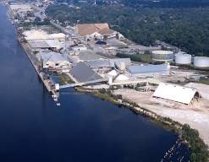
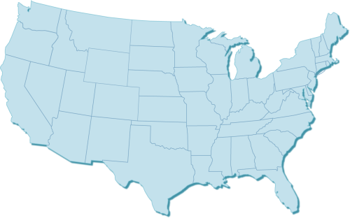
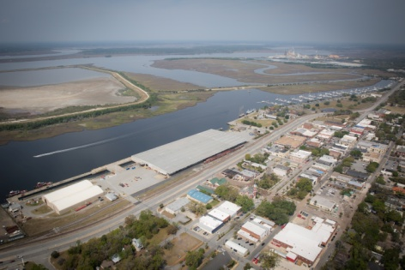
GEORGIA PORTS AUTHORITY
MORE DEEPWATER TERMINAL OPTIONS
Garden City Terminal
Ocean Terminal
Colonel’s Island
Terminal
East River Terminal /
Lanier Docks
Mayor’s Point
Terminal

Slide 4

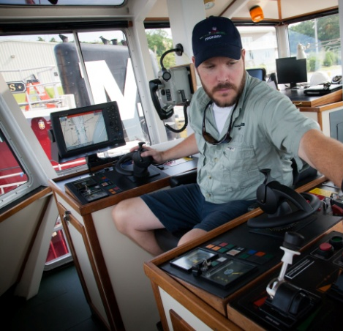
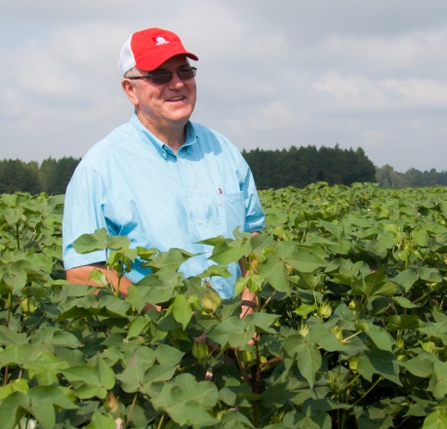
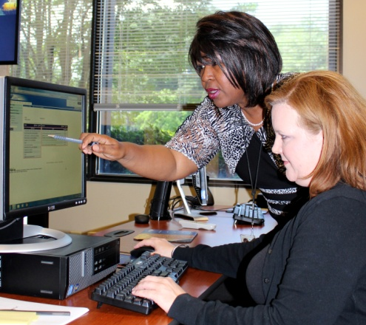
Statewide Economic Impact
369,163 full- and part-time jobs
$84.1 billion in sales (9.6% total sales)
$33.2 billion in state GDP (7.2% total GDP)
$20.4 billion in income (5.3% of total personal income)
Source: *Terry College of Business, University of Georgia (FY2014)

Slide 5

Savannah:
#4 and Fastest growing
PORT | 2005 TEUs | 2015 TEUs
1. LOS ANGELES | 7,484,624 | 8,160,458
2. LONG BEACH | 6,709,818 | 7,192,066
3. NY/NJ | 4,785,318 | 6,371,720
4. SAVANNAH | 1,901,506 | 3,737,425
5. SEA/TAC | 3,289,279 | 2,760,811
6. VIRGINIA | 1,981,955 | 2,549,270
7. OAKLAND | 2,273,990 | 2,277,515
8. HOUSTON | 1,582,081 | 2,130,544
9. CHARLESTON | 1,984,887 | 1,973,202
10. PT. EV | 814,745 | 1,056,524
TOP TEN TOTAL | 32,808,203 | 38,209,535
Source: AAPA; throughput excluding domestic

Slide 6
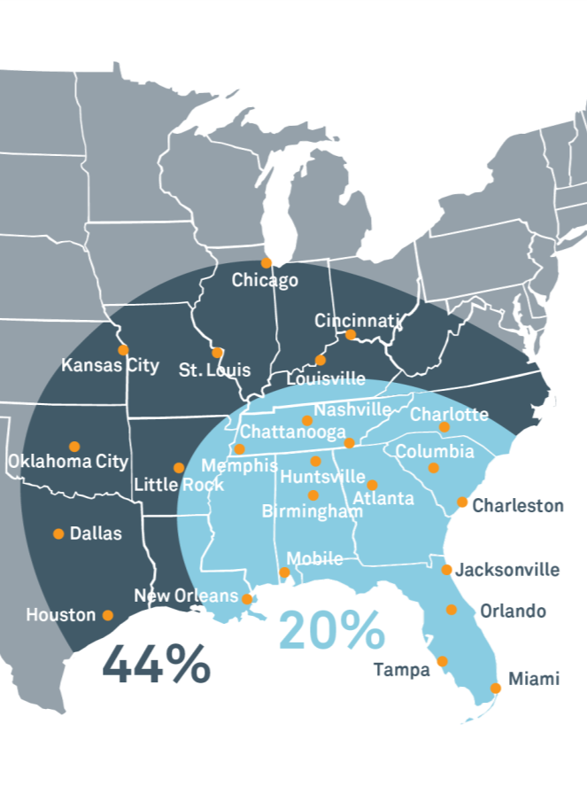
SAVANNAH:
GATEWAY TO AMERICAN COMMERCE:
POPULATION = CARGO
20%
of the U.S.
Population and Industry is best
served by
Port of Savannah
Savannah
44% Within easy reach of inland connectivity infrastructure

Slide 7
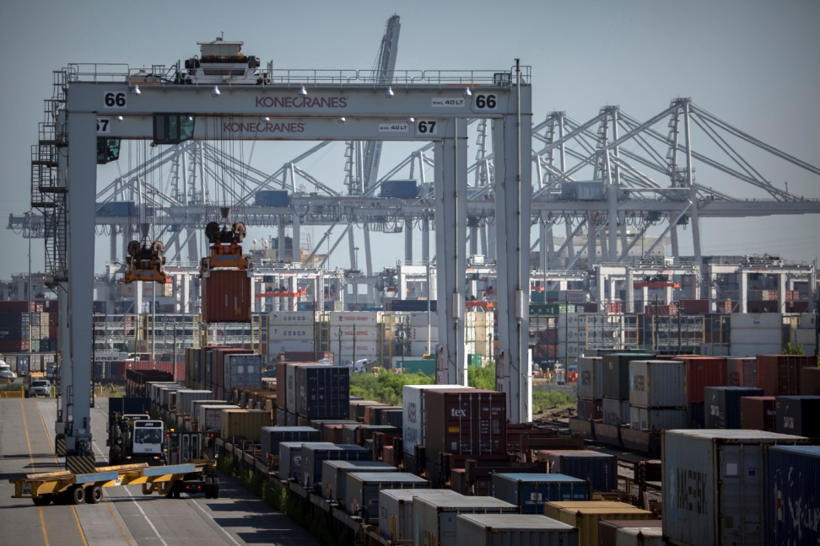
CAPITAL INVESTMENT
FY 2016: 141.8 million
FY 2017: 84 million
  *ARP Project 26.7 million
FY 2018: 137 million planned
1.87 Billion in Capital Investments projected over the next 10 years

Slide 8
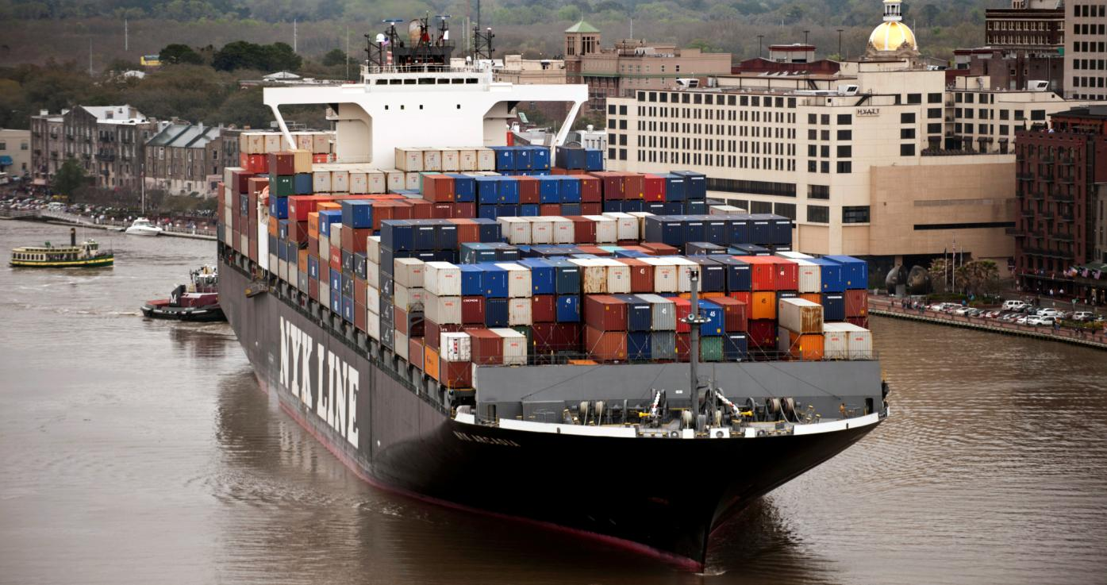
SAVANNAH HARBOR EXPANSION PROJECT
Feasibility Studies
Project Design
Construction
Completion

Slide 9
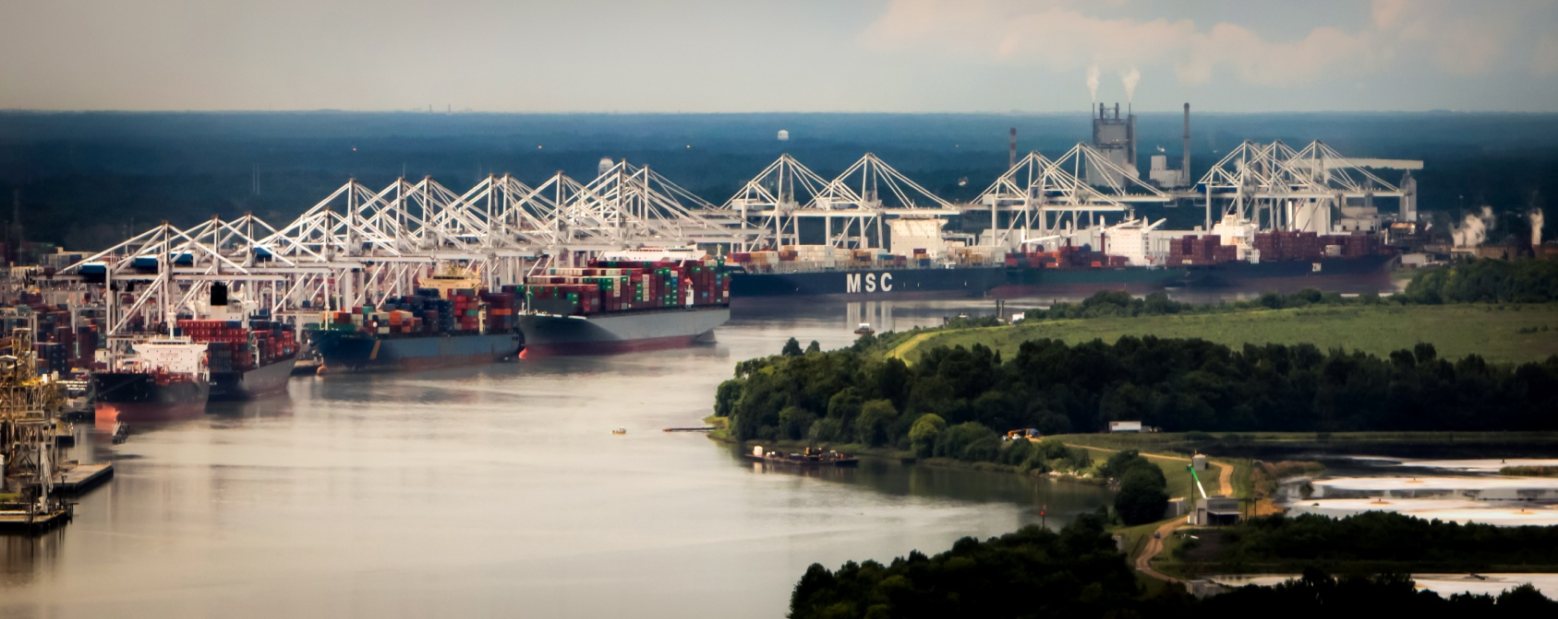
Freight Mobility - Vessel
3.78 million TEU (estimated through-put FY17)
35 weekly calls
Average Weekly Container Lifts 40,120 YTD
Gross Productivity 32.5 mph

Slide 10
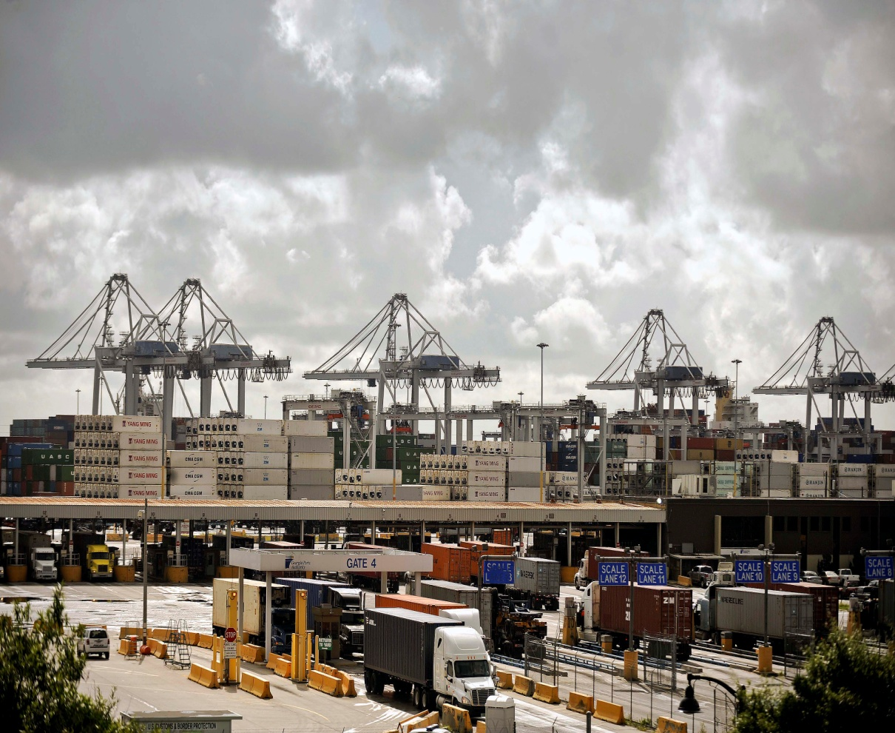
Freight Mobility - Truck
4 Truck Gates
48 Inspection Lanes
Weekly Volume 48,820 trucks
Weekday Average 9,800
Record Day 11,277
Open Monday through Saturday

Slide 11
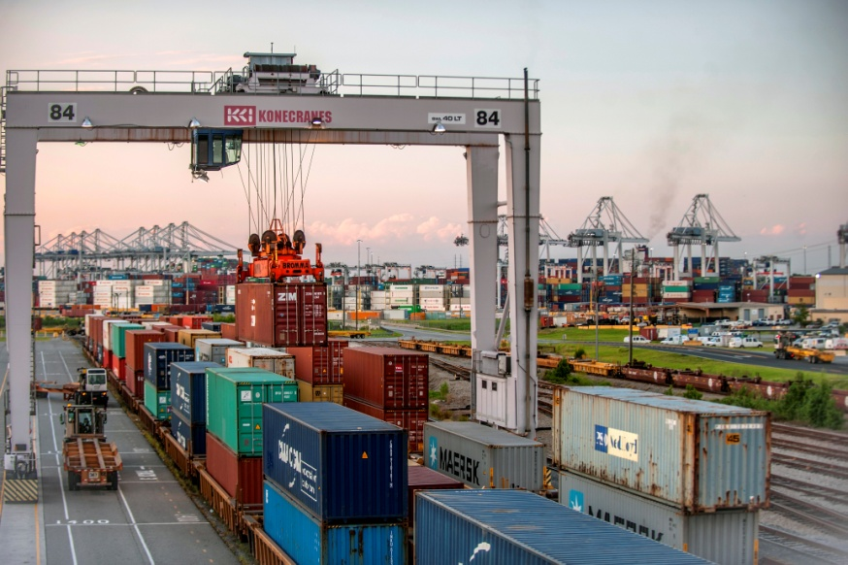
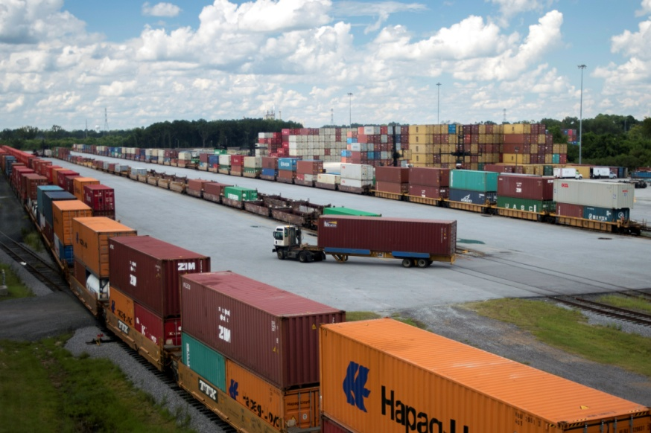
Freight Mobility – Rail
CHATHAM ICTF
MASON ICTF
CSX
Working Tracks 6,300 ft
Storage 11,615 ft
Total Rail Daily Average YTD 1,410
Norfolk Southern
Working Tracks 14,000 ft
Storage 8,000 ft
Total Rail Lifts YTD 282,139

Slide 12
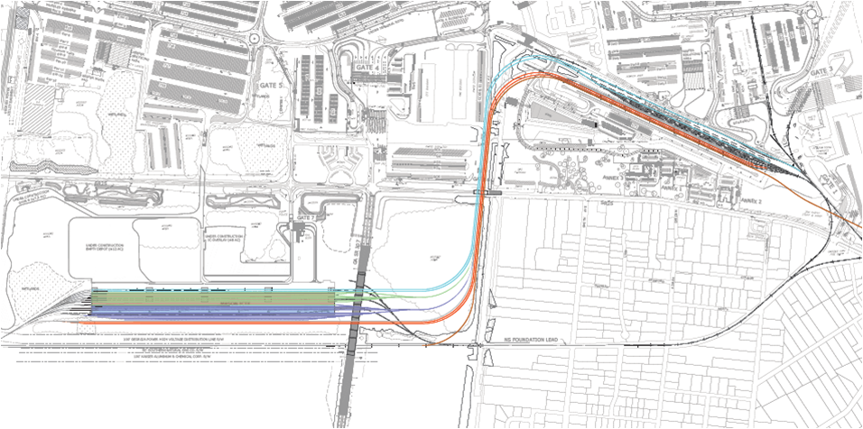
International Multimodal Connector
  A $128 million project to increase rail capacity at the Port of Savannah, expected to take four years to complete, for which GPA received a $44 million Fixing America's Surface Transportation (FAST) grant from the U.S. Department of Transportation

Slide 13
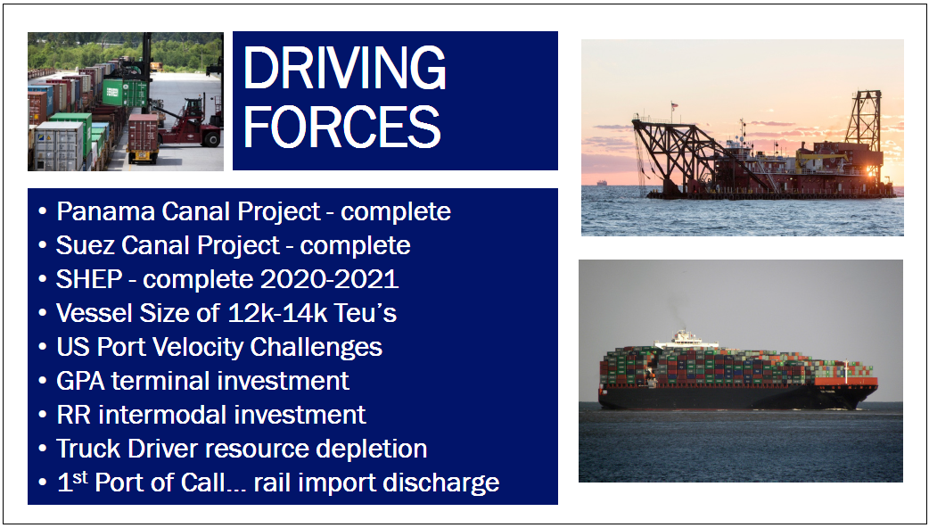

Slide 14
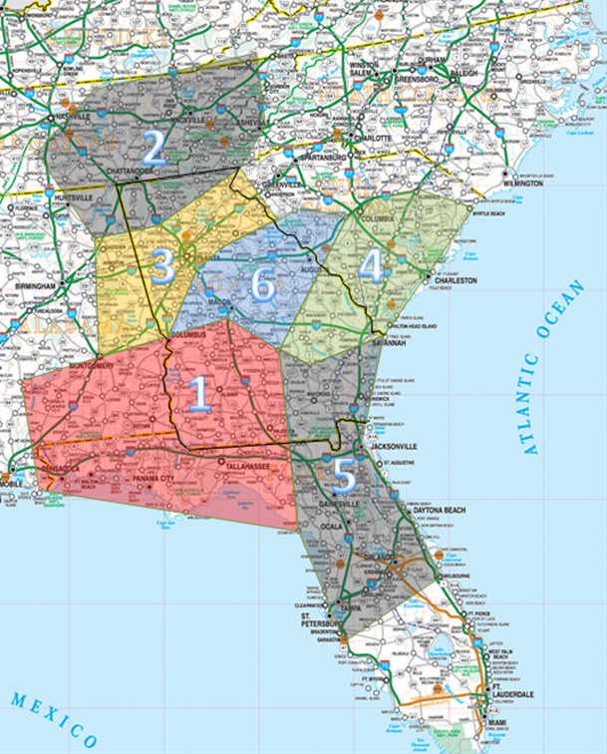
Network Georgia - 10 Year Strategy
  SW Georgia – Cordele
    Rail CY site. Established with CIS. Empty ocean containers supplied to move exports via GPA from Georgia, Alabama & Florida panhandle
  NW Georgia - Appalachian Regional Port
  April 2018 - October 2018
  Port Atlanta
    Presently utilizing existing CSX & NS rail intermodal terminals in & around Atlanta
  I-95 Corridor – North
    Next steps under review
  I-95 Corridor – South
    Next steps under review
  Middle Georgia
    Next steps under review
Savannah

Slide 15
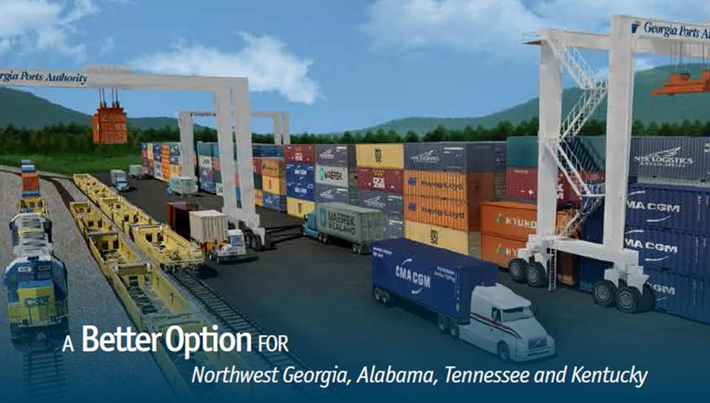
APPALACHIAN REGIONAL PORT

Slide 16
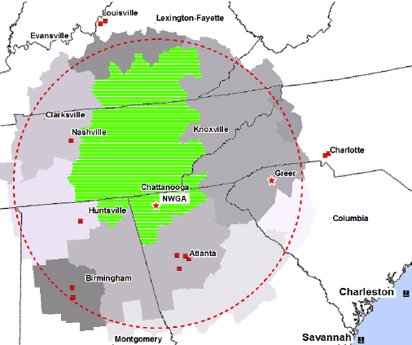
Northwest Georgia Market
Savannah’s Logistics Advantage
300,000
International & Domestic
Loaded Containers

Slide 17
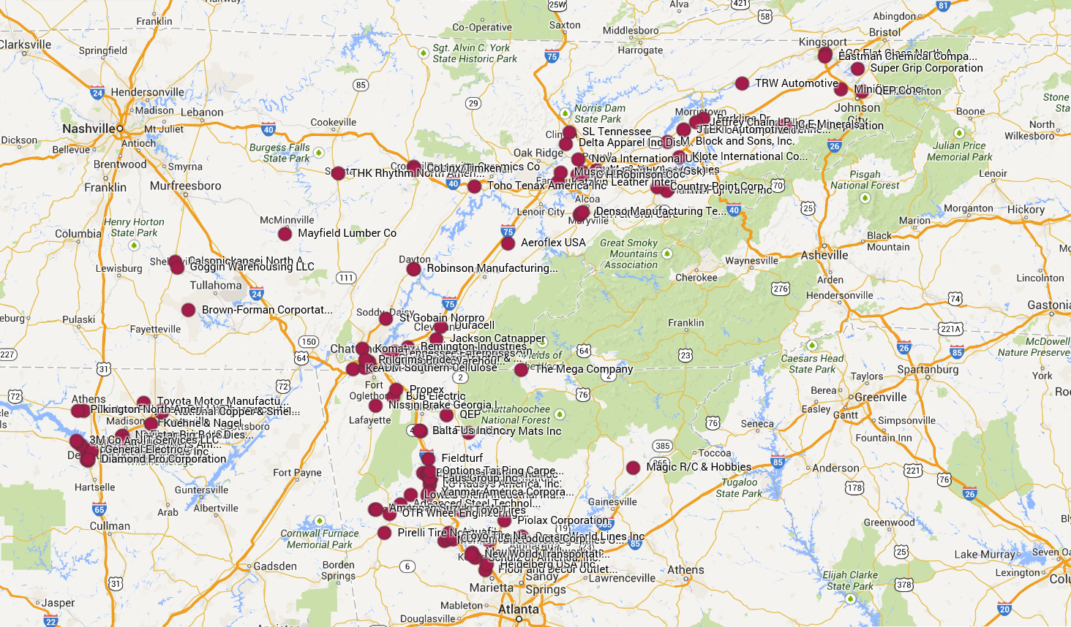
Import / Export Customers

Slide 18
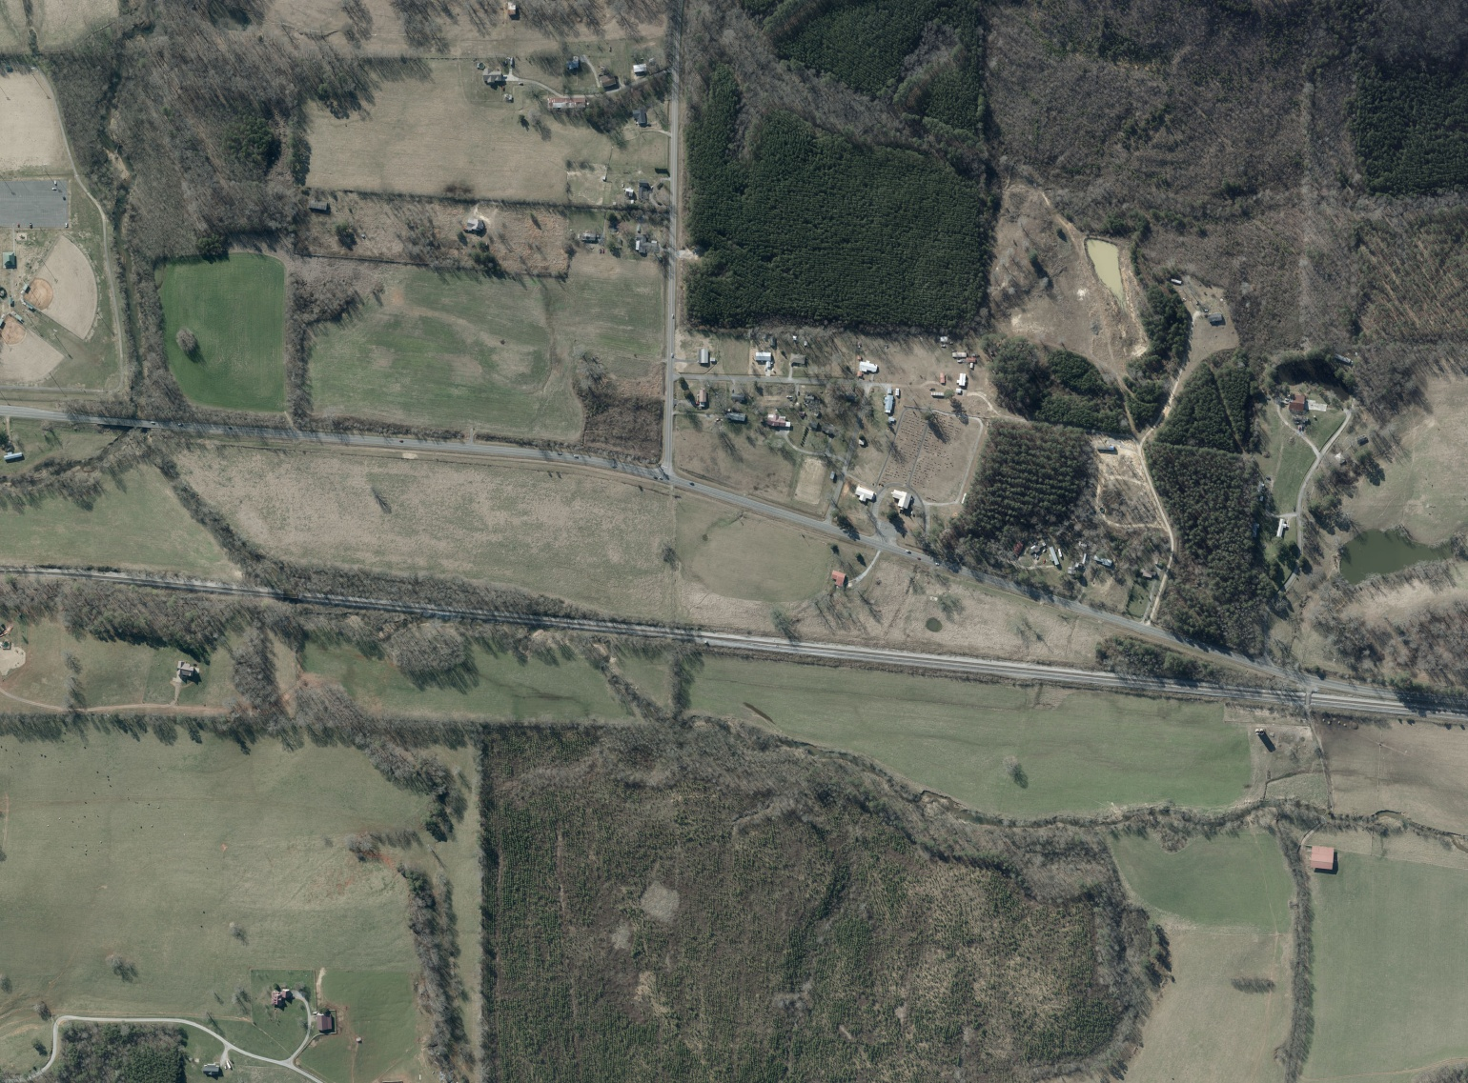
Appalachian Regional Port
Dec ‘17 Hire Staff
Jan ‘18 Equipment Training Sav
Mar ‘18 eRTG parts arrive
Jun ‘18 ARP commissioned
Oct ‘18 Operating

Slide 19
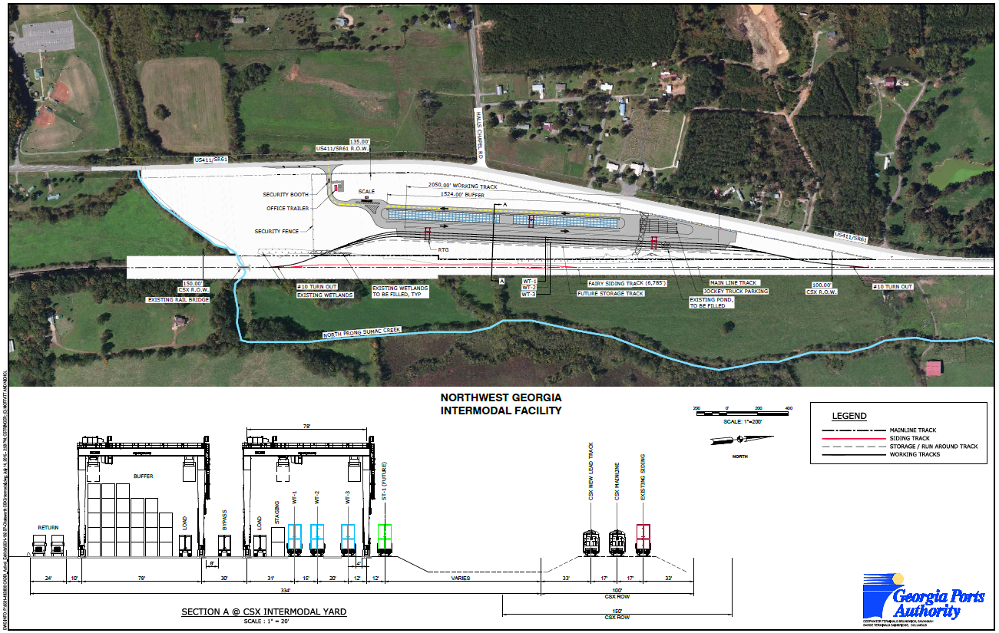
Appalachian Regional Port

Slide 20
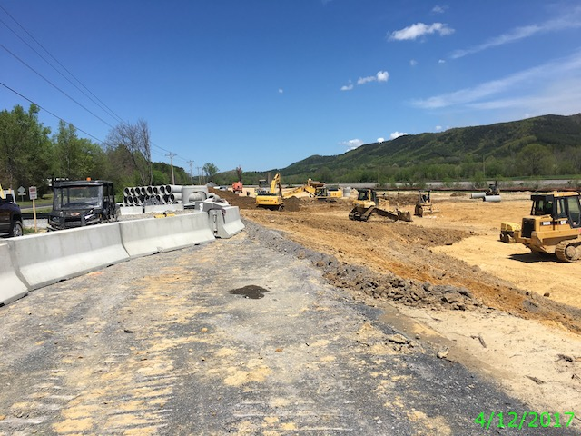
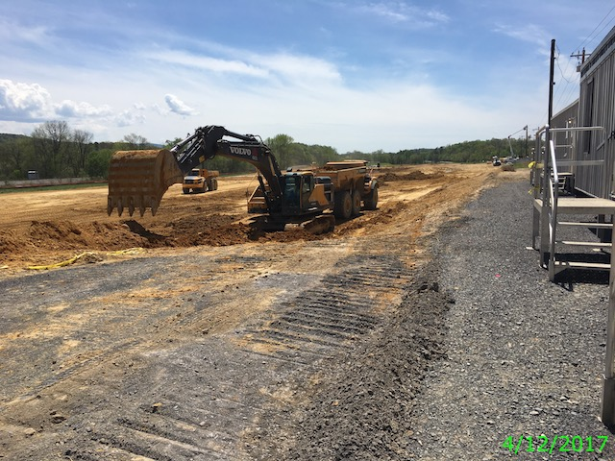
Appalachian Regional Port

Slide 21
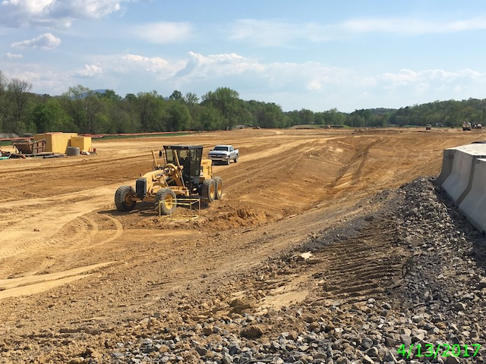
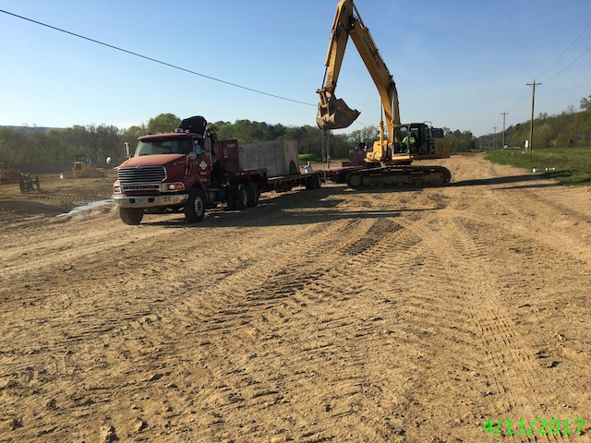
Appalachian Regional Port

Slide 22

Thank you

