Slide 1

2020 Census
Local Update of Census Addresses Operation
(LUCA)
Training
Introduction
Notes:
Thank you for attending this training today to introduce you to the 2020 Census Local Update of Census Addresses Operation, also known as LUCA.

Slide 2
Agenda
The Decennial Census.
Census Bureau terminology.
Preparation for 2020 LUCA participation.
The 2020 LUCA materials and operational instructions are subject to change between the LUCA Training timeframe and the time you receive your materials for review in the spring of 2018; therefore, the examples shown in the various training modules may differ from the official materials.
Notes:
During today’s introductory presentation, we will discuss, at a high level, the 2020 Census and 2020 LUCA, Census terminology, and preparing to participate.
The 2020 LUCA materials and operational instructions are subject to change between the LUCA Training timeframe and the time you receive your materials for review in the spring of 2018; therefore, the examples shown in the various training modules may differ from the official materials.

Slide 3
The Decennial Census
The purpose is to conduct a census of population and housing and disseminate results to the President, the States, and the American People.
Uses of Census data:
  Apportioning representation among states as mandated by Article 1, Section 2 of the US Constitution.
  Drawing congressional and state legislative districts, school districts and voting precincts.
  Enforcing voting rights and civil rights legislation.
  Distributing federal dollars.
  Informing planning decisions of tribal, federal, state and local government and organizational decisions (e.g., where to locate, size of market, etc.) of businesses and non-profits.
Notes:
The purpose of the Decennial Census (also known as the 2020 Census for this decade) is to conduct a census of population and housing and disseminate the results to the President, the States, and the American people. The United States Constitution mandates an actual count of every person residing in the United States every 10 years. The Census Bureau counts individuals within households and typically collects information about the housing structure and the housing unit.
The primary use of Decennial Census data is apportioning representation among states as mandated by Article 1, Section 2 of the United States Constitution, but additional data uses include:
Drawing congressional and state legislative districts, school districts and voting precincts by tribal, state and local governments.
Enforcing voting rights and civil rights legislation by the Department of Justice.
Distributing hundreds of billions of dollars in federal funding, EACH YEAR, to tribal, state, and local governments. Missing a housing unit, and the associated population, during the decennial census may result in a missed opportunity for governments to benefit, which perpetuates until the next decennial census.
Lastly, census data plays a role in informing the decisions of governments, businesses and non-profits regarding numerous topics such as community and regional development, education, agriculture, energy, and environmental programs, as well as other community improvements and enhancements.
To conduct the decennial census, the Census Bureau utilizes its census address list. A review and update of the census address list is the focus of LUCA.

Slide 4
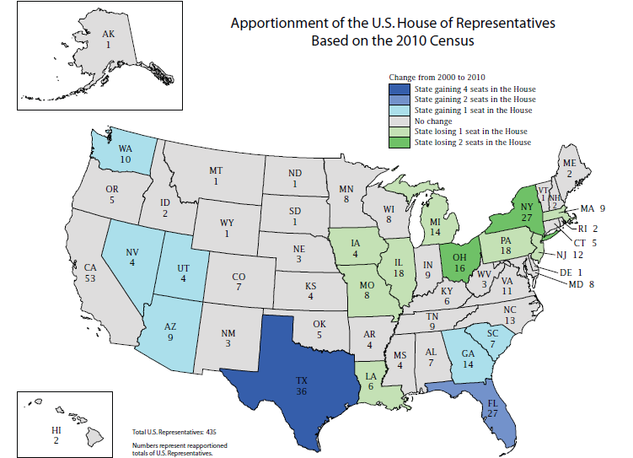

Slide 5
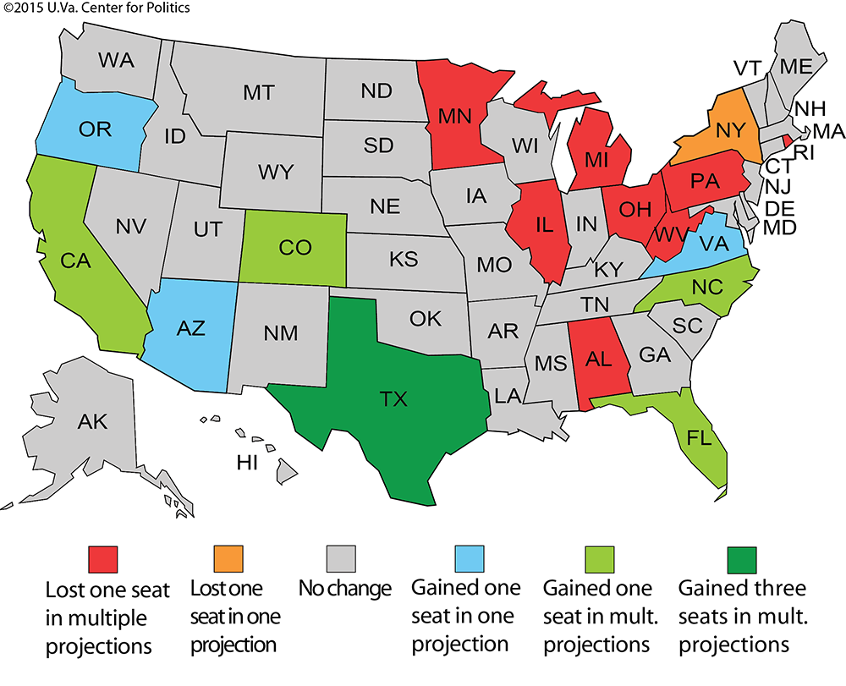
Notes:
These are not Census projections; this map is from the University of Virginia Center for Politics based on multiple projections by Election Data Services in their “2016 Reapportionment Analysis”.
These are mid-decade projections - very preliminary and subject to change. But, it is important to note that the foundation for these projections is based on the population counts from the 2010 Decennial. So, a question to ask is, how accurate do you feel the population counts were for your city or county in 2010? The next question to ask is, how many of the counties and cities represented here today participated in LUCA in 2010?
While multiple projections suggest Alabama may lose a seat – the margin is very, very close and an accurate population count is crucial…Which brings us to LUCA and why it is so important to start with a solid address list.

Slide 6
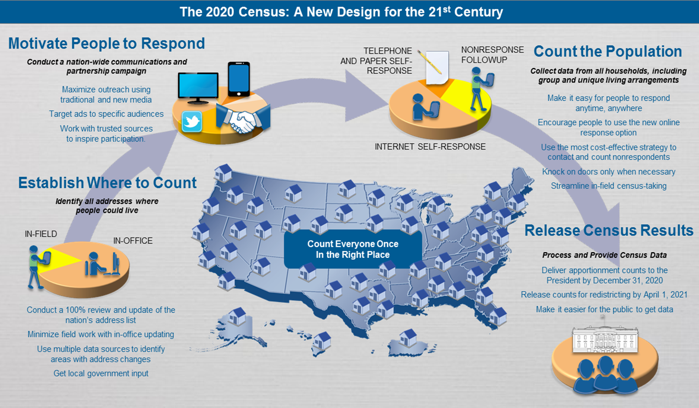
2020 Census Design
Notes:
This graphic illustrates the 2020 Census Design process and why building a strong geographic foundation is so important.
Starting at the bottom left of the slide, the Census Bureau must Establish Where to Count by identifying all the addresses where people could live. The census address list contains the residential addresses that form the “where to count”.
Moving up from the bottom left to the top left, the Census Bureau must Motivate People to Respond by conducting a nationwide communication and partnership campaign. This campaign utilizes the census address list to send materials that invite and encourage households to respond.
Moving across to the top right corner of the graphic, the Census Bureau must Count the Population by collecting data from all households, including group quarters and unique living arrangements. The Census Bureau uses the address list and maps to send enumerators to collect interview data from nonresponding households.
Finally, moving down from counting the population, the Census Bureau must Release Census Results by using the address list and geographic boundaries to process, tabulate, and disseminate apportionment counts to the President by December 31, 2020, redistricting data to the States by April 1, 2021, and high quality data to the public.
In this presentation and others you may receive throughout this year, the Census Bureau provides examples regarding the importance of LUCA participation and a successful 2020 Census that result AFTER the “Release Census Results” section of this slide. While the examples on the previous slide are all valid reasons for participating in LUCA, this graphic illustrates why your LUCA participation is so fundamentally important.
LUCA offers eligible entities the opportunity to provide their input into the address list that serves as the foundation of the entire 2020 Census Design process. Participants in the 2020 LUCA operation have a direct influence on the quality and completeness of the census address list.

Slide 7
Who Can Participate
Federally recognized tribes with a reservation and/or off-reservation trust land.
States and Counties.
Incorporated places.
  Cities, towns, boroughs, villages.
Notes:
The Census Bureau’s LUCA participants are comprised of active, functioning, legal governments including:
Federally recognized tribes with a reservation and/or off reservation trust lands.
States and Counties.
Incorporated Places (cities, towns, boroughs, villages).
Townships (Minor Civil Divisions).

Slide 8
Title 13 U.S.C. – Confidentiality and Security
Information provided to/from LUCA is covered under Title 13 of the United States Code which:
  Requires the Census Bureau to ensure confidential treatment of census-related information, including individual addresses and map structure points.
  Requires the Census Bureau maintain the confidentiality of all information it collects.
LUCA operation requires all liaisons, reviewers, and anyone with access to Title 13 materials abide by Confidentiality and Security Guidelines and requires all LUCA participants sign the Confidentiality Agreement Form (D-2005).
Notes:
Title 13 of the U.S. Code covers information provided to and from LUCA. Title 13 requires the Census Bureau ensure the confidential treatment of census related information, including individual addresses and map structure points, and maintain the confidentiality of all information it collects. The LUCA operation requires all liaisons, reviewers and anyone with access to the Title 13 materials abide by the Confidentiality and Security Guidelines and requires all LUCA participants (liaison and reviewers) sign the Confidentiality Agreement Form.
The census address list (both paper and digital formats) and PDF small format block maps are Title 13 material and require protection. The guidelines document that accompanied the LUCA invitation/registration materials is included as Appendix A of the Respondent Guide. If changes occur to staff that have access to the Title 13 materials, the jurisdiction must provide updated Confidentiality Forms as the changes occur, throughout the LUCA operation timeframe.

Slide 9
2020 LUCA Schedule
Timeframe | Activity
January 2017 | Advance Notice mailing mailed to Highest Elected Officials (HEOs), Tribal Chairs (TCs), Governors and other potential 2020 LUCA contacts.
March 2017 | 2020 LUCA Promotional presentations began.
July 2017 | 2020 LUCA invitation and registration materials mailed to HEOs, TCs and Governors.
October 2017 | 2020 LUCA Training workshops began.
December 15, 2017 | 2020 LUCA registration deadline.
February - April 2018 | Participants receive their 2020 LUCA materials.
March - September 2018 | Census Bureau processes 2020 LUCA submissions.
April 2018 - May 2019 | Census Bureau validates 2020 LUCA addresses.
Summer 2019 | Census Bureau delivers 2020 LUCA feedback.
April 1, 2020 | CENSUS DAY.
✓
✓
✓
✓
Notes:
It is important to discuss the LUCA schedule as a preparation aspect of 2020 LUCA. Keeping the schedule in mind prepares you for upcoming tasks and actions.
January 2017 – Advance Notice mailing conducted.
The purpose of the Advance Notice mailing was to bring awareness to 2020 LUCA and its schedule so governments could begin preparing to participate. The Census Bureau asked contacts to review the LUCA Information Guide and to confirm/correct their contact information. The Census Bureau sent a large number of Advance Notice materials in order to build a solid courtesy copy base for the invitation mailing that occurred in July 2017. Nearly 83,000 contacts were shipped the Advance Notice mailing which covered just over 40,000 governments and organizations.
March 2017 – LUCA promotional presentations began.
The six regional offices manage the scheduling of these presentations. Direct questions regarding the LUCA training presentations to the GEO 2020 LUCA e-mail and/or toll-free number provided on the next slide.
July 2017 – LUCA invitation mailing (which includes registration materials) conducted.
The invitation mailing included a letter, four forms necessary for LUCA registration, a document with instructions for registration, and a copy of the Confidentiality and Security Guidelines.
October 2017 – LUCA training workshops began.
December 15, 2017, is the 2020 LUCA registration deadline.
February - April 2018 – 2020 LUCA materials begin to ship to participants. Participants begin their review and have 120 calendar days to complete.
March - September 2018 – Census Bureau processes 2020 LUCA submissions.
April 2018 – May 2019 – Census Bureau validates 2020 LUCA addresses.
Summer 2019 – Census Bureau delivers LUCA feedback to participants (the Appeals process is still under development, but has a very short review timeframe).
April 1, 2020 is CENSUS DAY!

Slide 10
Census Bureau Terminology
Census Bureau terminology.
  Geocode.
  Housing Unit.
  Group Quarters.
  City Style Address.
  Non-city Style Address.
Notes:
The Census Bureau organization uses numerous terms and acronyms. This slide lists five of the most commonly used terms for LUCA. Understanding their definition is very important while conducting your LUCA review. The next eight slides define these terms and provide examples of acceptable and unacceptable housing units and group quarters.

Slide 11
Geocode
Geocoding is the process of taking an address and returning an actual or calculated latitude/longitude coordinate on the earth’s surface.
In terms of the Census Bureau, this includes assigning the proper state, county, census tract and census block codes that correspond to the physical location of the address.
The Census Bureau requires every address is assigned a Census geocode before it can be processed and added to its inventory and included in the Census.
Notes:
An address can not be added to our Master Address File unless its location is known; either we need the lat/long coordinates of the structure or its geocode.

Slide 12
Housing Unit (HU)
A single-family house, townhouse, mobile home, trailer, apartment, group of rooms, or a single room occupied as a separate living quarter or, if vacant, intended for occupancy as a separate living quarter.
Notes:
As part of the introduction, it is important to become familiar with some common Census Bureau terminology used while discussing the 2020 LUCA operation. These terms and others are included in the Respondent Guide your government will receive as part of your LUCA materials. The Respondent Guide will also be available for download from the LUCA web site. Understanding how the Census Bureau defines the term Housing Unit (HU) is critical to the success of participating in the 2020 LUCA operation.
Read the bullet.
A separate living quarter is one in which one or more occupants (or intended occupants, if vacant) live separate from any other individual(s) in the building and have direct access to the living quarter without going through another living quarter, such as from outside the building or through a common hall.

Slide 13
Acceptable Housing Units for LUCA
Houses, including townhouses, condominiums, and apartments.
Living quarters within an otherwise nonresidential structure such as an apartment within a church, school, or business.
Mobile homes or trailers occupied as separate permanent living quarters, or if vacant, intended for occupancy as separate permanent living quarters.
Any housing units under construction that will be habitable (closed to the elements with final roof, windows, and doors) on Census Day, April 1, 2020.
Notes:
The following types of housing units are acceptable for 2020 LUCA: read the contents of the slide. All of these housing units are acceptable for inclusion as part of your 2020 LUCA submission.
Empty trailer pads and mobile home sites intended to be permanent sites are also acceptable for LUCA, if the site has utility connections.

Slide 14
Group Quarters (GQs)
A place where people live or stay, in a group living arrangement, that is owned or managed by an entity or organization providing housing and/or services for the residents.
Notes:
The Census Bureau defines Group Quarters as: read the contents of the slide.
This is not a typical household-type living arrangement. These services may include custodial or medical care as well as other types of assistance, and residency is commonly restricted to those receiving these services. Residents of group quarters are usually unrelated.

Slide 15
Acceptable Group Quarters for LUCA
Correctional facilities.
  Federal and state prisons.
  Local jails and other municipal confinement facilities.
  Correctional residential facilities.
Group homes.
  Halfway houses and homes for people with special needs.
Juvenile facilities.
  Group homes for juveniles (non-correctional).
  Residential treatment centers for juveniles (non-correctional).
  Correctional facilities intended for juveniles.
Nursing homes.
  Nursing facilities/skilled-nursing facilities.
Notes:
The following types of group quarters are acceptable for 2020 LUCA: read the contents of the slide.
Presenters, within the Group homes bullet, “homes for people with special needs” are also “homes for the mentally and/or physically disabled”. Within the Nursing homes bullet, “skilled nursing facilities” provide rehabilitative services while regular nursing facilities do not.

Slide 16
Acceptable Group Quarters for LUCA (cont’d)
Hospitals.
  Mental (psychiatric) hospitals and psychiatric units in other hospitals.
  Hospitals with patients who have no usual home elsewhere.
  In-patient hospice facilities.
College or university dormitories, fraternity houses, and sorority houses.
Workers group living quarters or dormitories.
Religious group quarters.
Any group quarters under construction that will be habitable (closed to the elements with final roof, windows, and doors) on Census Day, April 1, 2020.
Notes:
Continued from the previous slide, these additional types of group quarters are also acceptable: read the contents of the slide. Should your jurisdiction choose to review group quarters as part of 2020 LUCA, then all of the group quarter types, mentioned on both slides, are acceptable for inclusion in your submission.

Slide 17
Unacceptable HUs and GQs for LUCA
Condemned or scheduled for demolition.
Under construction or remodeling for conversion to a nonresidential purpose.
Used solely for nonresidential storage.
Used solely as offices or businesses in which no one is living.
Used solely for ceremonial purposes.
Under construction and will not be habitable (closed to the elements with final roof, windows, and doors) on Census Day, April 1, 2020.
Notes:
Exclude the following unacceptable types of housing units and group quarters addresses from your address list: read the slide.
If addresses described in the first two bullets appear on the census address list, mark them for deletion with Action Code “D”. If the next four bullets regarding nonresidential status exist on the address list, mark them as nonresidential with Action Code “N”. Do not add addresses that will not be habitable on Census Day, April 1, 2020.

Slide 18
City Style Address
Include a house number and street name (e.g., 212 Elm St or 137 Clark Ct Apt 3 or 35A Fourth Ave W).
  For 2020 LUCA, participants adding multiunit addresses must provide unit identifiers (e.g., Apt 1, Apt 2, Unit A, Unit B).
Notes:
The Census Bureau defines city style addresses as those that have a house number and street name for their complete address. In some instances, the house number may also include an alpha character such as 35A Fourth Ave W. City style addresses are generally mailing address, but some are also used to provide a location for emergency services, such as police, fire, and rescue, i.e., E-911 addresses.
Of special note, for 2020 LUCA, participants who wish to add multiunit addresses must provide the unit identifiers. Ensure that all your apartment buildings, especially small multiunit buildings (3-4 units), such as large houses subdivided into apartments, have a separate address line for each unit that includes the basic street address and the individual unit designation.

Slide 19
Non-City Style Address
Do not include a house number and/or a street name.
May include incomplete house number and street name.
Frequently used non-city style mailing addresses include:
  Location Description with map spot.
  Rural route and box number.
  Highway contract route and box number.
Notes:
The Census Bureau defines non-city style addresses as those that do not have a house number and street name for their complete address or that may have incomplete house number and street name information.
Frequently used non-city style addresses in the Census Bureau data include location descriptions with map spots, rural route and box addresses, and highway contract route and box addresses.

Slide 20
Preparation for 2020 LUCA participation
Early tools.
  Address Block Counts.
  Census Geocoder.
  TIGERweb.
Product Preference combinations.
Notes:
The Census Bureau offers early tools that provide participants the opportunity to begin LUCA preparation in advance of materials receipt. Since January 2017, residential address block counts are available for download on the 2020 LUCA Web site. These residential block counts are derived from the geocodes of the individual addresses in the Master Address File (MAF). This is the first time the Census Bureau has provided this type of information in advance of the LUCA operation. The Census Bureau provides the Address Count List with the 2020 LUCA materials for reference purposes only.
The Census Geocoder tool allows users to upload a file of addresses (or enter in an individual address) to obtain census geography and approximate coordinates based on the address ranges within the MAF/TIGER database (MTDB). The Census Bureau offers support for the Census Geocoder through e-mail to <geo.geocoding.services@census.gov>.
For those not using a geographic information system, TIGERweb is an interactive web service for use, in advance of receiving LUCA materials, to view the features (roads, blocks, etc.) within jurisdictions. Used interactively with the early address block count list, it allows users to visually identify blocks that have high or low address block counts.

Slide 21
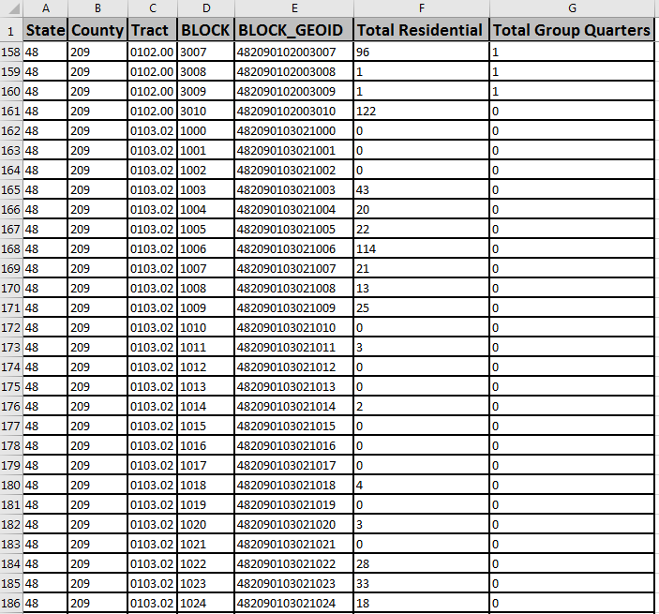
Early tools
Provide 2020 Census LUCA Address Block Count files.
Provide Census Geocoder to geocode jurisdiction’s address list: <https://geocoding.geo.census.gov/geocoder/>
TIGERweb: <https://tigerweb.geo.census.gov/tigerweb/>
Notes:
After navigating to the 2020 LUCA Web site, use the “How Can I Review the Address Block Counts for My Entity” section to search and download the Address Block Count file for your government. The download is in pipe-delimited text format, but easily converts into Excel (.xlsx).
To prepare for LUCA, potential participants can compare the Census Bureau’s address count data to their local data. Potential participants can join the address block count lists to 2010 tabulation block geography using a geographic information system to create an overlay for analysis prior to receiving actual LUCA materials. Discrepancies between the census and local counts may be a result of incorrect geocoding or missing information from the census address list.
The Census Geocoder takes individual addresses, or file of addresses, and obtains census geography and approximate coordinates. It can process files up to 10,000 records at a time. Governments with over 10,000 addresses can upload their addresses to the LUCA Geocoding Service using SWIM.
Geocoding a local address list using Census Geocoder is another way to begin early preparations for LUCA because it standardizes local data into the format the Census Bureau needs for LUCA processing and provides the census block geocode for the records submitted in the local address list file. Participants may use the geocode information to generate their own local block count tallies for comparison to the Census Bureau’s block count file discussed on the previous slide. Participants can also generate geocodes using their own GIS, but this tool may help smaller entities or entities that do not have access to their own GIS.
Find the TIGERweb web service at the URL listed on the slide, <https://tigerweb.geo.census.gov/tigerweb/>. Documentation is located within the same URL.

Slide 22
Product Preference Combinations
Geographic Update Partnership Software (GUPS).
Paper Address List & Large Format Paper Maps (Paper/Paper).
Paper Address List & Large Format Paper Maps with PDF small format block maps (Paper/PaperPDF).
Paper Address List & Digital Map (Paper/Digital).
Digital Address List & Large Format Paper Maps (Digital/Paper).
Digital Address List & Large Format Paper Maps with PDF small format block maps (Digital/PaperPDF).
Digital Address List & Digital Map (Digital/Digital).
Notes:
There are three mediums of materials available for 2020 LUCA; the Geographic Update Partnership Software, known as GUPS, paper formatted materials, and digitally formatted materials. From these three mediums, seven product preference combinations evolve.
The SEVEN product preference combinations are:
Geographic Update Partnership Software (GUPS) – Participants choosing this product preference receive a digital address list and digital map as part of the GUPS package. By doing so, they have all the components necessary to complete their work in GUPS or using their own GIS. GUPS has Title 13 protections programmed into the software, taking much of the guesswork out of Title 13 security concerns.
Paper Address List and Large Format Paper Maps – This product preference requires Title 13 protection for the paper address list. The large format paper maps do not display any Title 13 information. There are no small format block maps provided with this material combination.
Paper Address List and Large Format Paper Maps with PDF small format block maps – In addition to protecting the paper address list, the DVD requires digital Title 13 protection because the PDF small format maps on the DVD contain map spots. Any printed small format block maps also need protection.
Paper Address List and Digital Map – This product preference requires Title 13 protection for the paper address list. The “digital map” is a TIGER Partnership shapefile. The shapefiles do not contain structure points; therefore, no digital Title 13 security measures are required for the DVD containing the shapefiles.
Digital Address List and Large Format Paper Maps – This product preference requires digital Title 13 protection for the address list and if printed, requires Title 13 protection for printed copies of the address list. The large format paper maps do not display any Title 13 information. There are no small format block maps provided with this material combination.
Digital Address List and Large Format Paper Maps with PDF small format block maps – This product preference requires digital Title 13 protection for the address list and if printed, requires Title 13 protection for printed copies of the address list. The large format paper maps do not display any Title 13 information. The DVD requires digital Title 13 protection because the PDF small format maps on the DVD contain map spots. Any printed small format block maps also need protection.
Digital Address List with Digital Map – This product preference requires digital Title 13 protection for the address list and if printed, requires Title 13 protection for printed copies of the address list. The “digital map” is a TIGER Partnership shapefile. The shapefiles do not contain structure points; however, using GIS, the latitude/longitude coordinates in the digital address list can generate structure points. Participants must protect the structure points they generate using the census address list coordinates under the rules of Title 13. Participants choosing this option will also receive GUPS.
The words in parenthesis on this slide represent labels describing the various product preference combinations. Expect usage of these labels during other presentations related to LUCA. Each product preference has its own detailed “Acceptable Updates” presentation tailored specifically for participants who have chosen that product preference. This organization tactic ensures a totally paper participant is not distracted by digital discussions or vice versa.
Many governments will choose digital format for both their address list and maps to leverage their own GIS. Governments with computer expertise, but without a GIS, may prefer to use GUPS or may choose digital address list and paper maps. Governments without a local address list in digital format, and with 6,000 or fewer addresses, may prefer all paper products. Choosing a paper address list and digital maps would not allow for full use of GIS capabilities, but the format combination is available.

Slide 23
Review and Update Strategies
Notes:
Welcome to the 2020 Census LUCA operation training that discusses review and update strategies. This presentation serves to prepare participants for their LUCA review. It does not provide instructions for making updates or for submitting the updated materials. Separate presentations cover those two topics.
The Census Bureau expects to post this presentation on the LUCA web site, so participants can review them again prior to materials receipt in early 2018.

Slide 24
Agenda
Strategies for LUCA review and update.
  Things to consider.
  Potential address sources.
  Identify priorities.
  Beginning your review.
Notes:
This presentation discusses strategies for your LUCA review and potential updates. It identifies things to consider, potential address sources available to your jurisdiction to conduct your review, encourages the identification of priority areas of review, and discusses how to begin your review.
For more detailed information and instruction, refer to the Respondent Guide that accompanies the materials and to upcoming presentations that discuss review, update and submission details.

Slide 25
Things To Consider
How much time can we devote to LUCA review?
  Only 120 calendar days to conduct review upon receipt of materials.
Does your jurisdiction have an address list or access to an address list?
Does the address list include multiunit structure identifiers (e.g., Apt 1, Unit A2, #4, etc.)?
Does the address list include both residential and commercial addresses or include records that are not structures? If yes, are the residential records distinguishable?
Notes:
When preparing for your LUCA review, consider your time and staff resources. The 2020 LUCA operation allows 120 calendar days to review and provide the Census Bureau with your submission. The review time begins upon receipt of materials. If your entity decides to switch product preferences, the 120 days does not reset after receipt of new materials, nor does it pause while waiting for new materials. Time does not reset if you experience technical issues, so please contact the Census Bureau immediately if you experience problems with the materials (digital or otherwise).
Consider the availability of an address list or other source of address information. If an address list exists, does it include multiunit structure identifiers, such as Apt 1, Unit A2, #4? This information is required for 2020 LUCA submissions when adding new records to the address list or updating the address list. Does the address list include both residential and commercial addresses; and if so, are the residential addresses distinguishable? The Census Bureau only wants residential addresses for LUCA, so additional work may be necessary to prepare the local address list for use in 2020 LUCA review.

Slide 26
Potential Address Sources
E-911 address files.
New housing construction or building permits.
  Include only if final roof, doors, and windows will be in place on Census Day, April 1, 2020.
Housing inspection records or occupancy permits.
Planning and zoning records.
Local utility records.
School enrollment records.
Driver’s license files.
Annexation records.
Assessment or tax files (residential units).
Voter registration files.
Notes:
There are many possible sources of local address information. Some of these sources may not match the Census Bureau’s address list exactly, but they are a good indication of where change is taking place and can help you identify addresses that you need to add to the address list.
Presenters, read some/all of these on the slide.

Slide 27
Identify Priorities
Apartment buildings and/or areas of concentrated multi-unit housing.
Areas along governmental boundaries and/or newly annexed land.
Areas of new residential construction.
Blocks with the greatest differences between the Census Bureau’s address block count and your address block count.
E-911 address conversion areas.
Group Quarters (e.g., housing such as college dorms and nursing homes).
Mobile home parks or new, scattered mobile homes.
Single-family homes converted to multifamily homes, and vice versa.
Warehouses converted to residential lofts.
Notes:
When deciding how to conduct the LUCA review, consider your time, staff, and available local address information. If a complete review is not possible, focus your review on these areas (listed in alphabetical order, not order of Census priority).
Presenters, read some/all of these on the slide.

Slide 28
Beginning Your Review
Assemble local sources.
Read the 2020 LUCA Respondent Guide.
Review the Census Bureau’s online training presentations.
Familiarize yourself with LUCA materials.
  Address List.
  Address Count List.
  Paper Maps/Digital Shapefiles.
  Block to Map Sheet Relationship List (use with Large Format paper maps).
Organize LUCA materials based on priority areas.
Organized approach for review yields a successful LUCA submission.
Notes:
As you begin your review, assemble all of your local sources of information (local address sources and local map sources). Take time to read the LUCA Respondent Guide that accompanies the materials. Review the online presentations when they become available.
Familiarize yourself with your specific LUCA materials. For paper participants, check the paper address list for the sort option noted at the top of each page. Check to see that all the pages (e.g., 1 of 345 through 345 of 345) are included and that none are missing. If pages are missing or the sort option is not what you need/expect, contact the Census Bureau immediately for a replacement. As stated on the previous slide, your 120 days does not pause or reset when you receive your new materials. The Census Bureau suggests you move forward with your review while you await your new materials. For digital participants, check your address list to ensure it imported properly (e.g., leading zeros are present and data is in the appropriate fields). To check the connection between address list and the address count list, scroll to the bottom of your address list. If you subtract one (for the presence of the header row) from the last row number, you will have the tally of addresses (housing unit and group quarters) for your jurisdiction. This number should match the “Total” information at the end of your digital address count list. These are all checks that participants can perform upon receipt of materials to ensure your materials are complete and correct. Review the Address Count List to ensure it includes all of its pages (for paper) and blocks (for digital). Review your paper maps to ensure all are included and legible. Setup your shapefile material for potential updates to the edges shapefile. For paper map participants, check a few blocks on the Block to Map Sheet Relationship list by locating them on the respective large format map(s).
Organize your LUCA materials based on the priority areas your jurisdiction established and focus on those areas. Do not become distracted by the additional materials for other areas or other addresses. If you complete the priority areas, you can always choose additional addresses to review.
An organized approach to conducting your LUCA review will yield a successful LUCA submission for your jurisdiction.

Slide 29
Digital Address List and Digital Map Product Preference
Notes:
Welcome to the 2020 Census LUCA operation training to introduce the digital map materials. This presentation serves as an introduction to the digital map materials and prepares participants for this specific product preference selection. It does not provide instructions for making updates to the digital maps or for submitting the updated materials. Those two topics are discussed in separate presentations.
The Census Bureau expects to post this presentation on LUCA web site, so participants can review it again prior to materials receipt in early 2018.

Slide 30
Agenda
Digital Product DVD Overview & Product Preferences.
DVD Layout and Content by Product Preference
Digital Address materials.
  Address List – Title 13.
  Address Count List – not Title 13.
Digital Map Materials
  TIGER Partnership shapefiles
  Edits to the TIGER Partnership shapefiles
Notes:
This presentation identifies the specific product preference choices that are eligible to receive digital address materials. It discusses delivery of the LUCA digital materials; Title 13 as it relates to materials that fall under Title 13 protection, describes the digital address materials, and shows examples to provide an introductory visual. It reinforces the ways to receive support and assistance during the LUCA operation and mentions ways to stay connected to the Census Bureau through several social media sources as well as Census Bureau subscriptions.
For more detailed information and instruction, refer to the Respondent Guide that accompanies the materials and to upcoming presentations that discuss review, update and submission details.

Slide 31
Digital Product DVD Overview
Product Preferences
Paper Address List and Paper/PDF (1 DVD).
Paper Address List and Digital Map (1 DVD).
Digital Address List and Paper Large Format maps (1 DVD).
Digital Address List and Paper/PDF (1 DVD).
Digital Address List and Digital Map (3 DVDs).
Geographic Updates Partnership Software (GUPS) (3 DVDs).
Notes:
All active, functioning, legal governments can choose to receive digital address materials for the 2020 LUCA operation. Each of the FOUR product preferences highlighted on this slide receive digital address materials as part of their 2020 LUCA materials. Participants that selected those preferences are the intended audience for this presentation. We expect many governments will choose digital materials for both their address list and maps in order to leverage their own GIS, while some may only feel comfortable with using the digital address materials in a spreadsheet or database software.
While Geographic Updates Partnership Software (GUPS) participants technically receive their materials by DVD, they do not use the DVDs in the same manner as the other three product preference participants on this slide. They do not have to download the digital data off the DVD because the GUPS installation process details the GUPS participant’s steps for proper installation of the software and digital data. Please refer to the GUPS presentation for all of the details on this process. If GUPS participants decide to use their own GIS system, then they effectively become a Digital/Digital participant and those sections of this presentation apply to them.

Slide 32
DVD Layout and Content:
Digital Address List and Large Format Paper maps (Digital/Paper)
One DVD with one folder:
root directory of DVD.
  2020LUCA_<EntityID>_address_countlist.csv
  2020LUCA_digital_respondent_guide.pdf
  2020LUCA_header_file.txt
  LUCA20_inventory.pdf
  Readmefirst4.txt
“shape” folder.
  2020LUCA_<EntityID>_DISK1of2.exe (**Title 13 material**).
    Includes the Digital Address List
Notes:
For this product preference, participants receive one DVD with one folder – The “shape” folder.
The root directory of the DVD contains four files:
The 2020LUCA_<EntityID>_address_countlist.csv is the digital address count list. It is not Title 13 material.
The 2020LUCA_digital_respondent_guide.pdf is the pdf version of the respondent guide for digital address list participants. A paper copy is not provided.
The 2020LUCA_header_file.txt is a template participants may use to import their local address list into the Census Bureau’s address list layout.
The LUCA20_inventory.pdf is a digital inventory form to use when providing your submission to the Census Bureau. The final presentation on submission discusses how to send in this form.
The Readmefirst4.txt includes specific instructions for this product preference.
The “shape” folder contains 2020LUCA_<EntityID>_DISK1of2.exe that includes the digital version of the Title 13 Address List. Extraction of this file is described in the Digital Materials Initial Setup presentation.

Slide 33
DVD Layout and Content:
Digital Address List and Paper/PDF (Digital/PaperPDF)
One DVD with two folders:
root directory of DVD.
  2020LUCA_<EntityID>_address_countlist.csv
  2020LUCA_digital_respondent_guide.pdf
  2020LUCA_header_file.txt
  LUCA20_inventory.pdf
  Readmefirst5.txt
“maps” folder.
  About_the_maps.pdf
  LUCA20<EntType><EntCode>.pdf
  LUCA20<EntType<>EntCode>_BLK2MS.txt
  Readme.txt
  Title13_BlockMaps.exe (**Title 13 material**).
“shape” folder.
  2020LUCA_<EntityID>_DISK1of2.exe (**Title 13 material**).
    Includes the Digital Address List
Notes:
For this product preference, participants receive one DVD with two folders – The “maps” folder and the “shape” folder.
The root directory of the DVD contains five files.
The 2020LUCA_<EntityID>_address_countlist.csv
The 2020LUCA_digital_respondent_guide.pdf is the pdf version of the respondent guide for digital address list participants. A paper copy is not provided.
The 2020LUCA_header_file.txt is a template participants may use to import their local address list into the Census Bureau’s address list layout.
The LUCA20_inventory.pdf which is a digital inventory form to use when providing your submission to the Census Bureau. The final presentation on submission discusses how to send in this form.
The Readmefirst6.txt is specifically created with instructions for this product preference.
The “maps” folder contains five files:
The About_the_maps.pdf describes the “bundled” large format PDF, LUCA20<EntType><EntCode>.pdf.
The LUCA20<EntType><EntCode>.pdf is the single PDF of all large format maps. Printed large format maps are also provided, but this PDF is on the DVD for convenience. These are not Title 13 material since they do not show map spots.
The LUCA20<EntType><EntCode>_BLK2MS.txt is the block to map sheet relationship text file that identifies each census block in the entity and on what large format map each block is located. This is also provided in paper format for this product preference. This file, unlike the digital address list and digital address count list is a semi-colon delimited text file. Instructions for properly opening it are included in section 3.2.3 of the Respondent Guide.
The Readme.txt file discusses the need for Adobe software to view the pdf maps.
The Title13_BlockMaps.exe contains the Title 13 PDF small format block maps. Extraction of this file is described in the Digital Materials Initial Setup presentation. Because this file contains Title 13 materials, protect the DVD, this file and any printed PDF small format maps according to the instructions outlined in the Confidentiality and Security Guidelines. This document is included as Appendix A of the Respondent Guide and was mailed as part of the LUCA invitation materials.
The “shape” folder contains 2020LUCA_<EntityID>_DISK1of2.exe that includes the digital version of the Title 13 Address List. Extraction of this file is described in the Digital Materials Initial Setup presentation.

Slide 34
DVD Layout and Content:
Digital Address List and Digital Map (Digital/Digital)
&
GUPS
Three DVDs:
DVD with GUPS installation software.
DVD with Title 13 data.
  “shape” folder.
    Includes the Digital Address List
    2020LUCA_<EntityID>_DISK1of2.exe (**Title 13 material**).
      Includes the Digital Address List
DVD with non-Title 13 data.
  Root directory of DVD.
    2020LUCA_digital_respondent_guide.pdf
    2020LUCA_GUPS_respondent_guide.pdf
    2020LUCA_header_file.txt
    LUCA20_inventory.pdf
    Readmefirst6.txt
  “shape” folder.
    2020LUCA_<EntityID>_DISK2of2.exe
      Includes the Digital Address County List
Notes:
The GUPS product preference and the Digital/Digital product preference have identical DVD layout and content. Both options include a copy of the GUPS software on a separate DVD. The GUPS installation DVD self installs upon insertion of DVD into your computers CD/DVD drive. It prompts participants to insert the other two discs as part of its installation process. GUPS participants do not have to execute the .exe files or perform any of their own system setup. The installation process handles all of those tasks.
Digital/Digital participants can disregard the GUPS DVD unless they decide to use GUPS instead of their own GIS. Information on extraction of the Digital/Digital (only) files on both Disk 1 and Disk 2 will be described later in the Digital Materials Initial Setup presentation.
The DVD with Title 13 data contains a “shape” folder with 2020LUCA_<EntityID>_DISK1of2.exe that includes the digital version of the Title 13 Address List.
The DVD with non-Title 13 data contains information in the root directory and within a “shape” folder.
The root directory of the DVD contains five files.
The 2020LUCA_digital_respondent_guide.pdf is the pdf version of the respondent guide for digital address list participants. A paper copy is not provided.
The 2020LUCA_GUPS_respondent guide.pdf is the pdf version of the respondent guide for GUPS participants. This is the respondent guide that GUPS participants utilize for their 2020 LUCA work. It is included for BOTH GUPS and Digital/Digital participants in case Digital/Digital participants decide to switch product preferences and use GUPS for their LUCA work. A paper copy is not provided.
The 2020LUCA_header_file.txt is a template participants may use to import their local address list into the Census Bureau’s address list layout.
The LUCA20_inventory.pdf which is a digital inventory form to use when providing your submission to the Census Bureau. The final presentation on submission discusses how to send in this form.
The Readmefirst6.txt is specifically created with instructions for this product preference.
The “shape” folder contains 2020LUCA_<EntityID>_DISK2of2.exe that includes the non-Title 13 Address Count List and all the appropriate state and county TIGER Partnership shapefiles for the entity.

Slide 35
Digital Address Materials
Address List – Title 13
Census residential addresses.
  City style and non-city style.
Contain census geographic codes.
  State, county, census tract, and census block.
Comma Delimited Text (.csv) format.
  MUST import not simply open or “double-click”.
24 fields: Maximum 649 characters per record.
First row = Header row.
  Remove spaces from field names, if using Esri’s ArcGIS.
Notes:
The Census Bureau’s address list contains all of the residential (city-style and non-city style) addresses known to the Census Bureau within your jurisdiction, reservation or off reservation trust lands. It also contains census geographic codes (state, county, census tract, census block) that indicate the location of each address.
The address list is a comma delimited text file (.csv) and contains 24 fields of information. It is critical to follow the procedures that discuss “importing” the .csv rather than simply opening by using the File-Open method or double-clicking the file.
Each address record in the address list file is a maximum of 649 characters. The character length of each record may vary. The first row, or header row, of the address list file displays the field names for each data column in the file. Plan to remove spaces that exist in the header row for effective use in ArcGIS.

Slide 36
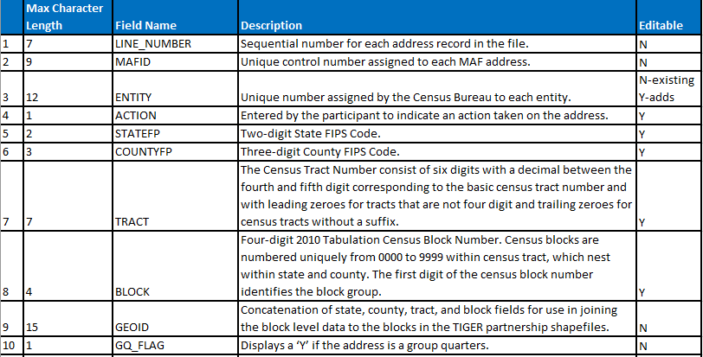
Digital Address Materials
Address List Record Layout
Refer to Table 3 located in your Respondent Guide for complete record layout.
Notes:
The slide illustrates a portion of Table 3 from the Respondent Guide. It depicts the record layout of the 2020 LUCA digital address list. As mentioned on the previous slide, there are 24 fields of information. Participants can review the Respondent Guide for a complete, clearer visual of the Address List record layout.

Slide 37
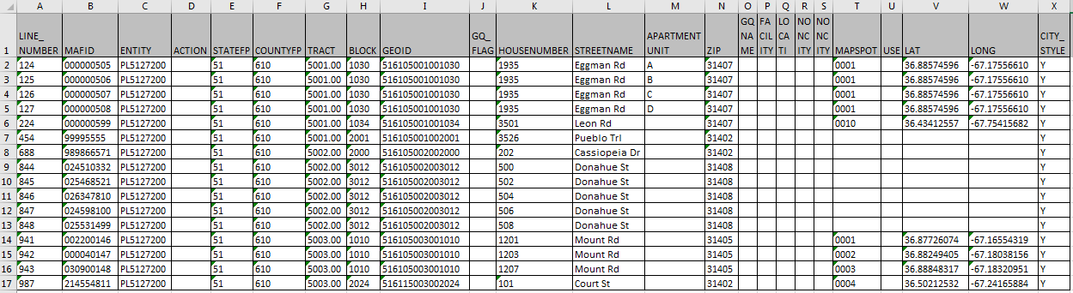
Digital Address Materials
Address List – Microsoft Excel Example
**No Title 13 Data Displayed**
Notes:
After properly importing the .csv into Microsoft Excel or other spreadsheet/database software, the 24-field address list appears similar to this example. It is important to mention this data is fictitious. It does not include any Title 13 information.

Slide 38
Digital Address Materials
Address Count List – Non-Title 13
Residential address census block tallies.
  Housing units and Group Quarters.
Reference only.
  Identify inconsistencies between census block counts and your jurisdiction’s block counts.
Comma Delimited Text (.csv) format.
  MUST import not simply open or “double-click”.
13 fields: Maximum 140 characters per record.
First row = Header row.
“Unable to Geocode” tally for state and county participants.
Notes:
The Census Bureau’s address count list contains the number of housing unit and group quarters addresses on the Census Bureau’s Address List for each census block within your jurisdiction. It is not Title 13 material.
Developed as an early tool for LUCA preparation and for use with GUPS, digital participants may use it for reference purposes only. The address count list can identify inconsistencies between the Census Bureau’s housing units and/or group quarters address counts and your housing unit and/or group quarters address counts.
Like the address list, the address count list is a comma delimited text file (.csv). It is critical to follow the procedures that discuss “importing” the .csv rather than simply opening by using the File-Open method or double-clicking the file.
The address count list contains 13 fields of information, with a maximum of 140 characters per record. The first row, or header row, of the address list file displays the field names for each data column in the file. The last row of the file is a Total row that sums all of the housing units and group quarters block counts for the jurisdiction.
The last important point to make regarding the address count list is to mention that for state and county participants the address count list includes an “unable to geocode” tally on the next to last line of the file. This row summarizes the ungeocoded address records, by housing unit and group quarters, included in the address list.

Slide 39
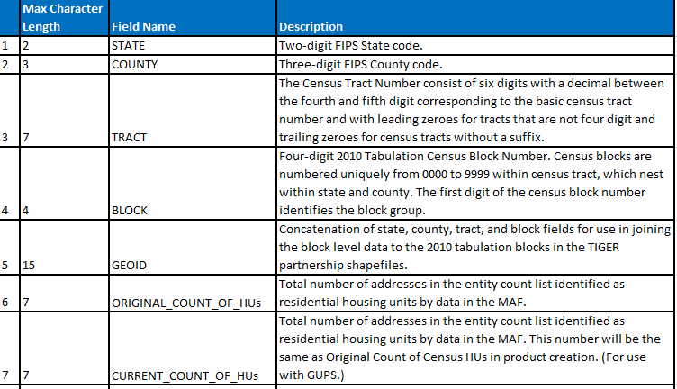
Digital Address Materials
Address Count List Record Layout
Refer to Table 4 located in your Respondent Guide for complete record layout.
Notes:
The slide illustrates a portion of Table 4 from the Respondent Guide. It depicts the record layout of the 2020 LUCA digital address count list. As mentioned on the previous slide, there are 13 fields of information. Participants can review the Respondent Guide for a complete, clearer visual of the Address Count List record layout.
The first five fields are the census geographic codes for state, county, tract and block, with the fifth field being a concatenation of the previous four fields to form the 15-character GEOID field.
Digital/Digital participants should place their focus on the two “ORIGINAL” fields; one for HUs and one for GQs. GUPS uses the six “CURRENT”, “LOCAL”, and “DIFFERENCE” fields for its processing; therefore, participants that do not use GUPS to review the LUCA materials can ignore those six fields.

Slide 40
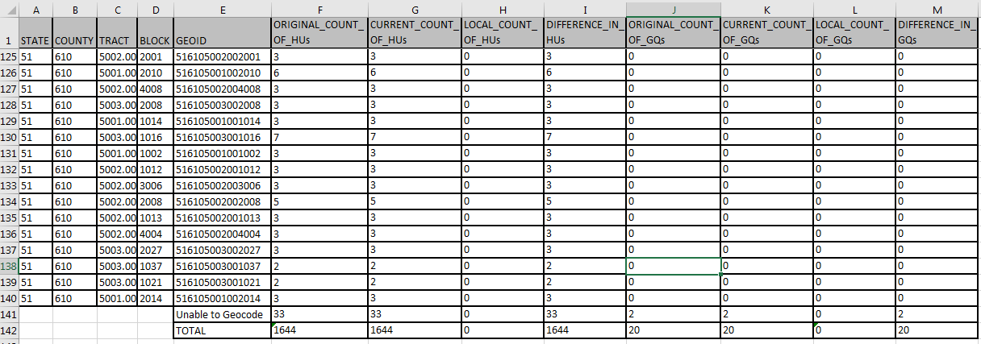
Digital Address Materials
Address Count List – Microsoft Excel Example
Notes:
After properly importing the .csv into Excel, the address count list appears similar to this example.

Slide 41
Digital Map Materials
TIGER Partnership Shapefiles
Created from Master Address File/Topologically Integrated Geographic Encoding and Referencing (MAF/TIGER) System.
Require use of a Geographic Information Software (GIS).
County based shapefiles, regardless of entity.
Do not contain structure points, so not Title 13 material.
  Generate structure points using Census Bureau’s digital address list (Title 13 material); refer to Respondent Guide Chapter 6.
Retain vintage for use in feedback products.
Notes:
The digital maps provided by the Census Bureau in support of the 2020 LUCA operation are the TIGER Partnership shapefiles. The Census Bureau’s MAF/TIGER System is the source for these shapefiles. Shapefiles require the use of a Geographic Information Software (GIS).
The Census Bureau provides county-based shapefile layers regardless of whether or not the entity is a tribal nation, state, county, or incorporated place participant. This means tribal participants receive county shapefiles that cover the extent of their reservation and off-reservations trust lands. State participants receive county shapefiles for the counties they wish to review and update. Likewise, the incorporated place participants receive county shapefiles for each county within which their jurisdiction falls within. The Census Bureau also includes state level shapefiles for reference and query purposes.
The TIGER Partnership shapefiles do not contain structure points (map spots), so they are not Title 13 material. Digital/Digital participants can generate structure points using GIS from the latitude and longitude coordinates in the Census Bureau’s address list. Upon creation, Title 13 protection is required. Participants may choose to use their local sources to generate residential address coordinate data. Refer to Chapter 6 of your Respondent Guide for instructions on this task using ArcGIS.
For 2020 LUCA, the Census Bureau intends to use the same vintage of blocks, 2010 blocks, for the feedback materials as with the initial materials. This decision helps with comparability of geography during the feedback phase in 2019.

Slide 42
Digital Map Materials
Edits to TIGER Partnership Shapefiles
Address focused operation, but updates to address list may require updates to digital maps.
Allow submission of linear feature updates electronically.
  Importing shapefiles, editing features, and exporting shapefiles.
Edges shapefile contains all linear features (road, rail, hydro).
  Used to Add Lines, Delete Lines, or Change Attribution for roads.
Tabblock2010 shapefile contains tabulation blocks used for 2020 LUCA.
  Used to geocode addresses.
More details in Respondent Guide Chapter 5.
Notes:
It is very important to note that LUCA is an address focused operation, and address list review its priority; however, some address list updates may require map updates, e.g., missing addresses from the address list may mean a missing road feature in the TIGER Partnership shapefiles.
Shapefiles allow participants to submit feature updates electronically if they follow Census Bureau requirements. In order to submit digital feature information, participants must have a GIS capable of importing Esri shapefiles, editing the features, and exporting layers back into Esri shapefile format.
All linear features in the MAF/TIGER System are contained in the edges shapefile. LUCA participants use the edges shapefile to add lines, delete lines, or change linear feature attributes for the road features impacted by an address list update. The Census Bureau does not expect, and will not process, updates to the edges shapefile for features other than roads. Participants use the tabblock2010 shapefile for geocoding addresses for inclusion or update to the address list.
For details on the contents of the shapefiles, review Chapter 5 of your Respondent Guide and the “readmefirst#.txt” file that is included on the DVD containing your shapefiles

Slide 43
Paper Address List and Paper Maps
Product Preference
Notes:
Welcome to the 2020 Census LUCA training that covers acceptable updates for paper address list and paper map participants. This presentation provides instructions and examples for making proper updates to both the paper address and paper large format map materials.
The Census Bureau expects to post this presentation on the LUCA web site, so participants can review them again prior to materials receipt in early 2018.

Slide 44
Agenda
Paper Product Overview
  Product Preference
Paper Address Related Materials
  Address List (D-2007) – Title 13
  Address List Add Page (D-2008) – Title 13
  Address Count List (D-2009)
Paper Map Materials
  Large Format Paper Maps
  PDF Small Format Block Maps – Title 13
Notes:
This presentation identifies the intended audience and specific product preference choices that are eligible to receive paper address related materials. It discusses Title 13 as it relates to materials that fall under Title 13 protection, describes the paper address related materials, and shows examples to provide an introductory visual. It reinforces the ways to receive support and assistance during the LUCA operation and mentions ways to stay connected to the Census Bureau through several social media sources as well as Census Bureau subscriptions.
For more detailed information and instruction, refer to the Respondent Guide that accompanies the materials and to upcoming presentations that discuss review, update and submission details.

Slide 45
Paper Product Overview
Product Preference
Paper Address List and Paper Large Format maps
Paper Address List and Paper/PDF maps
Paper Address List and Shapefiles
Digital Address List and Paper Large Format maps
Digital Address List and Paper/PDF maps
Notes:
Each of the THREE product preferences listed on this slide receive paper address related materials as part of their 2020 LUCA materials.
Paper address lists are only available to governments with 6,000 or fewer residential addresses.
Though there are no size limitations placed on who can receive paper maps, there are certainly limitations to their usability for larger entities. All entities listed on this slide are eligible to receive paper map materials.
This presentation, and others, will be posted on LUCA web site <https://www.census.gov/geo/partnerships/luca.html>, so participants can review it again, as a refresher, prior to materials receipt in early 2018.

Slide 46
Paper Address Materials
Address List (D-2007) – Title 13
Census residential addresses
  City style and non-city style
  Review and update as necessary
Contains census geographic codes
  State, county, census tract, census block
8.5” x 14” (legal size) with six addresses per page
Two sort options
  Street Name/House Number
  Census Tract/Census Block
Notes:
The census address list is Title 13 material. It contains all of the residential addresses (city style and non-city style) known to the Census Bureau within your jurisdiction and is used to review and update as necessary for 2020 LUCA. In addition to address information, it also contains census geographic codes (state, county, census tract, census block) that indicate the location of each address. The paper address list is on 8 ½ x 14 inch (legal size) paper. Each sheet contains six addresses.
There are two sort options: Street Name/House Number and Census Tract/Census Block
Consider your ability to re-sort your local address list. If you cannot change the sort of your local list, then choose the sort option that most closely resembles the sort of your local list.
Following procedures described in the Respondent Guide and in a later presentation, participants perform edits to this address material as they discover errors/discrepancies.

Slide 47
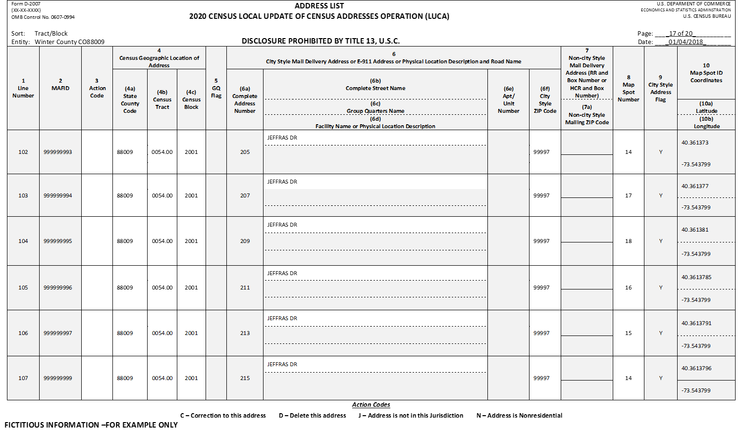
Paper Address Materials
Paper Address List (D-2007) – Example
**No Title 13 Data Displayed**
Notes:
Here’s an example of the 2020 LUCA paper Address List. In this slide and all of the forthcoming slides that include examples of the census address list and address list add pages, the address records are fictitious. No Title 13 data is displayed on any of these slides.

Slide 48
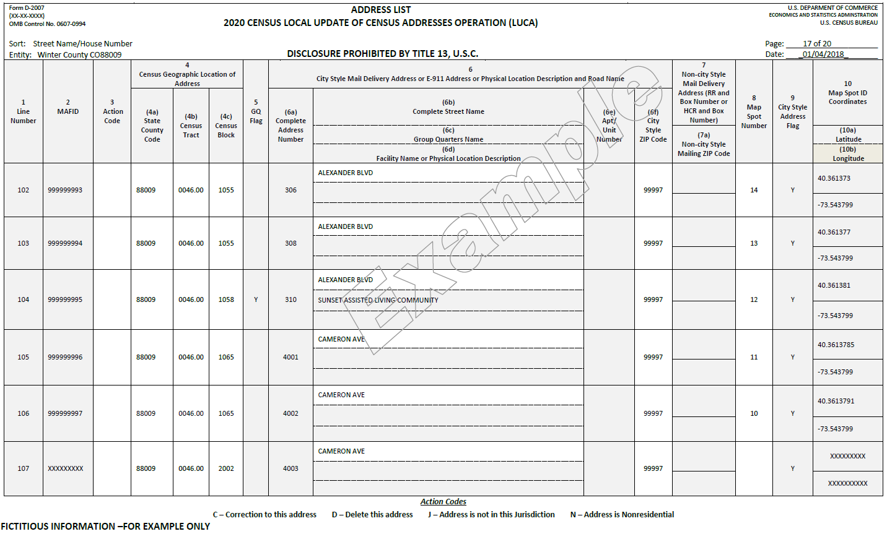
Paper Address Materials
Sort Option – Street Name/House Number
**No Title 13 Data Displayed**
Notes:
Street Name/House Number sort may seem most logical, but be aware the presence of the address in its correct location is very important.
The Street Name sort will list all addresses on any given street by house number and unit number, but participants will need to pay special attention to the geographic information to ensure the addresses are not only present on the census address list, but also geocoded to the correct census geography (census tract and block). Participants may not notice the geocode information as closely in this sort option and may just move on without realizing the Census Bureau has the address in the wrong block.

Slide 49
Paper Address Materials
Sort Option – Census Tract/Census Block
**No Title 13 Data Displayed**
Notes:
On the other hand, having the census address list sorted by Census Tract/Census Block may lead participants to think addresses are missing when they are actually just improperly geocoded to an adjacent census block.
The Census Tract sort will group all addresses geographically (by census tract and block), which means participants will need to search additional blocks on the address list to ensure the addresses that may appear as missing are not incorrectly geocoded.

Slide 50
Paper Address Materials
Address List Add Page (D-2008) – Title 13
Used to add residential addresses
    New
    Missing
    requiring change/correction not allowed to the Address List
8.5” x 11” (letter size) with four addresses per page.
Five blank Add Pages provided with materials.
Additional blank Add Page available:
  Respondent Guide
  LUCA Web site <https://www.census.gov/geo/partnerships/luca.html>
Notes:
The Address List Add Page is used to add residential addresses for your jurisdiction not shown on the Census Bureau’s address list and/or for adding addresses that require a change or correction not allowed to the address list. Once an add page contains address information, it is considered Title 13 material.
The Address List Add Page is letter size, 8.5” x 11” for ease of photocopying, with space for FOUR addresses per page.
The Census Bureau provides five (5) copies of the Address List Add Page with materials. We suggest that you make additional copies before recording any updates.
For your convenience, a blank Address List Add Page is included in the Respondent Guide. In addition, a blank Address List Add Page is on the LUCA Web site at http://www.census.gov/geo/partnerships/luca.html>.

Slide 51
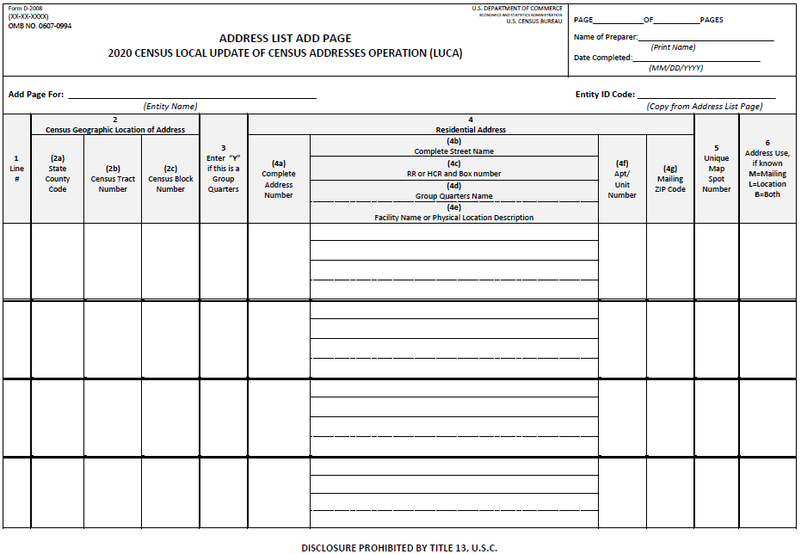
Paper Address Materials
Address List Add Page (D-2008) – example
Notes:
For the Address List Add Page, participants fill-in the Entity Name and Entity ID code, as well as page information, name of the person completing the add page and the date for each address list add page they complete. As noted on the bottom, disclosure is prohibited by Title 13 U.S.C. Once these blank pages contain address information, they become Title 13 material. These pages must be protected in the same manner as the address list. Follow the Confidentiality and Security Guidelines outlined in the Respondent Guide.

Slide 52
Paper Address Materials
Address Count List (D-2009)
Residential address census block tallies.
  Housing units and Group Quarters.
Reference only.
  Identify inconsistencies between Census block counts and your jurisdiction’s block counts.
8.5” x 11” (letter size) with 72 blocks per page.
Ungeocoded tally for state and county participants.
Not Title 13.
Notes:
The Address Count List contains the number of residential housing unit and group quarters addresses on the address list for each census block within your jurisdiction.
The address count list is for reference only and is used to identify inconsistencies between the Census Bureau’s housing unit and/or group quarters address counts and your housing unit and/or group quarters address counts.
The address count list is 8.5”x11”, letter sized, and contains 72 census blocks per page.
The “Ungeocoded” tally is listed just prior to the “Total” row for state and county participants. By ungeocoded, at Census we mean an address without the census geographic codes for tract and block. We can provide the tallies at the state and county level because we receive the US Postal Service’s Delivery Sequence file by state, county and zip code. We cannot provide ungeocoded tallies below the county level without the tract and block information.

Slide 53
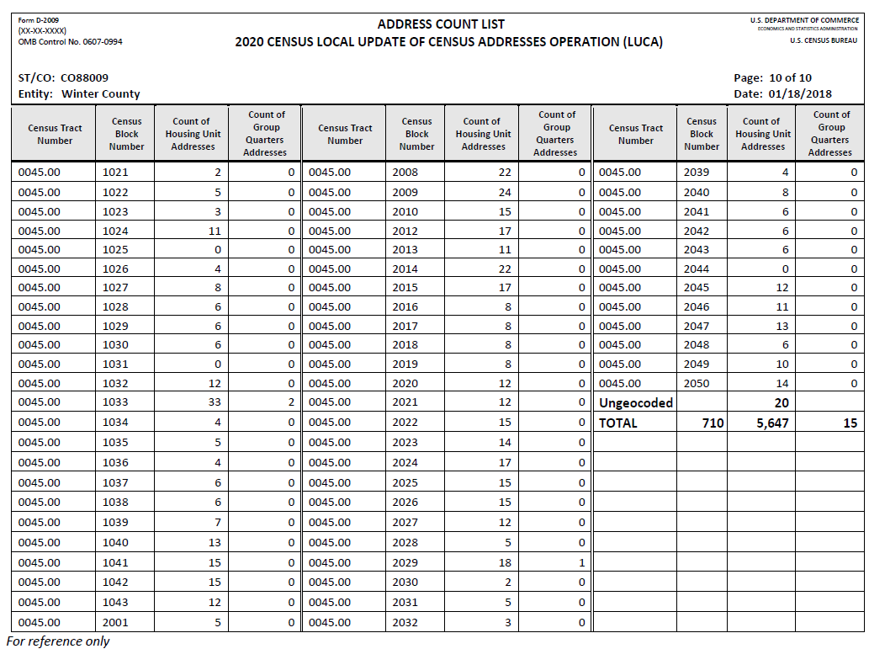
Paper Address Materials
Address Count List (D-2009) – Example
Notes:
Participants can refer to this list to help identify areas that need special attention or a closer review of the address list. For example, if block 2044 in tract 0045.00 has housing units, participants can determine from the address count list that the Census Bureau does not have any housing units or group quarters geocoded to that census block and they can choose to focus on that area for their LUCA review. Conversely, if they notice too many housing units/group quarters geocoded to a block, they can choose to focus on that area for their LUCA review in order to correct the misgeocoded address records. Establishing priorities for LUCA review is important and will be discussed in another presentation.

Slide 54
Paper Map Materials
Large Format maps
Not Title 13.
Reference only to provide census geocodes.
Updates only required for non-city style address records.
36” x 32”.
Three types:
  Index sheet.
  Parent sheets.
  Inset sheets.
Block to Map Sheet Relationship List (D-2010).
Large Format maps legend.
Notes:
The large format maps do not include map spots, so they are not Title 13.
The Census Bureau provides large format paper maps to all participants that selected Paper or Paper/PDF maps on their Product Preference form during 2020 LUCA registration. The large format maps are a reference used to identify the census geocode information for addresses on the address list.
While helpful, map updates are only required to indicate new, or updates to existing, non-city style address records. Participants choosing the “Paper/Paper” product preference that wish to make a map update to accompany their address list updates, must use the Large Format Parent sheet (or Inset sheet) maps for their map updates. Please do not allocate much of your 120-day review period attempting map updates. Focus the review on the address list.
The Large Format maps are 36”x32” in size and may include one or more sheets. There are three types of large format paper maps: Index sheets, Parent Sheets, and Inset sheets. Subsequent slides of this presentation detail these three types. The last two slides in this section discuss the Block to Map Sheet Relationship List and a large format map legend. The legend is included as an appendix in the Respondent Guide.

Slide 55
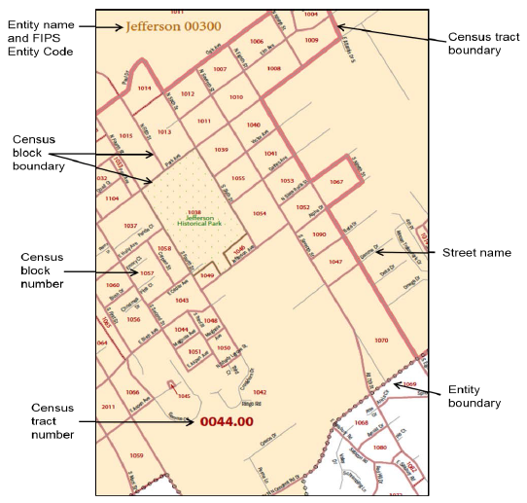
Paper Map Materials
Large Format Maps – Content Detail
Notes:
The LUCA paper large format maps show some of the same information found on a typical road map, such as streets and roads, water features, and legal boundaries. However, the LUCA map displays this information using symbols unique to the Census Bureau.
This zoomed section example of a large format parent map sheet displays the following information:
• Entity boundary.
• Entity name and FIPS Entity Code.
• Census tract boundaries and numbers.
• Census block boundaries and numbers.
• Streets and street names.
Other features not shown on this example, but could be on other parent sheets, include railroads and water features.

Slide 56
Paper Map Materials
Large Format Maps – Index Sheet
Reference only
Used with jurisdictions with more than one parent sheet
Cover entire extent of jurisdiction
Numbered grids that correspond to the parent sheets
Each numbered grid area corresponds to a parent sheet
Notes:
Large format map index sheets are for reference only and are used with jurisdictions containing more than one parent sheet. They cover the entire extent of your jurisdiction. They are divided into blue-outlined, numbered grids that correspond to the parent sheets with each numbered grid area corresponding to the area covered by a parent sheet.

Slide 57
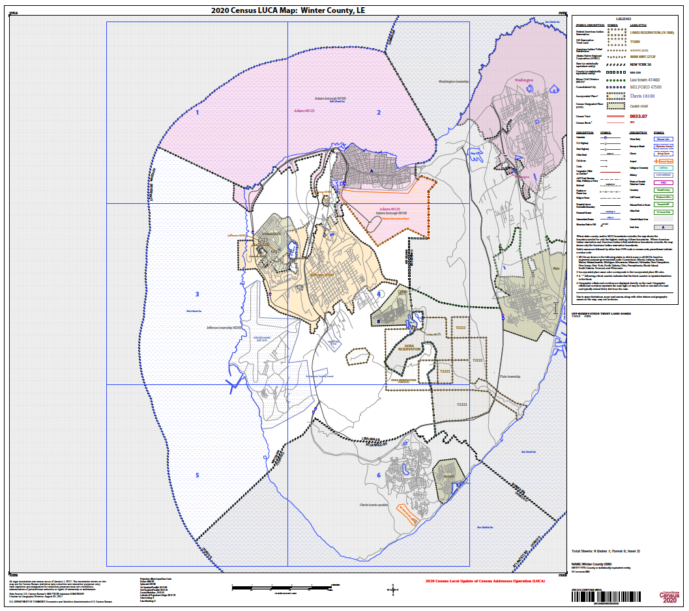
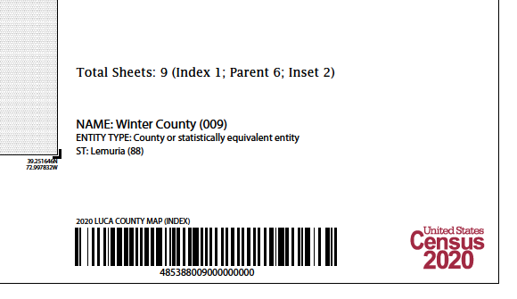
Paper Map Materials
Large Format maps – Index Sheet Example
Notes:
This slide shows an example of a 2020 LUCA Large Format Index sheet and a zoomed section of the same map. The Index sheet is one page. Notice the blue-outlined, numbered grids. The bottom right margin of the Index sheet identifies the total number of sheets that comprise the entire large format map set, breaking it down into the three categories: Index, Parent and Inset. This example has NINE sheets total: one Index sheet, six Parent sheets, and two Inset sheets.
Index sheets are always numbered as the “000” sheet. The barcode along the bottom contains the entity code (88009) and the sheet code information (000). The map type identifier, in this case “(INDEX)”, is above the barcode along with reference to 2020 LUCA.

Slide 58
Paper Map Materials
Large Format Maps – Parent Sheet
Correspond to grid and grid number on Index sheet
Detailed view of section of jurisdiction
Identifies location of census tract and blocks on the parent sheet (used with Block to Map Sheet Relationship List)
Depicts detail for features (roads, water, rail) and geographic areas
**Blocks affected by boundary improvements contain an alpha suffix on the parent sheet and on the inset sheet
Notes:
Large format parent sheets correspond to the grid and grid number on the Index sheet for your jurisdiction. They provide a detailed view of a section of your jurisdiction. They identify the census tract and blocks on the parent sheet and are used in conjunction with the Block to Map Sheet Relationship List discussed in an upcoming slide. The parent sheets depict detail excluded from the Index sheet for features such as roads, streams, water bodies, railroads, etc., and geographic areas such as city limits, county boundary, parks, etc.
It is important to note that blocks affected by boundary improvements since the 2010 Census contain an alpha suffix on the parent sheet, and if present, on the inset sheet as well. This suffix does not appear in the address products and is not required when performing address updates. See section 3.x.x of the Paper Address List Respondent Guide or section 3.2.2 of the Digital Address List Respondent Guide for an example of a suffixed block.

Slide 59
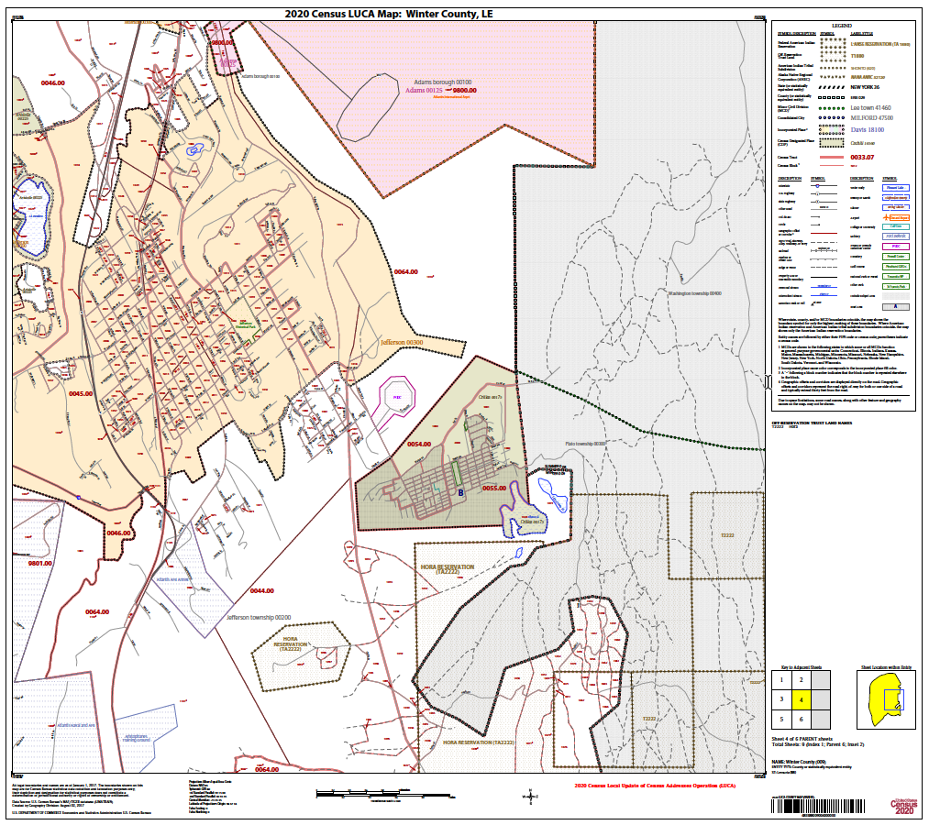
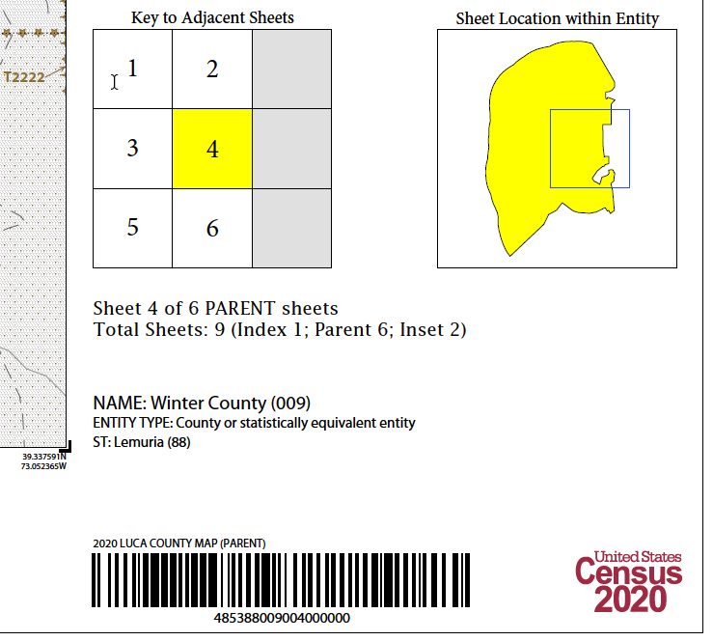
Paper Map Materials
Large Format Maps – Parent sheet example
Notes:
This slide shows an example of a 2020 LUCA Large Format Parent sheet (Parent sheet 4) and a zoomed section of the same map. The Parent sheet is one page. The bottom right margin of the Parent sheet shows a “key to adjacent sheets” that mimics the blue grid pattern on the Index sheet. It also identifies the total number of sheets that comprise the entire large format map set, breaking it down into the three categories: Index, Parent and Inset. This example has NINE sheets total: one Index sheet, six Parent sheets, and two Inset sheets.
The barcode along the bottom contains the entity code (88009) and the sheet code information (004). The map type identifier, in this case “(PARENT)”, is above the barcode along with reference to 2020 LUCA.
It is important to note that blocks affected by boundary improvements since the 2010 Census contain an alpha suffix. These suffixed blocks appear on Parent sheets (and Inset sheets, if present), but do not appear in the address materials. Suffix information is not required when performing address updates. See the Respondent Guide for an example of a suffixed block

Slide 60
Paper Map Materials
Large Format Maps – Inset Sheets
Do not exist for all jurisdictions or on every parent sheet
Highlighted on a parent sheet with fill pattern and identified with alpha character (e.g., B)
  May be multi-sheeted (e.g., B1, B2, etc.)
Show detail of congested areas on parent sheets
Depicts detail for features (roads, water, rail) and geographic areas
**Blocks affected by boundary improvements contain an alpha suffix on the parent sheet and on the inset sheet
Notes:
Large format Inset sheets do not exist for every jurisdiction, and if they exist, they don’t necessarily exist on each parent sheet. They correspond to a highlighted area with a fill pattern on the parent sheet with congestion and are identified with an alpha character, such as “B”. Due to the level of congestion, these may also be multi-sheeted (B1, B2, etc.). They show the detail of the congested area. Like the parent sheets, they depict the features for roads, water, rail and various geographic areas.
It is important to note that blocks affected by boundary improvements since the 2010 Census contain an alpha suffix on the parent sheet, and if present, on the inset sheet as well. See section x.x.x of the Paper Address List Respondent Guide or section 3.2.2 of the Digital Address List Respondent Guide for an example of a suffixed block.

Slide 61
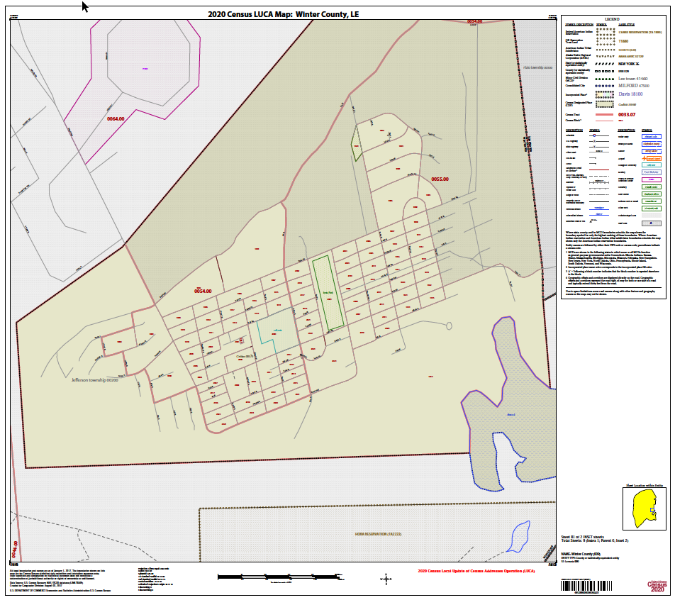
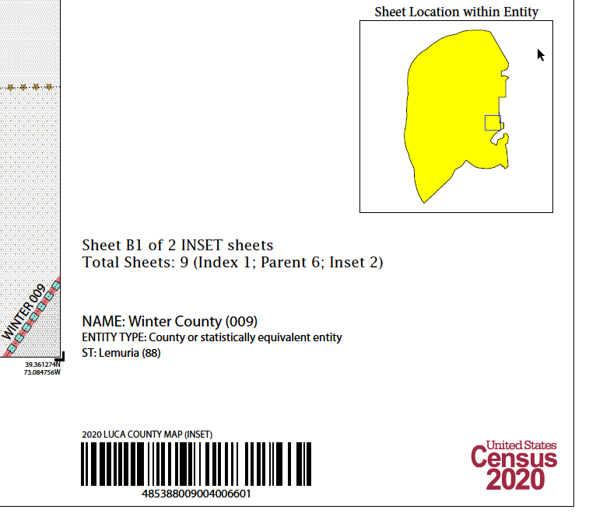
Paper Map Materials
Large Format Maps – Inset Sheet Example
Notes:
This slide shows an example of a 2020 LUCA Large Format Inset sheet (Inset B, 1 of 2 INSET sheets) and a zoomed section of the same map. The Inset sheet is one page. The bottom right margin of the Inset sheet identifies the total number of sheets that comprise the entire large format map set, breaking it down into the three categories: Index, Parent and Inset. This example has NINE sheets total: one Index sheet, six Parent sheets, and two Inset sheets.
The barcode along the bottom contains the entity code (88009) and the sheet code information (004). The map type identifier, in this case “(INSET)”, is above the barcode along with reference to 2020 LUCA.
As with the Parent sheet, blocks affected by boundary improvements since the 2010 Census contain an alpha suffix appear on Inset sheets, but do not appear in the address materials. Suffix information is not required when performing address updates. See the Respondent Guide for an example of a suffixed block.

Slide 62
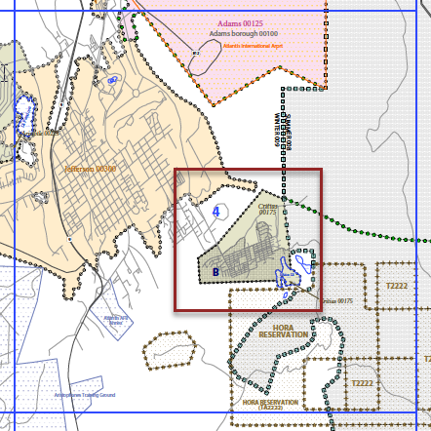
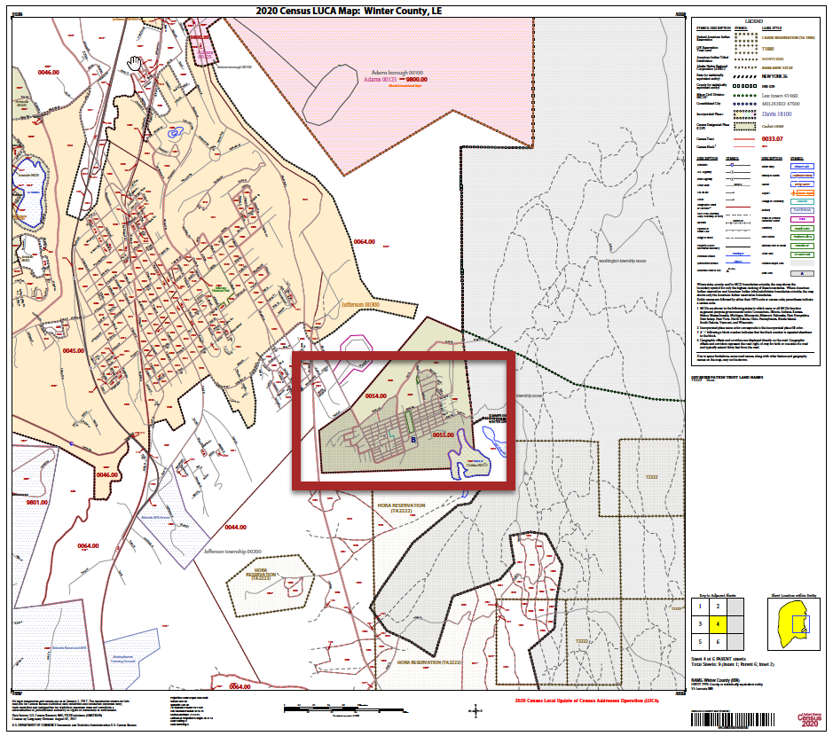
Paper Map Materials
Large Format maps – Index→ Parent→ Inset
Notes:
To summarize the linkage between the large format map types, this slide depicts the three large format map types, Index, Parent, and Inset. The left portion of this slide depicts a zoomed section of the Index sheet with blue grid 4, Parent sheet 4, and Inset B notated. The middle image shows Parent sheet 4 with Inset B notated. The image on the far right shows full Inset sheet B.

Slide 63
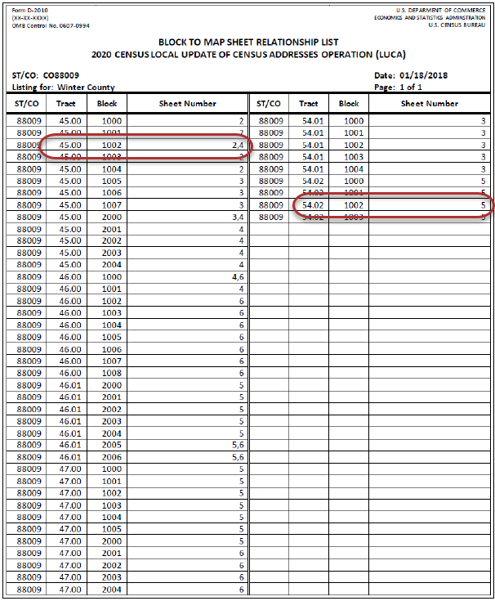
Paper Map Materials
Block to Map Sheet
Relationship List (D-2010)
Identifies large format parent map sheet(s) for each census block within jurisdiction.
Sorted by tract and block in ascending order.
Blocks are unique within a tract, so block numbers do repeat within jurisdiction.
Notes:
The Block to Map Sheet Relationship List identifies the large format Parent map sheet or sheets in which each census block is located for the given jurisdiction. The sort for this product is by census tract number and census block number in ascending order.
Census blocks are unique within a census tract, so block numbers do repeat within jurisdiction. In this example, census block 1002 in census tract 45 is located on parent sheets 2 and 4. Census block 1002 of census tract 54.02 is located on parent map sheet 5.

Slide 64
Paper Map Materials
PDF Large Format Maps
Not Title 13
“Paper/PDF” - courtesy pdf file provided.
One PDF file of all large format maps
  Delivered on DVD
  LUCA20<EntType><EntCode>.pdf
Adobe Reader or Adobe Professional software
Digital version of Block to Map Sheet Relationship List
Notes:
As with the printed large format paper maps, the PDF of the large format maps is not considered Title 13 materials.
While all paper map participants receive paper large format maps, participants who choose the Paper/PDF map product preference also receive a PDF of the large format maps as a courtesy. Participants must make edits on the PDF small format maps instead of the large format maps when both map types are received. One PDF file contains all of the large format maps and is delivered on DVD. The ONE PDF file includes the index sheet, all the parent sheets, and all of the inset sheets you received in paper. The lower right corner of the map margin (on paper maps and pdf as well) provides the total number of map sheets within the PDF file.
In order to view the PDF of large format maps, participants use Adobe Reader or Adobe Professional software. Refer to the Respondent Guide for additional details.
The PDF content matches the content of the large format paper maps, so the information presented in earlier slides applies to the PDF large format maps as well. For instance, the numbered grids displayed on the index map correspond to each parent sheet number within the file.
Participants can utilize the printed version of the Block to Map Sheet Relationship List or the digital version, LUCA20<EntType><EntCode>_BLK2MS.txt, included on the DVD.

Slide 65
Paper Map Materials
PDF Small Format Block Maps – Title 13
8.5” x 14” (legal size)
  Portrait or landscape orientation
Delivered on DVD
  Title13_BlockMaps.exe
  Password required to launch .exe
Three types
  Index sheet; Parent sheet; Inset sheet
Small Format Block Map Legend
Courtesy Large Format Maps Included
Notes:
Participants receiving PDF small format block maps materials are required to protect the materials to ensure they remain confidential by following the instructions outlined in the Confidentiality and Security Guidelines document that accompanied the LUCA invitation/registration materials. A copy of the document is included as an appendix in the Respondent Guide for your convenience.
These block maps are 8.5” x 14” (legal-size) with either portrait or landscape orientation, depending on the shape of the block.
The PDF small format block map materials are delivered on DVD embedded within an executable file named Title13_BlockMaps.exe. A password is required to execute this file. The password information is provided in advance of the materials in a separate correspondence, delivered by regular mail. Retain the password information for use upon receipt of the DVD(s) for the remainder of your LUCA materials. After launching the .exe file, it will save to a local directory you create. Review the BlockMap_Info_LUCA20<EntType><EntCode>.txt for more information (what is in this file???).
Like the large format maps, there are three types of PDF small format block maps: Index, Parent and Inset. Each is describe in the next slides.

Slide 66
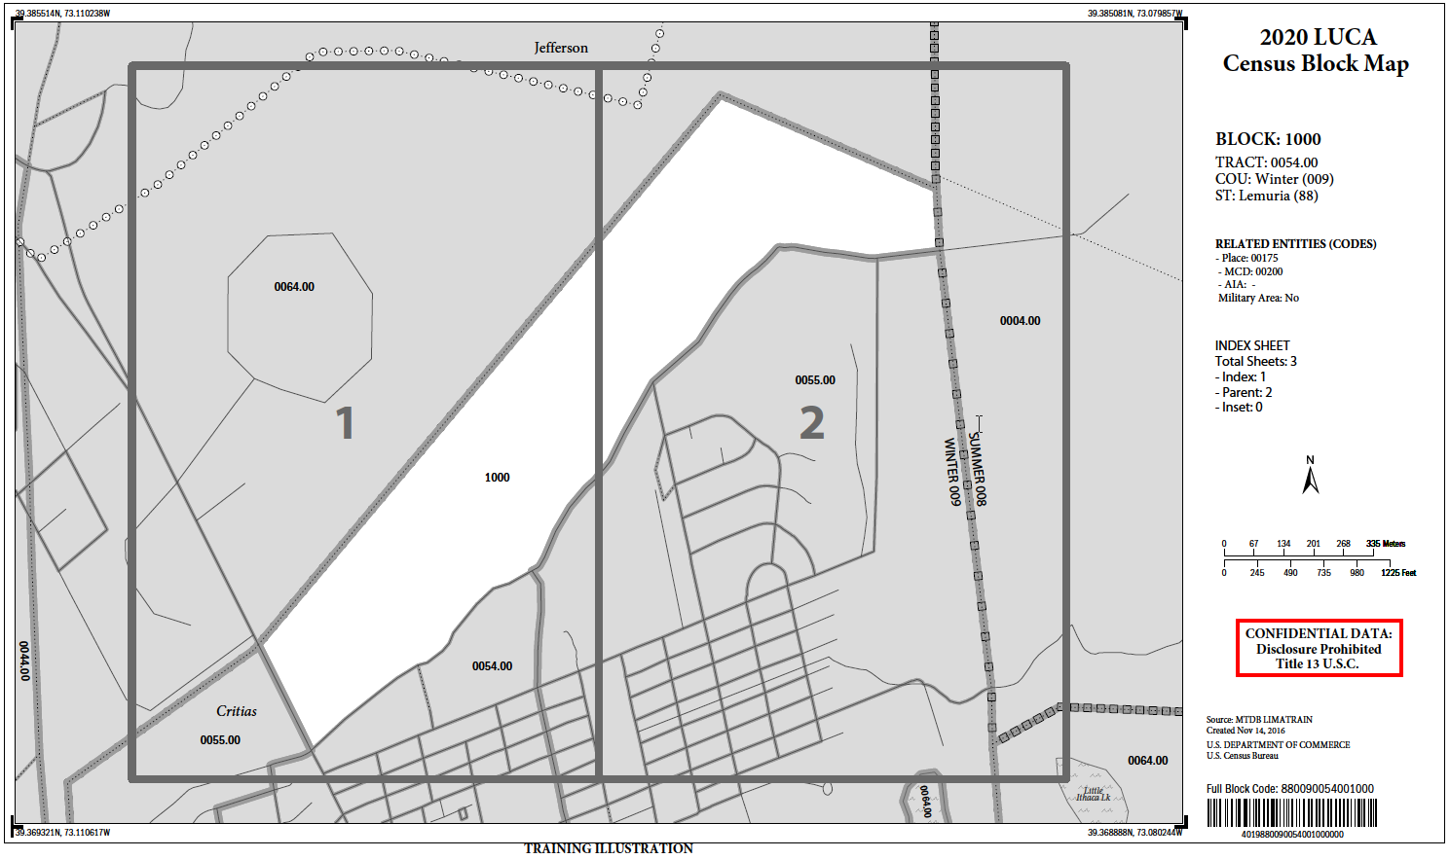
Paper Map Materials
PDF Small Format Block Map – Index sheet
Notes:
This slide shows an example of an Index sheet for the PDF small format maps. As with the large format maps, the numbered grids displayed on the index map correspond to each parent sheet number within the bundled PDF file. Review the BlockMap_Info_LUCA20<EntType><EntCode>.txt for more information. You can find where each census block is located on the large format parent sheets by using the Block to Map Sheet Relationship List, LUCA20<eti><EntCode>_BLK2MS.txt.

Slide 67
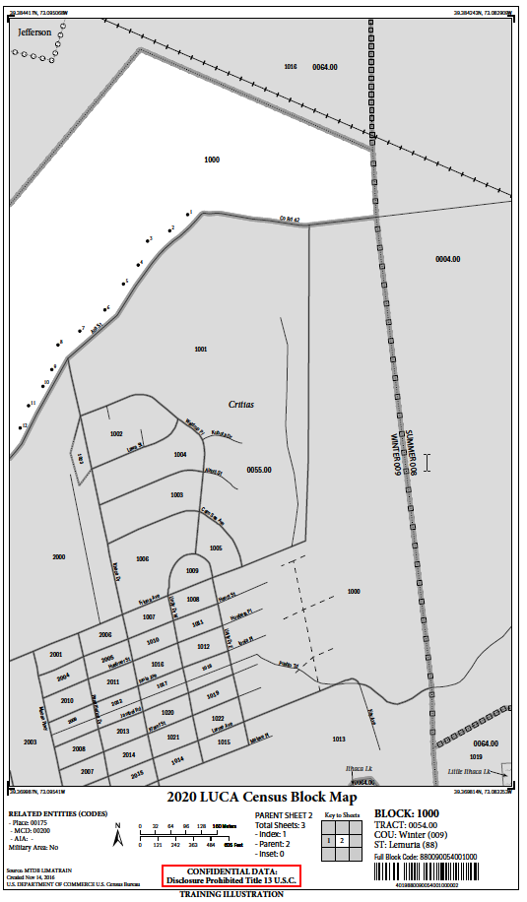
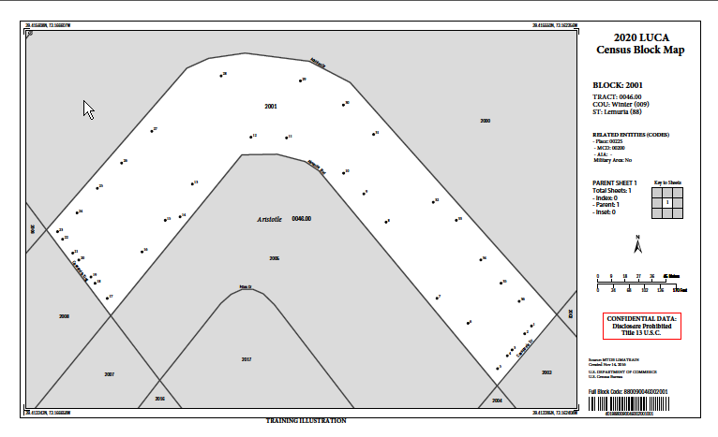
Paper Map Materials
PDF Small Format Block Map – Parent sheet
**No Title 13 Data Displayed**
Notes:
The data in all of our examples is fictitious, so no Title 13 information is displayed in this example. This slide shows two examples of the PDF small format block map parent sheets, the left depicts a portrait orientation and the right depicts a landscape orientation.

Slide 68
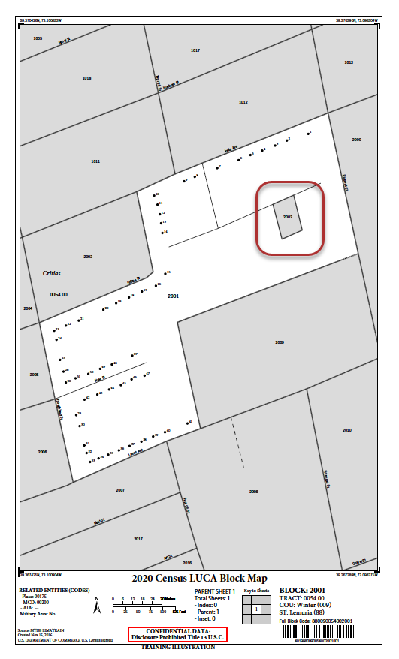
Paper Map Materials
PDF Small Format Block Map – Parent sheet “Internal Block” Example
**No Title 13 Data Displayed**
Notes:
This example shows an internal block (block 2002) that is different from the active block (block 2001). Notice all of the area that is not part of block 2001 is shaded and do not include any structure points. Do not edit any features outside of the active block. If edits are necessary for block 2002, participants must print and edit the PDF small format block map for block 2002.

Slide 69
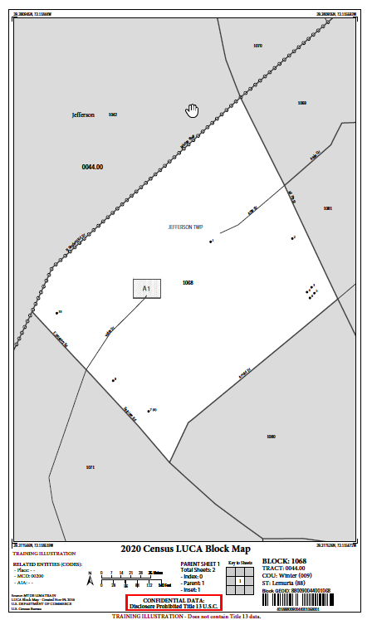
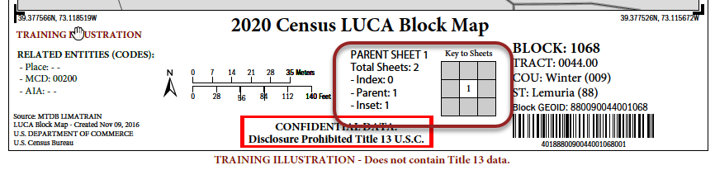
Paper Map Materials
PDF Small Format Block Map – Parent With Inset
**No Title 13 Data Displayed**
Notes:
Because this block had an area of congested map spots, an Inset was created. When this occurs, the parent and inset sheets will be bundled into one PDF for the block. In this slide, the parent sheet with a single inset sheet is the first page of two. This slide depicts the parent sheet for the PDF small format block map and a zoomed section to illustrate the map margin.

Slide 70
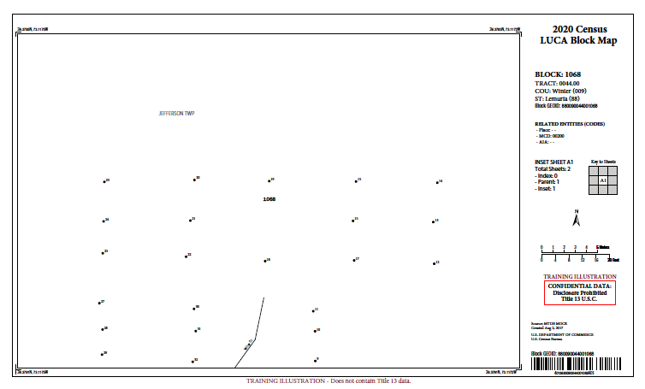
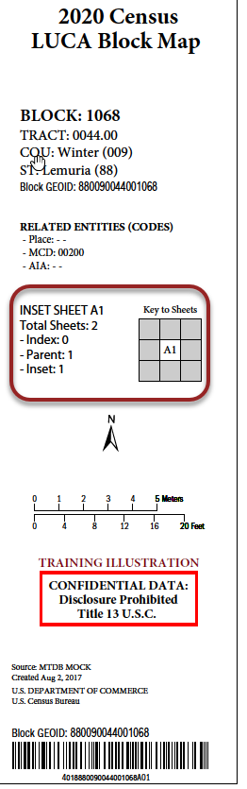
Paper Map Materials
PDF Small Format Block Map – Inset Sheet
**No Title 13 Data Displayed**
Notes:
In this slide, the inset sheet corresponds to the previous slide and is the second page of two for this block. This slide depicts the inset sheet for the PDF small format block map and a zoomed section to illustrate the map margin.

Slide 71
Digital Materials
Initial Setup
Notes:
Welcome to the 2020 Census LUCA operation training to introduce the initial setup process for the digital materials. This presentation serves as an introduction to the digital LUCA materials and provides detailed information for each product preference that receives digital materials. It does not provide instructions for making updates or for submitting the updated materials. Separate presentations cover those two topics.
The Census Bureau expects to post this presentation on LUCA web site, so participants can review them again prior to materials receipt in early 2018.

Slide 72
Agenda
Digital Materials Initial Setup Summary
Digital Product DVD Overview
Getting Started
  DVD(s) of digital LUCA materials.
  Suggested setup of local system.
  Extracting files.
  File naming convention and examples.
Using Your LUCA Digital Materials
  Opening .csv files in Microsoft Excel
  Opening .shp files in Esri ArcGIS
Notes:
As participants begin to prepare for 2020 LUCA and receipt of digital materials, it is important to identify the product preferences that receive digital materials and discuss preparing for the delivery of the digital materials. We will describe the DVD layout and content for the six product preferences that receive digital materials and walk through getting started. We will end the presentation with discussing how to receive support and assistance from the Census Bureau as well as connect with us through social media.

Slide 73
Digital Materials Initial Setup Summary
Ensure Confidentiality and Security Guidelines followed and Title 13 security in place prior to installation of DVD material to local drive.
Review the “readmefirst#” txt file on DVD.
Review presentation again upon receipt of materials.
Use presentation in conjunction with Respondent Guide and the 2020 LUCA Quick Start Guide.
Notes:
This presentation covered a lot of detail of the digital materials that accompany six different product preference selections. Before we close, we will summarize the presentation. Ensure the implementation of the Confidentiality and Security Guidelines, Appendix A of the respondent guide. Ensure Title 13 security precautions are in place prior to installing any of the DVD materials discussed today. If your jurisdiction cannot meet the digital security requirements, please do not install the data. Contact the Census Bureau immediately to discuss alternatives.
Upon receipt of the LUCA materials, review the product preference specific “readmefirst#” text file included in the root directory of your DVD. Please plan to review this presentation again and use it in conjunction with the appropriate respondent guide as resources for getting started. Be on the lookout for a hardcopy 2020 LUCA Quick Start Guide that accompanies the materials, as it will contain tips on organizing and handling the digital materials.

Slide 74
Digital Product DVD Overview
Paper Address List and Paper/PDF (1 DVD).
Paper Address List and Digital Map (1 DVD).
Digital Address List and Paper Large Format maps (1 DVD).
Digital Address List and Paper/PDF (1 DVD).
Digital Address List and Digital Map (3 DVDs).
Geographic Updates Partnership Software (GUPS) (3 DVDs).
Notes:
All active, functioning, legal governments can choose to receive digital address materials for the 2020 LUCA operation. Each of the FOUR product preferences highlighted on this slide receive digital address materials as part of their 2020 LUCA materials. Participants that selected those preferences are the intended audience for this presentation. We expect many governments will choose digital materials for both their address list and maps in order to leverage their own GIS, while some may only feel comfortable with using the digital address materials in a spreadsheet or database software.
While Geographic Updates Partnership Software (GUPS) participants technically receive their materials by DVD, they do not use the DVDs in the same manner as the other three product preference participants on this slide. They do not have to download the digital data off the DVD because the GUPS installation process details the GUPS participant’s steps for proper installation of the software and digital data. Please refer to the GUPS presentation for all of the details on this process. If GUPS participants decide to use their own GIS system, then they effectively become a Digital/Digital participant and those sections of this presentation apply to them.

Slide 75
Getting Started
DVD(s) of LUCA Digital Materials
Digital/Paper-PDF & Paper/Digital-PDF participants.
  One DVD (contains both Title 13 and non-Title 13 materials).
    root directory.
    “maps” folder.
    “shape” folder.
Digital/Digital & GUPS participants.
  Three DVDs.
    One with Title 13 data in “shape” folder.
    One with non-Title 13 data in “shape” folder.
    One with GUPS installation software.
Notes:
For 2020 LUCA, the Census Bureau delivers the LUCA digital materials on DVD. Due to confidentiality and security requirements of Title 13 data, we cannot make the digital LUCA materials available through download (ftp or internet) or through e-mail.
For the four product preferences, besides Digital/Digital, that receive digital materials:
One DVD
Contains both the Title 13 and non-Title 13 materials
Has files stored in:
the root directory
and in either or both
a “maps” folder
a “shape” folder
Presence of these two folders is dependent on the product preference, meaning all four of the product preferences may not have both folders on their DVD.
Digital/Digital participants
receive three DVDs
one containing the Title 13 data
one containing the non-Title 13 data
one containing GUPS installation software.
The Census Bureau intends to provide the GUPS installation DVD to Digital/Digital participants in case they decide to use GUPS instead of their own GIS. The three DVDs have similar layout and content as described for the single DVD participants. More details on the DVD layout and content of each product preference are included in forthcoming slides.
For reference, the digital Title 13 data includes:
Census Bureau’s Address List
PDF small format block maps that contain structure points depicted as map spots.
Requires a password to access
Participants must use the Census provided password in order to gain access to these Title 13 materials. The password was prepared and shipped under a separate correspondence. Participants must ensure the confidential treatment of the DVD and contents included within the DVD in order to comply with Title 13 restrictions. Use the Confidentiality and Security Guidelines for descriptions of the necessary protections.
The digital non-Title 13 data includes the Address Count List and the TIGER Partnership shapefiles. No password is required for accessing this information, as with the Title 13 materials.

Slide 76
Getting Started
Suggested Setup of Local System
Read the installation instructions included in your materials.
Inspect your DVD(s) immediately upon receiving:
  If DVDs damaged, incomplete, or files corrupted contact Geographic Programs Support Desk at: 1-844-344-0169.
  If DVDs ok, create folder named “2020LUCA” on your hard drive.
Copy contents of DVD into your new “2020LUCA” folder.
Execute the various .exe files (if present).
Review the other files on DVD for additional instructions.
Review the 2020 LUCA Respondent Guides for instructions on use.
Notes:
Upon receipt of the DVDs containing the LUCA digital material if the DVDs are damaged, incomplete, or if the files are corrupted, contact the Geographic Programs Support Desk at 1-844-344-0169 immediately for assistance and potential replacement of DVD.
The Census Bureau recommends that you make a copy of each of the files and place them on the hard drive of a computer, only after ensuring you can adhere to the Confidentiality and Security Guidelines. Retaining a copy will preserve the original files should you need to look at an original record or require another original copy of the file.
To keep your work organized, create a new directory/new folder on your hard drive. We suggest naming it “2020LUCA”. Copy all of the contents from the DVD into the newly created folder on your local system. Execute the various .exe files, if they are present, that we will discuss in the next slides and review the other files included on the DVD that were not part of the .exe files for additional instructions.
Participants needing assistance with saving, executing, and/or opening the files, should refer to the materials specific Respondent Guide included with the materials for detailed instructions. Consider the Respondent Guide the source for answering questions regarding the LUCA operation. Call the Geographic Programs Support Desk at the number listed above or send an e-mail the LUCA staff at <GEO.2020.LUCA@census.gov> if questions still exist.

Slide 77
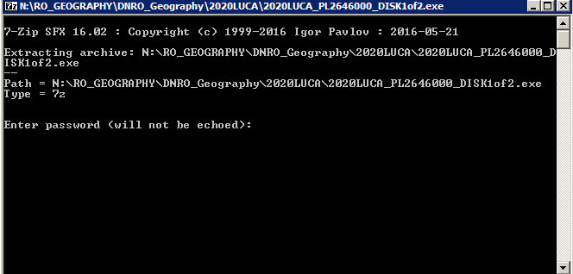
Getting Started
Extracting 2020LUCA_<EntityID>_DISK1of2.exe
Navigate to the “2020LUCA” folder you created.
If present, double click on the file named
  “2020LUCA_<EntityID>_DISK1of2.exe”.
Command prompt opens,
  requests password &
  closes upon completion.
Notes:
For training purposes, slides seven through 12 depict product preference specific examples. The Census Bureau did not include examples of extraction results for every product preference that receives digital material.
Navigate to the 2020LUCA folder on your local system. The DVD for two of the product preferences (Paper/PaperPDF and Paper/Digital) does not include this file because they receive paper address materials. For the other three product preferences (Digital/Paper, Digital/PaperPDF and Digital/Digital), double click on the file, 2020LUCA_<EntityID>_DISK1of2.exe, from your copy on the local system to execute the file and extract its encrypted contents. A command prompt opens and prompts for a password. Enter the password provided by the Census Bureau separately from your LUCA materials. The password is not visible when entering into the command prompt window. The command prompt window shows the progress of the file extraction and closes upon completion. This action has effectively unzipped and unencrypted the Title 13 address list for your jurisdiction.

Slide 78
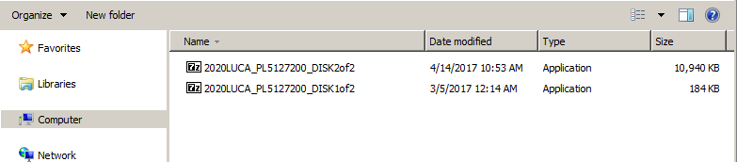
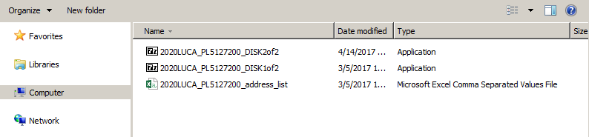
2020LUCA_<EntityID>_DISK1of2.exe – Visual
In this example for the Digital/Digital option - After executing the Disk1of2.exe file the resulting address list file appears in 2020LUCA folder.
Notes:
This visual represents how the local system would appear for Digital/Digital participants. The important point we are trying to illustrate is the presence of the resulting file, 2020LUCA_<EntityID>_address_list.csv, after the execution of the Disk1of2.exe file.
The file name varies based on the “EntityID”, which is comprised of a two character, alpha entity type (ST=state, CO=county, PL=Place, MC=minor civil division or MCD) and a variable length, numeric entity ID code. The code varies based on the type of entity. State code=2 digits, County=5 digits, Place=7 digits, MCD=10 digits. An upcoming slide discusses the file naming conventions. To properly open the Address List, see section 2.1.5, Converting Comma Delimited Files of the Respondent Guide, to ensure the field contents are preserved.

Slide 79
Getting Started
Extracting Title13_BlockMaps.exe
Navigate to the “2020LUCA” folder you created.
If present, double click on the file named
  “Title13_BlockMaps.exe”.
Command prompt opens,
  requests password &
  closes upon completion.
Notes:
Navigate to the 2020LUCA folder on your local system. Only the DVD for two of the product preferences (Paper/PaperPDF and Digital/PaperPDF) includes this file. For these two, double click on the file, Title13_BlockMaps.exe, from your copy on the local system to execute the file and extract its encrypted contents. A command prompt opens and prompts for a password. Enter the password provided by the Census Bureau separately from your LUCA materials and is the same one used to extract the digital address list. The password is not visible when entering into the command prompt window. The command prompt window shows the progress of the file extraction and closes upon completion. This action has effectively unzipped and unencrypted the Title 13 PDF small format block maps for your jurisdiction.

Slide 80
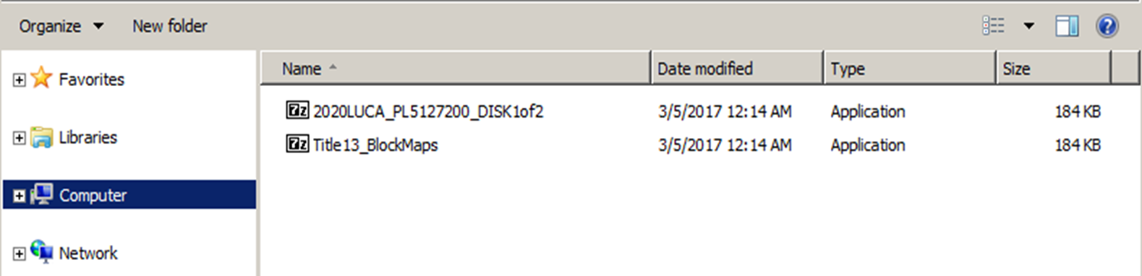
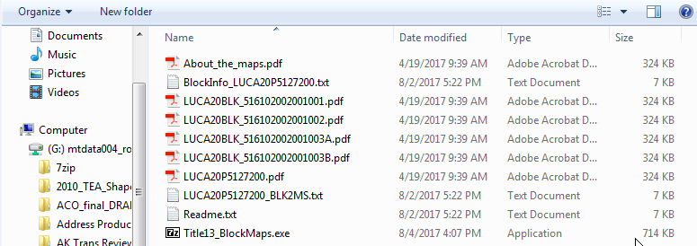
Title13_BlockMaps.exe – Visual
In this example for the Digital/PaperPDF option - After executing the Title13_BlockMaps.exe file the resulting block map PDFs appear in 2020LUCA folder.
Notes:
This visual represents how the local system would appear for Digital/PaperPDF participants. The important point we are trying to illustrate is the presence of the resulting files, beginning with “LUCA20BLK”, which appear after the execution of the Title13_BlockMaps.exe file.

Slide 81
File Naming Convention – Digital Materials
Address List.
  2020LUCA_XXyyyyyyyyyy_address_list.csv
  2020LUCA_TRxxxxTAyyyy_address_list.csv
Address Count List.
  2020LUCA_XXyyyyyyyyyy_address_countlist.csv
  2020LUCA_TRxxxxTAyyyy_address_countlist.csv
TIGER Partnership shapefiles.
  PVS_17_v2_<layername>_SSCCC.shp
  PVS_17_v2_<layername>_SS.shp
Notes:
Replace the <EntityID> mentioned on the previous slides dealing with extracting the data from the DVDs with Xxyyyyyyyyyy or TRxxxxTAyyyy in the following four slides WHERE:
XX is a 2 character, alpha entity type (ST=state, CO=county, PL=Place, MC=minor civil division or MCD)
yyyyyyyyyy is a variable length, numeric entity ID code that varies based on the type of entity (State code=2 digits, County=5 digits, Place=7 digits, MCD=10 digits).
TRxxxxTAyyy is a fixed length alphanumeric code composed of 12 character. First six (TRxxxx) represent the tribal identification code and the last six (TAyyyy) represent the code for the tribal geographic area.
The shapefiles for 2020 LUCA are TIGER Partnership shapefiles based off the official boundaries resulting from the 2017 BAS program. Their vintage is the fall of 2017. They have a standard naming convention that changes depending on the data content (“layername” shown above). The SS and CCC correspond to the state and county FIPS codes for the state and each county in which the entity exists.

Slide 82
File Naming Convention – Address List
2020LUCA_XXyyyyyyyyyy_address_list.csv
  2020LUCA_ST01_address_list.csv (State of Alabama).
  2020LUCA_CO12001_address_list.csv (Alachua County, FL).
  2020LUCA_PL1378800_address_list.csv (Valdosta city, GA).
  2020LUCA_TR0016TA1555_address_list.csv (Immokalee Reservation).
    TR0016 = Seminole Tribe of Florida .
    TA2980 = Immokalee Reservation.
Notes:
Presenters may alter the file naming convention slides to reflect audience, i.e., change from Kansas entities to Florida entities, remove tribal if no tribes present at the workshop, or remove MCDs if no functioning MCDs in the state. This slide is editable for content; just ensure the naming convention is accurate. All that should change is the <EntityID> and the description in parenthesis.
This slide explores the various naming conventions for the address list based upon the entity types, state, county, incorporated place, minor civil division and federally recognized tribes with reservation and/or off reservation trust lands.
ST20 identifies a state address list for Kansas. CO20001 identifies a county address list for Allen County KS. PL2000125 identifies an incorporated place address list for Abilene city KS. MC2000120550 identifies a minor civil division address list for Elm township KS. TR0197TA2980 identifies a tribal address list for Prairie Band of Potawatomi Nation Reservation, where TR0197 is the tribal identification code for Prairie Band Potawatomi Nation and TR2980 represents the Prairie Band of Potawatomi Nation Reservation, the geographic area associated with the Prairie Band Potawatomi Nation.

Slide 83
File Naming Convention – Address Count List
2020LUCA_XXyyyyyyyyyy_address_countlist.csv
  2020LUCA_ST22_address_countlist.csv (State of Louisiana).
  2020LUCA_CO28001_address_countlist.csv (Adams County, MS).
  2020LUCA_PL3770540_address_countlist.csv (Wake Forest town, NC).
  2020LUCA_TR0035TA0525_address_countlist.csv (Catawba Reservation).
    TR0035 = Catawba Indian Nation.
    TA0525 = Catawba Reservation.
Notes:
Presenters may alter the file naming convention slides to reflect audience, i.e., change from Kansas entities to Florida entities, remove tribal if no tribes present at the workshop, or remove MCDs if no functioning MCDs in the state. This slide is editable for content; just ensure the naming convention is accurate. All that should change is the <EntityID> and the description in parenthesis.
The address count list follows the same naming convention as for the address list, except for reference to the “countlist” in the file name.

Slide 84
File Naming Convention –
TIGER Partnership Shapefiles
PVS_17_v2_<layername>_SSCCC.shp
  PVS_17_v2_edges_20001.shp (edges for Allen County, KS).
  PVS_17_v2_tabblock2010_20001.shp (2010 Census tabulation blocks for Allen County, KS).
  PVS_17_v2_place_20001.shp (place boundaries for Allen County, KS).
  And numerous others.
PVS_17_v2_<layername>_SS.shp (for reference and query only).
  PVS_17_v2_state_20.shp (Kansas state boundary).
  PVS_17_v2_county_20.shp (county boundaries within Kansas).
  PVS_17_v2_place_20.shp (place boundaries within Kansas).
  And numerous others.
Notes:
Presenters may alter the file naming convention slides to reflect audience, i.e., change from Kansas entities to Florida entities, remove tribal if no tribes present at the workshop, or remove MCDs if no functioning MCDs in the state. This slide is editable for content; just ensure the naming convention is accurate. All that should change is the <EntityID> and the description in parenthesis.
Numerous files accompany the county-based TIGER Partnership shapefiles for LUCA, but the two of importance are the Edges and Tabblock2010 shapefiles within each of the county folder(s). The edges shapefile is the only file edited during the 2020 LUCA operation. Use it to make road feature updates resulting from address list updates. Use the tabblock2010 shapefile for geocoding purposes, as it is the block base for the 2020 LUCA operation. Make no updates to the tabblock2010 file.
Programmed to use both state level and county level shapefiles, the Census Bureau provides GUPS state level shapefiles as part of the LUCA TIGER Partnership shapefiles. These state level files are for reference only. Make no updates to any of the shapefiles located within the state folder. These files can, however, be used for reference purposes.
As an example, for an incorporated place that crosses county lines, they may wish to use the state level incorporated place shapefile (e.g., PVS_17_v2_place_20.shp) to help them identify the 2010 tabulation blocks for their entity. Since incorporated place boundaries do not cross state lines, the state level file for incorporated places shows the place boundary in its entirety, without fragmenting at the county boundary. Using the PVS_17_v2_place_20001.shp would only show the Allen County KS portion of any split boundary places.

Slide 85
Using Your LUCA Digital Materials
Opening .csv files in Microsoft Excel.
Opening .shp files in Esri ArcGIS.
Notes:
With the conclusion of the DVDs content and layout section, it is very important to review how to get started with the digital address and maps materials. Digital address materials participants must follow the exact procedures described in this presentation and in the Respondent Guide for opening the .csv files. These steps are critical. Improper opening of the .csv corrupts the data content of the digital address list. Opening the shapefiles is less complicated, but examples of opening the files using Esri’s ArcGIS software are included.

Slide 86
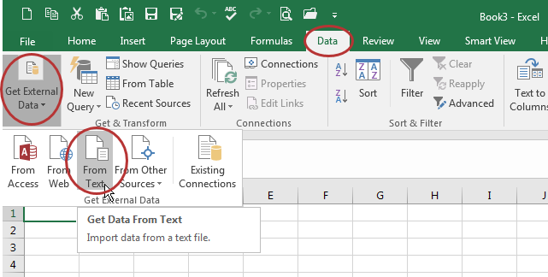
Opening .csv Files in Microsoft Excel:
Data – Get External Data – From Text
Launch Microsoft Excel and open a blank workbook.
Choose Data – Get External Data – From Text.
Notes:
It is important to open the .csv files in a particular manner so the field structure is preserved and data content is not corrupted. The next three slides of information were created using Excel 2016. Because software versions and vintages may display information differently, please keep this in mind while viewing these examples.
After launching Microsoft Excel, open a blank workbook. Choose from the Data menu to Get External Data from Text.

Slide 87
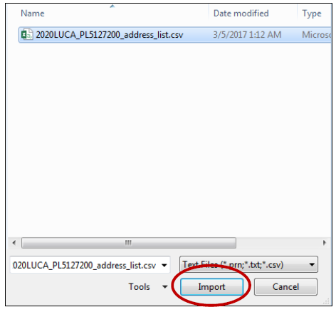
Opening .csv Files in Microsoft Excel:
Navigate – Import
Navigate to the “2020LUCA” folder, choose the .csv and then choose Import.
Notes:
Navigate to the “2020LUCA” folder on your local system, choose the .csv you wish to open, and then choose Import.

Slide 88
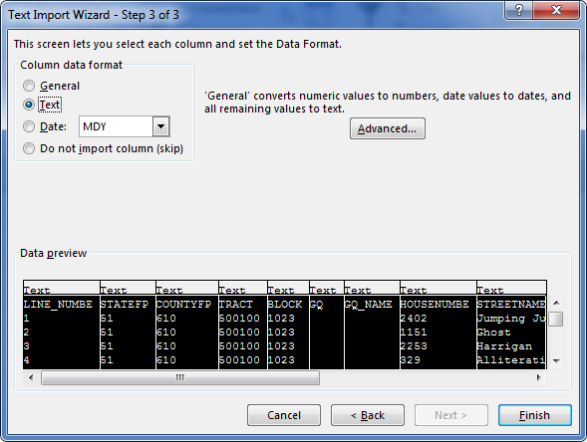
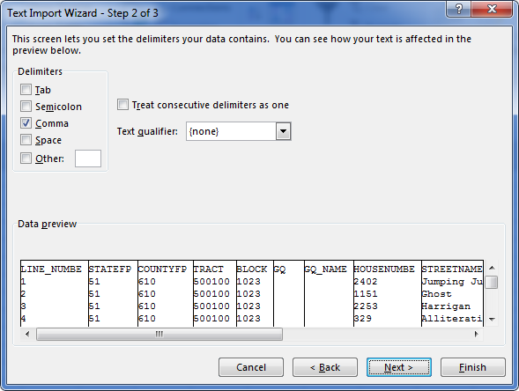
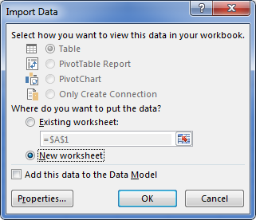
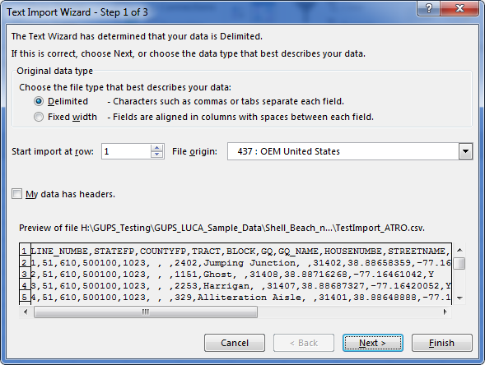
Opening .csv Files in Microsoft Excel:
Text Import Wizard
Text Import Wizard appears:
      Step 1/3 (Original data type=Delimited and choose Next).
      Step 2/3 (Change Delimiters from Tab to Comma and choose Next).
      Step 3/3 (Select all fields in Data preview, Change Column data format to Text & choose Finish).
      Import Data choose New worksheet and OK.
**No Title 13 Data Displayed**
Notes:
Follow the Import Wizard by selecting the following choices:
Original data type = Delimited and choose Next
Change Delimiter from Tab to Comma and choose Next
Select all of the fields in the Data preview window and change the data format to Text, and choose Finish (Setting the fields to Text preserves the leading zeros in the value fields)
For the Import Data window, participants may choose “New worksheet” to have the information imported into a blank new worksheet. If they choose “Existing worksheet”, make sure the field beneath is set to the upper left cell, =$A$1

Slide 89

Opening .shp Files In Esri ArcGIS:
Launch ArcGIS – ArcMap
From the Start Menu or a shortcut icon on desktop, launch ArcMap.
A “Loading Document” window appears.
Notes:
The Census Bureau uses Esri’s ArcGIS ArcMap version 10.4.1. Please note different versions of ArcGIS yield different actions and screen visuals. These screenshots provide only one method for setting up your digital map materials. This presentation does not discuss editing the shapefiles. The “Acceptable Update” presentations discuss editing the shapefiles.
Presenter read the bullets on the slide.

Slide 90
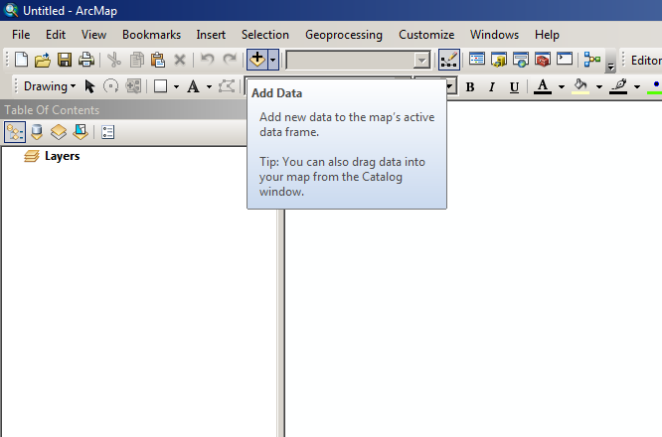
Opening .shp Files In Esri ArcGIS
Setting up .mxd
A blank Map Document (.mxd) will open.
Click the Add button to add your data to the blank .mxd.
Notes:
After the “Loading Document” window closes, a blank map document, or .mxd, will open. Click the Add button, represented as a plus sign in the ArcMap software as shown in the image on the right side of the screen.

Slide 91
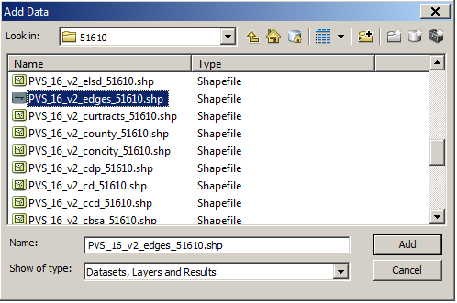
Opening .shp files in Esri ArcGIS
Browse and add data
Browse for your data.
Select the edges shapefile and the tabblock2010 shapefile and click Add.
Notes:
Browse for your shapefile data, extracted after execution of the 2020LUCA_<EntityID>_DISK2of2.exe file. Select the edges shapefile and the tabblock2010 shapefile for your jurisdiction and click Add.

Slide 92
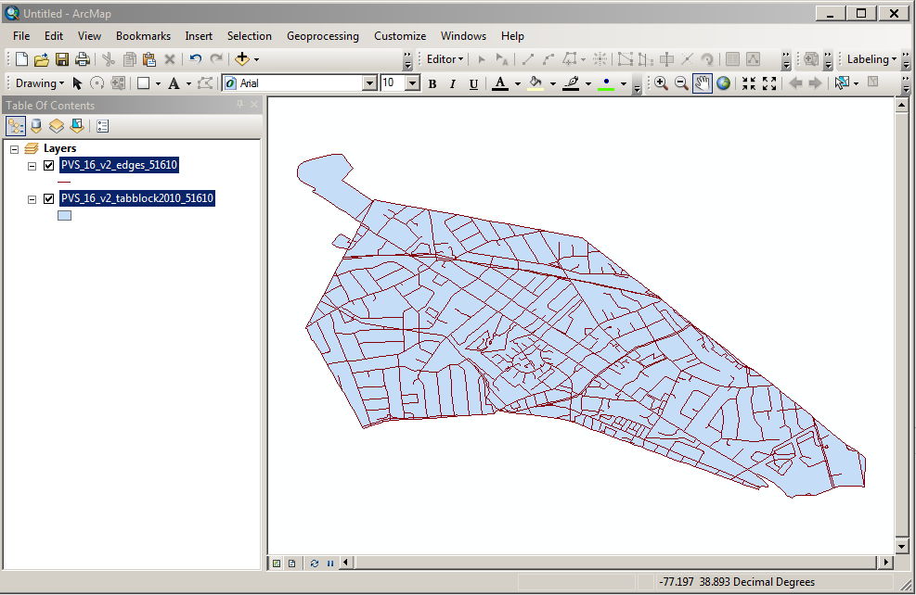
Opening .shp files in Esri ArcGIS
Add Data resulting visual
Something similar to this image appears after successfully adding the edges and tabblock2010 shapefiles.
Notes:
A visual very similar to this image appears after successfully adding the edges and tabblock2010 shapefiles to the blank map document.

Slide 93
Paper Product Preference
Acceptable Updates

Slide 94
Agenda
Paper Address List and Paper Map Updates
Address List Action Codes (D-2007)
Address List Add Page (D-2008)
Ungeocoded Addresses
Non-City Style Addresses

Slide 95
Address List (D-2007) – Example
**No Title 13 Data Displayed**
Notes:
This is an example of a the census address list in Tract/Block sort. Participants can update specific columns on the address list as illustrated in upcoming slides.
In this slide and all of the forthcoming slides that include examples of the census address list and address list add pages, the address records are fictitious. No Title 13 data is displayed on any of these slides.

Slide 96
Address List Add Page (D-2008) – Example
Notes:
This is an example of a blank Address List Add Page. Participants using this to add residential addresses must ensure all entries are complete and legible. As well, complete the header information for your jurisdiction, copying the Entity Name and Entity ID Code from your Address List. Complete the page tally information, name of preparer and date completed information as each page is completed. Do not fill in the “OF ___ PAGES” value until completion of all “Adds” is certain.
Participants must provide the correct census geographic codes (i.e., state county code, census tract number, and census block number) when adding an address record. The Census Bureau will not accept addresses without census geographic codes. Participants can find all of these census geographic codes on the 2020 LUCA large format maps, as well as on their PDF small format block maps. This add page is used to add city style and non-city style addresses.

Slide 97
Acceptable Updates & Examples
Address List (D-2007)
  Action Codes
    C – Correction to this address
    D – Delete this address
    J – Address is not in this Jurisdiction
    N – Address is Nonresidential
Address List Add Page (D-2008)
  City Style Addresses
  Non-city Style Addresses
Notes:
We are entering the section of the presentation that deals with specific examples for updating the LUCA materials. Please remember, LUCA is an address-focused operation. Some map updates intertwine with some of the examples, but the focus of this section of the presentation details permissible actions that can occur to the address list and the address list add page. There are four acceptable action codes used to edit the census address list- C, D, J, and N. Each will be discussed in detail. All four action codes may be used with city style addresses (e.g., 1000 Main St), non-city style addresses (e.g., RR 3 Box 34) and ungeocoded addresses (available for state and county level participants only).
For the examples, both city style and non-city style address examples are shown within the Address List and Address List Add Page sections. Ungeocoded address examples are discussed while reviewing the C action code.

Slide 98
C – Action Code
Use a “C” Action Code for the following situations:
  Incorrect state code
  Incorrect county code
  Incorrect census tract number
  Incorrect census block number
  Incorrect street name (including street directional and street type information)
  Incorrect ZIP Code
  Include tract and block numbers for *Ungeocoded address records
*Ungeocoded records are missing the tract and block geocode information and will only exist for state and county participants. The only action code participants will use with ungeocoded records is the “C” action code.
Notes:
Participants use the “C” action code to update the census address list in the following situations: to correct incorrect state codes, county codes, census tract numbers, census block numbers, street names (including directional and street type information) and ZIP codes. These are the only six fields that can be updated for 2020 LUCA. Repeat, the fields shown on this slide are THE ONLY six fields that can be updated on the Address List for 2020 LUCA!
The presentation includes three examples of using the C action code, shown in bold on the slide.
Correction of an incorrect census block number
Correction of an incorrect street name
Correction to tract and block geocodes for *Ungeocoded records
*Ungeocoded records are missing the tract and block geocode information and will only exists for state and county participants. Though all action codes can be used for ungeocoded address records, the most informative update for the Census Bureau is inclusion of the tract and block information that provides the necessary geocode information to distribute a questionnaire.

Slide 99
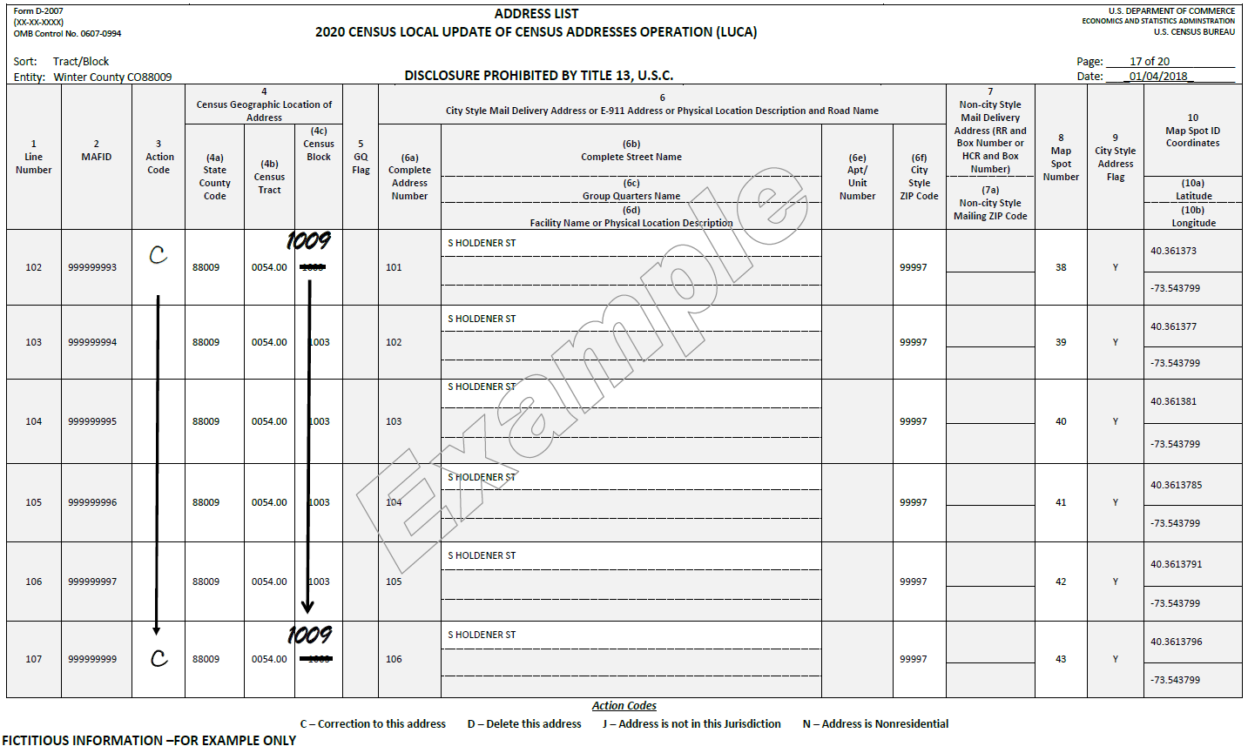
C Action Code – Correcting Block Geocode
**No Title 13 Data Displayed**
Notes:
In this example, the census block for the address records on this page along S Holdener Street do not exist in block 1003. The feature exists in the adjacent block, block 1009.
Print a “C” in the Action Code, column 3. In the Census Block (4c) column, cross out 1003 and print 1009.
Notice the use of the “arrow down” so all information does not have to be written on each record. Ensure the action code and other corrected information appears for the first and last record for which that update applies.
While helpful, map updates are only required to indicate new, or updates to existing, non-city style address records; otherwise, map updates are optional. No change to the Map Spot Number (8) column is required.

Slide 100
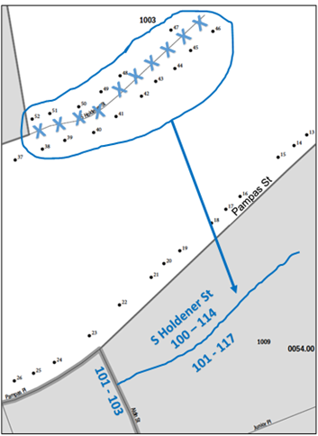
Map: C Action Code – Correcting Block Geocode
**No Title 13 Data Displayed**
Use colored pencil to cross out incorrect location of S Holdener St and circle the entire street and all map spots that move with street
Draw street in correct location, include street name (and address ranges and breaks if known)
Draw arrow to correct location for S Holdener St
Include address range and address breaks, if known
Notes:
Locate the appropriate PDF small format block map (block 1003 in tract 54). Print it at full scale, legal size. Use a colored pencil to cross out the incorrect location in block 1003 of S Holdener Street with a series of “Xs.” Circle the entire street and include all the affected map spots that need moved with the street.
Draw S Holdener Street in its correct census block, the adjacent block 1009, and print the street name above it.
Draw an arrow from the incorrect location to the correct location for S Holdener Street.
Optional: At the correct location, S Holdener Street includes an even numbered address range from 100 through 114 on the north and an odd numbered address range from 101 through 117 on the south.
Print the address ranges above and below the S Holdener Street. Print the address breaks where S Holdener Street intersects Aldin Street between address numbers 101 and 103.
Address ranges are the lowest and highest address numbers used to identify structures along each side of a street segment that has city-style addresses. Usually one side of the street has even address number and the opposite side has odd address numbers.
Address breaks are the city-style addresses on each side of a boundary or at an intersection of a street with another street or feature.
Please note, this is an example of a correction in an adjacent block. In cases, where the blocks are not adjacent, omit the “circle entire street and all map spots” and the “draw arrow” steps. Simply mark the Xs to denote deletion of the feature and add the feature to the appropriate PDF small format block map in its proper location as described in this example. Provide as much detail as possible, but do not allow map updates to steal time from address updates.

Slide 101
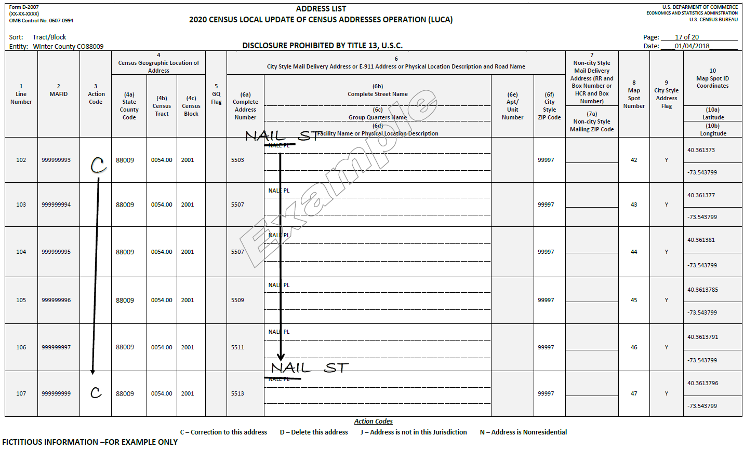
C Action Code – Correcting Street Name
**No Title 13 Data Displayed**
Notes:
In this example, the address records in block 2001 along Nail Street have the incorrect street name of Nale Place.
Print a “C” in the Action Code (3) column for the first and last addresses that are affected by the street name correction. Arrow down from the first entry to the last entry.
In the Complete Street Name (4b) column, cross out the incorrect name, in this example, Nale Place, and print the correct name, Nail Street, above it for the first street name and the last street name that needs corrected. Arrow down from the first entry to the last entry.
If the street extends into multiple blocks, repeat this procedure for all the Address List sheets containing the street name that needs corrected.

Slide 102
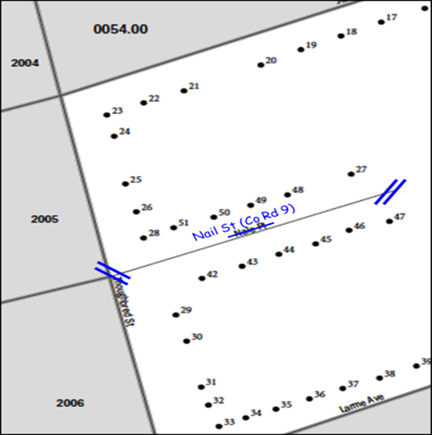
Map: C Action Code – Correcting Street Name
**No Title 13 Data Displayed**
Use colored pencil to cross out incorrect street name (Nale Pl) and print correct street name (Nail St) above it
Use double hatch marks to define extent of name change
If alternate street name exists, print it in parentheses after primary street name
Notes:
Locate the appropriate PDF small format block map (block 2001 in tract 54). Print it at full scale, legal size. Using a colored pencil, cross out the incorrect street name (Nale Place) and print the correct street name (Nail Street) above it.
Use double hatch marks to show the extent of the street name change. In this example, the entire street needs correction.
If there is an alternate street name, include it in parentheses after the primary street name. In this example, County Road 9 is the alternate street name for Nail Street.
If this update extended to more than one block, print all the block maps containing the incorrect street name for each block affected by the street name correction and complete the aforementioned steps.

Slide 103
Ungeocoded Addresses
State and County participants only
Included on the last page(s) of address list
United States Postal Service (USPS) provides without tract and block geocode information
Consider reviewing if on address list
Use “C” action code to provide tract and block geocodes
Use “D”, “J” or “N” action codes as described in upcoming slides
Notes:
The Address List for state and county participants may contain ungeocoded addresses. If so, these appear at the end of the printed address list.
The USPS provides these new addresses to the Census Bureau by state, county and zip code. In Census Bureau terms, “ungeocoded” means these records do not contain census tract or census block codes.
Consider reviewing these addresses to determine if they are valid residential addresses. If they are, please use the “C” action code and provide the census tract and census block for these ungeocoded addresses to ensure an accurate enumeration in the correct location.
If participants determine the ungeocoded record does not exist/is not valid, is out of the jurisdiction, or is nonresidential, they may mark them according to guidance in upcoming slides for the D, J and N action codes and as described in the Respondent Guide.

Slide 104
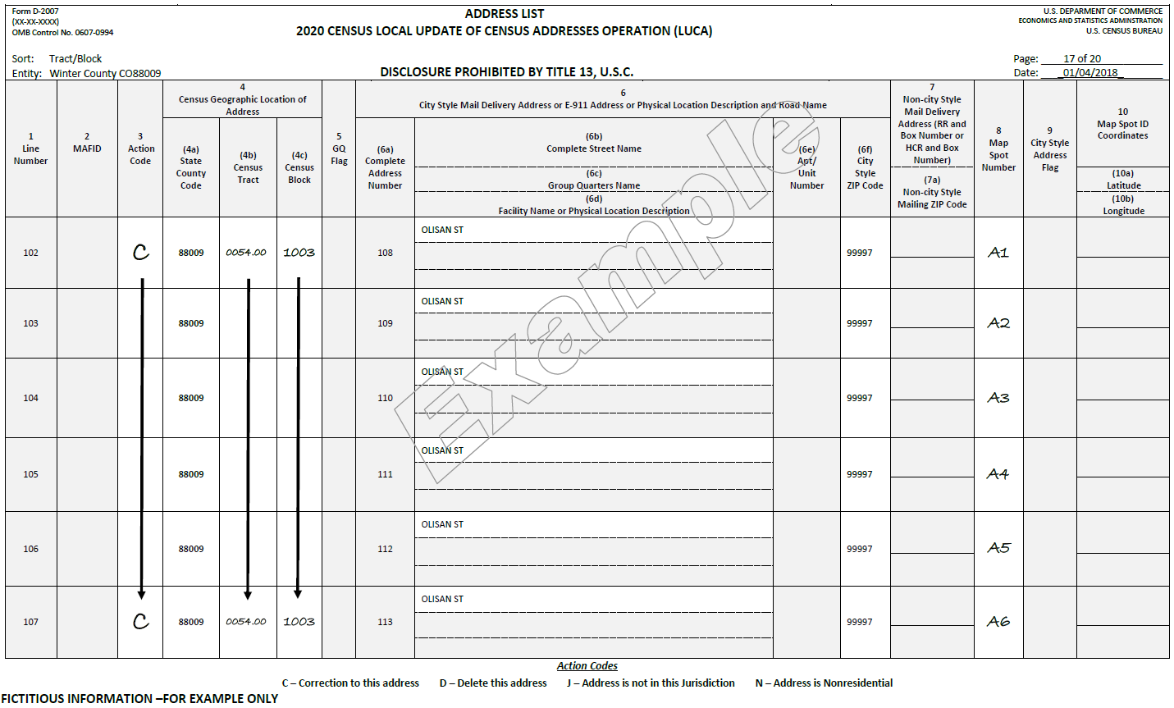
C Action Code – Ungeocoded Addresses
**No Title 13 Data Displayed**
Notes:
In this example, the Address List for Winter County contains several new city style addresses that are ungeocoded, i.e., missing geocodes.
Print a “C” in the Action Code (3) column for the first and last addresses that need geocodes added.
Arrow down from the first entry to the last entry.
Print the census tract number in the Census Tract (4b) column and the census block number in the Census Block (4c) column and arrow down in each column from the first entry to the last entry. Participants determine the correct tract and block information by utilizing the large format maps or the PDF small format block maps.
Optional: If you know the approximate location of each address, assign a unique Map Spot Number in column 8 and place corresponding map spots on the appropriate PDF small format parent sheet or inset sheet. This example shows map spot numbers A1 – A6.

Slide 105
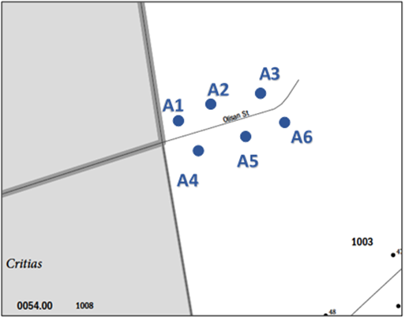
Map: C Action Code – Ungeocoded Addresses
**No Title 13 Data Displayed**
Optional: Include unique map spot for each ungeocoded address geocoded during LUCA review
Label each map spot to match corresponding code within column 8 on the address list
Can be shown on PDF Small Format Block Map Parent sheet or Inset sheet (if available)
Notes:
Locate the appropriate PDF small format block map (block 1003 in tract 54). You do not need to print another copy of this block map, make this update on the same printed copy for the deletion of S Holdener Street from the “correcting block geocode” example. Since these addresses along Olisan Street were included on the address list and were geocoded, include the approximate location by drawing the map spots and using the unique Map Spot Number from column 8. Include the map spots on either the PDF small format parent sheet or inset sheet (if available).

Slide 106
D – Action Code
Use a “D” Action Code for the following situations:
  Residential address no longer exists, is uninhabitable, or is a duplicate
  Street, or section of street, no longer exists (& addresses along street no longer exist)
  Incorrect house number or Incorrect apartment/unit number
  Housing Unit, Multiunit or Group Quarters Conversions:
    Housing unit converted to a multiunit structure or group quarters
    Multiunit structure converted to a housing unit or group quarters
    Group quarters converted to a housing unit or multiunit structure
Use the Address List Add Page (D-2008) to add corrected addresses deleted from the Address List
Do not make corrections to any other columns
Notes:
The “D” action code is used on the census address list to flag residential address records that no longer exist, are uninhabitable or are duplicates. The “D” action code is also used to flag residential addresses along streets that no longer exist, as well as to flag records with incorrect house numbers or apartment/unit numbers. The “D” action code is used in instances of residential address conversion (e.g., housing units converted to multiunit structure or group quarters; multiunit structure converted to a housing unit or group quarters; group quarters converted to a housing unit or multiunit structure).
In the cases of incorrect house number, apartment numbers and conversions, participants use the paper Address List Add Page (D-2008) to add the corrected addresses that correspond to the records marked for deletion. The Census Bureau terms this type of update a “delete/add” action combination.
Besides updating column 3 with the “D” action code, participants must not make any additional corrections for these records on the address list.
The presentation includes three examples of proper use of the “D” action code, all three bolded on the slide.
Deletion of address records along portion of street that no longer exists
Deletion of records with an incorrect house number and the corresponding “Add” action
Deletion of housing unit converted to multiunit structure and the corresponding “Add” action

Slide 107

D Action Code – Deleting Addresses
**No Title 13 Data Displayed**
Notes:
In this example, a section of S Holdener Street in census block 1003 no longer exists and the four housing units along this section were demolished.
Print a “D” in the Action Code (3) column for the first and last addresses that need deleted. Arrow down from the first entry to the last entry. If these addresses spanned more than one page, participants should repeat this procedure for all the Address List sheets containing the addresses that need deleted. No other action is necessary for these four records.

Slide 108

Map: D Action Code – Deleting Section of Street
**No Title 13 Data Displayed**
Use colored pencil to “X” out section of street to delete
Use double hatch marks to define extent of deletion
No need to “X” out the map spots; they are marked for deletion on the Address List
Notes:
To complete the deletion marked on the address list, use a colored pencil to “X” out the section of S Holdener Street to delete. Use the double hatch marks to define the extent of deletion, since the entire street is not deleted in this example. There is no need to “X” out the map spots because the corresponding address records are marked for deletion on the Address List.

Slide 109

D Action Code – Deleting Incorrect House Numbers
**No Title 13 Data Displayed**
Notes:
In this example, a review of the address list uncovers an error with the house numbers on Ionia Avenue. They are four digit and not three digit. All other fields of information for these records is correct. Since participants are not permitted to edit the house number field, these addresses must be deleted and the correct records must be added using the Address List Add Page.
Print a “D” in the Action Code (3) column for the first and last incorrect house number addresses that need deleted. Arrow down from the first entry to the last entry. Repeat this procedure for all the Address List sheets containing the incorrect house numbers that need deleted. Make no further update to these records on the address list.

Slide 110

Address List Add Page – Correct House Numbers
**No Title 13 Data Displayed**
Notes:
To complete the corresponding add action for the deleted records on the Ionia Avenue, enter the appropriate heading information including entity name, entity ID code, page number, name of the preparer (Preparer required to have signed Confidentiality Agreement Form.), and the date.
Enter the appropriate Line Number in column 1. (If you need multiple pages, begin the first page with 1 and end with 4 in the Line Number column, on the second page begin with 5 and end with 8. Continue adding the line number sequence on each page used for the LUCA operation.)
Enter the information in section 2, Census Geographic Location of Address, including the State County Code (2a) number, Census Tract Number (2b), and Census Block Number (2c). Locate this information on either the large format maps or the PDF small format block maps. If there are multiple entries, print the information in the first and last lines needed. Arrow down from the first entry to the last entry.
Enter the correct house number for each address in the Complete Address Number (4a) column.
Enter the street name in the Complete Street Name (4b) column in the first and last lines needed.
Arrow down from the first entry to the last entry.
Enter the Mailing ZIP Code (4g) in the first and last lines needed and arrow down from the first entry to the last entry.
Though optional, if the location of the map spots for these records is correct, the map spot information from the census address list column 8 can be copied over to the Unique Map Spot (5) for each respective address. This example omits that information.
Enter the Address Use (6) only if known. Use “M” for mailing, “L” for location, or “B” for both. You may enter the address use in the first and last lines needed and arrow down from the first entry to the last entry if the address use is the same for all the addresses added.
Repeat this procedure for all the Address List Add Page sheets necessary to complete the “Add” action.

Slide 111

D Action Code – Deleting Incorrect Apartment Numbers
**No Title 13 Data Displayed**
Notes:
In this example, the units at 3567 Achilles Drive are incorrect as listed on the census address list. Because participants cannot edit the apartment/unit information field on the address list, they must delete the incorrect records and add the correct records on an Address List Add Page.
Print a “D” in the Action Code (3) column for the first and last addresses that need correction. Arrow down from the first entry to the last entry. Repeat this procedure for all the Address List sheets containing the addresses that need correction. Complete the corresponding Add action as shown on the next slide.

Slide 112

Address List Add Page – Correct Apartment Numbers
**No Title 13 Data Displayed**
Notes:
To add the corrected apartment or unit numbers to the Address List Add Page, enter the appropriate heading information including your entity name, entity ID code, page number, name of the preparer (Preparer required to have signed Confidentiality Agreement Form.), and the date.
Enter the appropriate Line Number in column 1. (If you need multiple pages, begin the first page with 1 and end with 4 in the Line Number column, on the second page begin with 5 and end with 8. Continue adding the line number sequence on each page.)
Enter the information in section 2, Census Geographic Location of Address, including the State County Code (2a) number, Census Tract Number (2b), and Census Block Number (2c). Locate this information on the large format maps or PDF small format block maps. If there are multiple entries, print the information in the first and last lines needed and arrow down from the first entry to the last entry.
Enter the house number in the Complete Address Number (4a) column in the first and last lines needed.
Arrow down from the first entry to the last entry.
Enter the street name in the Complete Street Name (4b) column in the first and last lines needed.
Arrow down from the first entry to the last entry.
Enter the correct apartment or unit number for each address in the Apt/Unit Number (4f) column.
Enter the Mailing ZIP Code (4g) in the first and last lines needed.
Arrow down from the first entry to the last entry.
Though optional, if the location of the map spots for these records is correct, the map spot information from the census address list column 8 can be copied over to the Unique Map Spot (5) for each respective address. This example omits that information.
Enter the Address Use (6) only if known. Use “M” for mailing, “L” for location, or “B” for both. You may print the address use in the first and last lines needed and arrow down if the address use is the same.
Repeat this procedure for all the Address List Add Page sheets necessary to complete the “Add” action.

Slide 113

D Action Code – Deleting Housing Unit Converted to Multiunit Structure
**No Title 13 Data Displayed**
Notes:
In this example, the single housing unit at 105 Minoan Pkwy recently converted to a multiunit structure containing two apartments, apartments 105 A and 105 B, respectively. To properly complete the update, participants must delete the one record and add the two records to an Address List Add Page.
To complete this update, print a “D” in the Action Code (3) column for the converted housing unit address, 105 Minoan Pkwy. Do not make any additional updates to this address record.

Slide 114

Address List Add Page – Correct Multiunit Structure
**No Title 13 Data Displayed**
Notes:
To add the two new corresponding records to the Address List Add Page, enter the appropriate heading information including your entity name, entity ID code, page number, name of the preparer (Preparer required to have signed Confidentiality Agreement Form.), and the date.
Enter the appropriate Line Number in column 1. (If you need multiple pages, begin the first page with 1 and end with 4 in the Line Number column, on the second page begin with 5 and end with 8. Continue adding the line number sequence on each page.)
Enter the information in section 2, Census Geographic Location of Address, including the State County Code (2a) number, Census Tract Number (2b), and Census Block Number (2c). Locate this information on the large format maps or PDF small format block maps. If there are multiple entries, print the information in the first and last lines needed and arrow down from the first entry to the last entry.
Enter the house number for each address in the Complete Address Number (4a) column.
Enter the street name in the Complete Street Name (4b) column in the first and last lines needed.
Arrow down from the first entry to the last entry.
Enter the correct apartment or unit number for each unit in the Apt/Unit Number (4f) column.
Enter the Mailing ZIP Code (4g) in the first and last lines needed.
Arrow down from the first entry to the last entry.
Enter the Address Use (6) only if known. Use “M” for mailing, “L” for location, or “B” for both. You may print the address use in the first and last lines needed and arrow down if the address use is the same.
Repeat this procedure for all the Address List Add Page sheets necessary to complete the “Add” action.

Slide 115

D Action Code – Deleting Non-city Style Address
**No Title 13 Data Displayed**
Notes:
Non-city style addresses may be included on the census address list and may require correction. To update a physical location description and map spot address participants need to delete the address on the Address List and add the updated address to the Address List Add Page.
In addition to the required state and county codes, and census tract and block codes, participants must provide a well-defined description of the non city style address location. If the location is the same, enter the map spot number from the Address List to the Address List Add Page, column 5, Unique Map Spot Number.
In this example, a section north of Aca Street in census tract 0054.00, block 1000 developed over the last several years. The tan trailer identified by map spot number 1 in column 8, no longer exists but was replaced with a brown tutor style house with beige trim and an attached two-car garage.
Print a “D” in the Action Code (3) column for the location description address that no longer exists. Make no other changes to the address record.

Slide 116

Address List Add Page – Correct Non-city Style Address
**No Title 13 Data Displayed**
Notes:
To complete the “delete/add” action, enter the appropriate heading information including your entity name, entity ID code, page number, name of the preparer (Preparer required to have signed Confidentiality Agreement Form.), and the date on the Address List Add Page.
Enter the appropriate Line Number in column 1. (If you need multiple pages, begin the first page with 1 and end with 4 in the Line Number column, on the second page begin with 5 and end with 8. Continue adding the line number sequence on each page.)
Enter the information in section 2, Census Geographic Location of Address, including the State County Code (2a) number, Census Tract Number (2b), and Census Block Number (2c). Locate this information on the large format maps, PDF small format block maps, or copy from the “delete” record if the geocode information is identical.
Enter the Complete Street Name (4b) for the corrected physical location description address.
Identify the corrected housing unit with a Physical Location Description (4e). Provide a well-defined description.
Enter the Mailing ZIP Code (4g) in the first and last lines for multiple entries, if known.
Enter the Unique Map Spot Number (5) as shown on the Address List, if the location is the same. If different, add a unique map spot number and code it appropriately on the PDF small format block map for block 1000 in tract 54.
Enter the Address Use (6) only if known. Use “M” for mailing, “L” for location, or “B” for both.

Slide 117
J – Action Code
Use a “J” Action Code to flag residential addresses that are not in your jurisdiction
Do not make corrections to any other columns
Use for city style, non-city style and ungeocoded address records
Notes:
Participants use the “J” action code to flag residential addresses that are not in their jurisdiction, meaning the address does not fall within the legal boundary of the jurisdiction. When used, participants must not make any other corrections to the address record. The J action code can be used for city style, non-city style and ungeocoded address records (state and county participants only).

Slide 118

J Action Code – Out of Jurisdiction
**No Title 13 Data Displayed**
Notes:
In this example, two addresses on Pueblo Trail are not within the jurisdiction of Winters County.
Print a “J” in the Action Code, column 3. If there were more than two entries, print the information in the first and last lines needed and arrow down from the first entry to the last entry. Make no other corrections to these two address records.

Slide 119
N – Action Code
Use an “N” Action Code to flag addresses used for purposes other than residential such as:
  Businesses
  Schools
  Churches
  Government offices
Do not make corrections to any other columns
Use for city style, non-city style and ungeocoded address records
Notes:
Use an “N” Action Code to flag addresses that are listed on the Address List, but used for any purpose other than residential such as businesses, schools, churches and government offices.
Before entering an “N” action code, ensure that the structure does not contain a housing unit. Some structures can contain both residential and nonresidential units even though they have a single address such as an apartment over a store or a home with an office.
Do not make corrections to any other columns for nonresidential addresses.
The N action code can be used for city style, non-city style and ungeocoded address records (state and county participants only).

Slide 120

N Action Code – Nonresidential
**No Title 13 Data Displayed**
Notes:
In this example, one address on Cassiopeia Drive is nonresidential. Print an “N” in the Action Code, column 3. Make no other corrections to the address record.

Slide 121
Acceptable Updates & Examples of “City Style Adds”
Address List (D-2007)
  Action Codes
    C – Correction to this address
    D – Delete this address
    J – Address is not in this Jurisdiction
    N – Address is Nonresidential
Address List Add Page (D-2008)
  City Style Addresses
  Non-city Style Addresses
Notes:
The next several examples depict “Add” situations using the Address List Add Page for city style addresses.

Slide 122

Address List Add Page – Housing Unit Addresses
**No Title 13 Data Displayed**
Notes:
For this example, four addresses along a new portion of Olisan Street need to be added to the census address list. In order to add addresses, participants use the Address List Add Page.
Enter the appropriate heading information including your entity name, entity ID code, page number, name of the preparer (Preparer required to have signed Confidentiality Agreement Form.), and the date.
Enter the appropriate Line Number in column 1. (If you need multiple pages, begin the first page with 1 and end with 4 in the Line Number column, on the second page begin with 5 and end with 8. Continue adding the line number sequence on each page.)
Enter the information in section 2, Census Geographic Location of Address, including the State County Code (2a) number, Census Tract Number (2b), and Census Block Number (2c). ). Locate this information on the large format maps or PDF small format block maps. If there are multiple entries, print the information in the first and last lines needed and arrow down from the first entry to the last entry.
Enter each individual house number in the Complete Address Number (4a) column.
Enter the Complete Street Name (4b) in the first and last lines needed and arrow down from the first entry to the last entry.
Enter the Mailing ZIP Code (4g) in the first and last lines needed and arrow down from the first entry to the last entry.
If you know the approximate location of each housing unit you are adding, you may assign each individual address a Unique Map Spot Number (5) such as A1, A2, A3, etc. Each map spot number must correspond to the address’s location if you are using the PDF small format block maps.
Enter the Address Use (6) only if known. Use “M” for mailing, “L” for location, or “B” for both. You may print the address use in the first and last lines needed and arrow down if the address use is the same.
Repeat this procedure for all the Address List Add Page sheets needed.

Slide 123

Map Update – Housing Unit Addresses
**No Title 13 Data Displayed**
Optional: Include approximate location of each “Added” housing unit
Label each map spot with corresponding Unique Map Spot Number from Address List Add Page column 5
Example shows address ranges and address breaks as well
Notes:
Though optional, to complete the “Add” shown in the previous slide example, after drawing the street, include the map spots and corresponding unique map spot numbers from the Address List Add Page. This example also shows the inclusion of address ranges and address breaks along Nale Place and Larme Avenue

Slide 124

Address List Add Page – Multiunit Structure Addresses
**No Title 13 Data Displayed**
Notes:
In this example, a new two-story multiunit building at 2014 Maople Rd contains four apartments, two on the first floor and two on the second floor, in block 1002 of tract 54 that are not listed on the Address List.
Enter the appropriate heading information including your entity name, entity ID code, page number, name of the preparer (Preparer required to have signed Confidentiality Agreement Form.), and the date.
Enter the appropriate Line Number in column 1. (If you need multiple pages, begin the first page with 1 and end with 4 in the Line Number column, on the second page begin with 5 and end with 8. Continue adding the line number sequence on each page.)
Enter the information in section 2, Census Geographic Location of Address, including the State County Code (2a) number, Census Tract Number (2b), and Census Block Number (2c). ). Locate this information on the large format maps or PDF small format block maps. Enter the same information in the last line and arrow down.
Enter the house number in the first and last line needed in the Complete Address Number (4a) column and arrow down.
Enter the street name in the first and last lines needed in the Complete Street Name 4b) and arrow down.
Enter the Apt/Unit Number (4f) for each apartment or unit.
Note: You must provide unit the actual identifiers (e.g. Apt 1, Apt 2, Unit A, Unit B) for multiunit buildings. Ensure that all your apartment buildings, especially small multiunit buildings (3-4 units), such as large houses subdivided into apartments, have a separate address line for each unit that includes the basic street address and the individual unit designation.
Enter the Mailing ZIP Code (4g) in the first and last lines needed and arrow down.
Enter the Unique Map Spot Number (5)—Optional, if the approximate location is known. If you include a unique map spot number on the Address List Add Page, identify the map spot location on the PDF small format block map. In this example, all four units are in the same building, so they receive the same map spot number. Map spots are not required for adding any records, other than non-city style addresses that are shown in an upcoming example.
Enter the Address Use (6) only if known. Use “M” for mailing, “L” for location, or “B” for both. You may enter the address use in the first and last lines needed and arrow down from the first entry to the last entry if the address use is the same for all the addresses added.
On the next page of the Address List Add Page, repeat the instructions until all of the buildings and their individual units are added.

Slide 125

Map Update – Multiunit Structure Addresses
**No Title 13 Data Displayed**
Optional: If you know the approximate location of new apartment building, you may assign each individual address located within the building the same unique map spot number (e.g., A1)
Notes:
Because the four units in the one new multiunit structure are in the same building, they are assigned the same map spot number on the Address List Add Page and only one map spot is added to the PDF small format block map for the four units. This example reflects the update for block 1002 in tract 54.

Slide 126

Address List Add Page – Group Quarters with Units
**No Title 13 Data Displayed**
Notes:
For this example, Aristotle University constructed three new residence halls, Pandora Hall, Buildings 1, 2, and 3 at 225 Achilles Drive. This visual shows only one page of four units for Building 1. Participants with a similar scenario complete the necessary number of Address List Add Pages to add all of the units for each of the three buildings.
Enter the appropriate heading information including your entity name, entity ID code, page number, name of the preparer (Preparer required to have signed Confidentiality Agreement Form.), and the date.
Enter the appropriate Line Number in column 1. (If you need multiple pages, begin the first page with 1 and end with 4 in the Line Number column, on the second page begin with 5 and end with 8. Continue adding the line number sequence on each page.)
Enter the information in section 2, Census Geographic Location of Address, including the State County Code (2a) number, Census Tract Number (2b), and Census Block Number (2c). Locate this information on the large format maps or PDF small format block maps. If there are multiple entries, print the information in the first and last lines needed and arrow down from the first entry to the last entry.
Enter a “Y” in column 3, Enter “Y” if this is a Group Quarters, to flag that this is a group quarters.
Enter the address number, 225 in column 4a, Complete Address Number, in the first and last lines needed and arrow down.
Enter the street name, Achilles Drive, in column 4b, Complete Street Name. Enter the name of the group quarters in column 4d, Group Quarters Name. In this example, Pandora Hall and the building number.
Enter the Facility Name in column 4e, if the group quarters is associated with a facility. In this example, the facility is Aristotle University. After entering the information in sections 4b, 4d, and 4e, re-enter the same information in the last lines needed and arrow down.
Note: If you enter a “Y” in column 3, you must provide a group quarters name (column 4c) and a facility name (column 4d) if the group quarters are associated with a facility (e.g. Group Quarters Name – Pandora Hall; Facility Name – Aristotle University). The Census Bureau will not process an identified group quarters address record without a group quarters name.
Enter the individual unit numbers in column 4f, Apt/Unit Number. Continue to add all of the individual units for each building. Do not arrow down in column 4f, Apt/Unit Number, since you must enter each individual unit number.
Enter the Mailing ZIP Code (4g) in the first and last lines needed and arrow down.
Though this example does not show inclusion of the Unique Map Spot Number (5), participants would only have three new map spot numbers for this example. Similar to the previous example with multiunit structures, one map spot number is assigned for each building and the individual units within each building receive the appropriate building’s map spot number.
Enter the Address Use (6) only if known. Use “M” for mailing, “L” for location, or “B” for both. You may enter the address use in the first and last lines needed and arrow down from the first entry to the last entry if the address use is the same for all the addresses added.
On the next page of the Address List Add Page, repeat the instructions until all of the individual units are added for each of the three buildings.
Since the action is identical to adding the multiunit structure address from the previous example, no map update slide accompanies this Group Quarters example.

Slide 127
Acceptable Updates & Examples of “Non-city Style Adds”
Address List (D-2007)
  Action Codes
    C – Correction to this address
    D – Delete this address
    J – Address is not in this Jurisdiction
    N – Address is Nonresidential
Address List Add Page (D-2008)
  City Style Addresses
  Non-city Style Addresses
Notes:
The next several examples depict “Add” situations using the Address List Add Page for non-city style addresses.

Slide 128
Non-city Style Addresses
No House number/Street name OR Incomplete House/Street
Physical Location Description with Map Spot
Rural Route and Box Numbers
Highway Contract Route and Box Numbers
PO Box and General Delivery not acceptable
Must provide well-defined description of the location and identify the approximate location on the PDF small format block map
Notes:
The Census Bureau classifies addresses that do not include a house number and/or a street name as non-city style addresses. Non-city style addresses also may include an incomplete house number or street name address. Frequently used non-city style mailing addresses that are included on the Census Bureau’s Address List are:
Physical location description.
Rural route and box number.
Highway contract route and box number.
Non-city style addresses often do not follow any numeric sequence and may not be associated with the name of the street or highway on which they are located. For this reason, the Census Bureau uses different methods to compile the list of addresses for inclusion into the address list, such as a physical location description (BRICK HSE w/ATTACHED GARAGE ON RIGHT), structure points (geographic coordinates), and census geographic codes (state code, county code, census tract number, census block number).
Rural routes and highway contract routes are mailbox delivery routes served by rural carriers to deliver and collect mail from roadside mailboxes. In addition to the route and box numbers, these addresses may also include a complete address number, complete street name, and location description, or any combination used for emergency location services, such as police, fire, and rescue (E-911 addresses). In some instances, the complete address number and box number are identical. In other instances, the rural or highway contract route and box number and the complete address number are different.
Since PO Box numbers and general delivery addresses are mailing addresses only and not associated with a housing unit or housing unit location, the Census Bureau cannot accept them through the LUCA operation.
In addition to the required state and county codes, and census tract and block codes, for participants to successfully add non-city style addresses in 2020 LUCA, participants must provide a well-defined description of the address location and identify the approximate location on the appropriate PDF small format block map.

Slide 129

Address List Add Page – Physical Location Description
**No Title 13 Data Displayed**
Notes:
In this example an area north of Aca Street includes three new housing units. The physical location descriptions and their identifying map spots are missing from the Address List and map.
Enter the appropriate heading information including your entity name, entity ID code, page number, name of the preparer (Preparer required to have signed Confidentiality Agreement Form.), and the date.
Enter the appropriate Line Number in column 1. (If you need multiple pages, begin the first page with 1 and end with 4 in the Line Number column, on the second page begin with 5 and end with 8. Continue adding the line number sequence on each page.)
Enter the information in section 2, Census Geographic Location of Address, including the State County Code (2a) number, Census Tract Number (2b), and Census Block Number (2c). Locate this information on the large format maps or PDF small format maps. If there are multiple entries, print the information in the first and last lines needed and arrow down from the first entry to the last entry.
Enter the Complete Street Name (4b) for each new location description address.
Identify each new housing unit with a Physical Location Description (4e). Provide a well-defined description.
Enter the Mailing ZIP Code (4g) in the first and last lines, if known.
Arrow down from the first entry to the last entry.
Enter a Unique Map Spot Number in column 5 for each new location description address. This information is required for adding non-city style addresses. Use the appropriate PDF small format map product to correlate the map spot numbers.
Enter the Address Use (6) only if known. Use “M” for mailing, “L” for location, or “B” for both.

Slide 130

Map Update – Physical Location Description
**No Title 13 Data Displayed**
Required to provide approximate location of each non-city style address added
Label each map spot with its associated unique Map Spot Number as you recorded in column 5 on the Address List Add Page beginning with A1, A2, A3, etc.
Notes:
The Census Bureau requires the inclusion of map spots with non-city style record adds or updates. Locate the appropriate PDF small format block map, in this case, block 1000 in tract 54. After adding the map spot, label each with its associated Unique Map Spot Number as recorded in column 5 on the Address List Add page, beginning with A1, A2, A3, etc.

Slide 131

Address List Add Page – Rural Route and Box Number
**No Title 13 Data Displayed**
Notes:
For this example, all of the mailing addresses in Winter County are rural route and box number. Several addresses along Olympus Hwy in tract 0046.00, block 2000, are missing on the Address List.
Enter the appropriate heading information including your entity name, entity ID code, page number, name of the preparer (Preparer required to have signed Confidentiality Agreement Form.), and the date.
Enter the appropriate Line Number in column 1. (If you need multiple pages, begin the first page with 1 and end with 4 in the Line Number column, on the second page begin with 5 and end with 8. Continue adding the line number sequence on each page.)
Enter the information in section 2, Census Geographic Location of Address, including the State County Code (2a) number, Census Tract Number (2b), and Census Block Number (2c). Locate this information on the large format maps or PDF small format maps. If there are multiple entries, print the information in the first and last lines needed and arrow down from the first entry to the last entry.
Enter the RR or HCR and Box Number (4c) for each address.
Enter the Mailing ZIP Code (4g) in the first and last lines, if known. Arrow down from the first entry to the last entry.
Enter a Unique Map Spot Number in column 5 for each new location description address. This information is required for adding non-city style addresses. Use the appropriate PDF small format map product to correlate the map spot numbers.
Enter the Address Use (6) only if known. Use “M” for mailing, “L” for location, or “B” for both. In this example, since the addresses are Rural Route and Box Number, they are for mailing “M.”

Slide 132

Map Update – Rural Route and Box Number
**No Title 13 Data Displayed**
Required to provide approximate location of each non-city style address added
Label each map spot with its associated unique Map Spot Number as you recorded in column 5 on the Address List Add Page beginning with A1, A2, A3, A4, etc.
Notes:
As with the physical location description example, this example of adding rural route, box number addresses also requires the inclusion of map spots. Locate the appropriate PDF small format block map, in this case, block 2000 in tract 46. After adding the map spot, label each with its associated Unique Map Spot Number as recorded in column 5 on the Address List Add page, beginning with A1, A2, A3, A4, etc.

Slide 133
Digital Address List
Acceptable Updates
Notes:
Welcome to the 2020 Census LUCA operation training that covers acceptable updates for digital address list and digital map participants. This presentation provides instructions and examples for making proper updates to both the digital address and digital map materials.
The Census Bureau expects to post this presentation on the LUCA web site, so participants can review them again prior to materials receipt in early 2018.

Slide 134
Agenda
Digital Address List and Digital Map Updates
Digital Address List Action Code Updates
Address List Add Updates
Digital Map Updates
Ungeocoded Addresses
Non-City Style Addresses
Notes:
This presentation identifies the intended audience for this presentation. It discusses Title 13 U.S.C. and provides a materials refresher to reintroduce the specific materials for this product preference. It defines acceptable updates, provides several examples of each, and a summary of the process. It reinforces the ways to receive support and assistance during the LUCA operation and mentions ways to stay connected to the Census Bureau through several social media sources as well as Census Bureau subscriptions.
For more detailed information and instruction, refer to the Respondent Guide that accompanies the materials and to upcoming presentations that discuss review, update and submission details.

Slide 135
Acceptable Updates and Examples
Address List action codes (ACTION):
  A – Add this address.
  C – Correct this address.
  D – Delete this address.
  J – Address is not in this jurisdiction.
  N – Address is nonresidential.
Edges shapefile change type codes (CHNG_TYPE):
  AL – Add Line.
  DL – Delete Line.
  CA – Change Attribute.
Notes:
We are entering the section of the presentation that deals with specific examples for updating the LUCA materials. Please remember, LUCA is an address-focused operation. Some map updates intertwine with some of the examples, but the focus of this section of the presentation details permissible actions that can occur to the address list.
There are five acceptable action codes used to edit the census address list, A, C, D, J, and N. Participants enter the action codes into the ACTION field. All five action codes may be used with city style addresses (e.g., 1000 Main St), non-city style addresses (e.g., RR 3 Box 34) and ungeocoded addresses. There are three acceptable change type codes used to edit the edges shapefile, AL, DL, and CA. Each updated road feature in the edges shapefile must contain one of the change type codes in the CHNG_TYPE field.
For the training examples, city style addresses are the focus, but an example of a non-city style address is included within the A action code section. As work begins on address list updates, the Census Bureau encourages participants to save their work often to preserve changes. Saving often ensures work is not lost. Keeping an original in a secure location also ensures the recreation of updates if something necessary. Lastly, please use caution when re-sorting the address list. Capture all 24 fields within the address list before re-sorting the list. Accidentally not capturing all of the fields during a sort action will jumble the records, thereby corrupting the information

Slide 136

“A” Action Code – Address List:
City Style Addresses – HUs
**No Title 13 Data Displayed**
Notes:
Participants use the “A” action code to add residential addresses that are new or missing from address list. The “A” action code updates may result in updates to the edges shapefile, usually the “AL” change type.
During a participant’s review, they may find addresses missing from the census address list located on streets that are partially or entirely missing from the maps. For this example, a participant discovers addresses along Crystal Avenue, a new street, are missing from the address list. The example depicts adding the addresses to the address list and the road feature to the edges shapefile. This screen is the Excel view for adding the 14 new records on to the address list.
For all of the upcoming address list examples, the bold field headings on the slide indicate required information, while the other highlighted fields represent optional/if known information.
In the census address list, create/insert a new record/row.
Copy the ENTITY code from an existing record in the address list.
Enter an “A” in the ACTION field.
Enter/Copy the required geocode information in the appropriate fields for each new address:
State Code in the STATEFP field (51)
County Code in the COUNTYFP field (610)
Census Tract Number in the TRACT field (5002.00)
Census Block Number in the BLOCK field (1014)
Enter the complete house number in the HOUSENUMBER field.
Enter the complete street name in the STREETNAME field. (Crystal Ave)
If known, enter the ZIP (31402)
If known, enter the address use information, in the USE field: (B)
M—mailing purposes.
L—location purposes, including emergency services.
B—both mailing and location purposes.
If known, enter the structure latitude in the LAT field and the structure longitude in the LONG field.
Leave the MAPSPOT field blank because participants cannot add actual map spots to the shapefiles and because the inclusion of LAT/LONG information is effectively, the map spot coordinate information.
Leave the CITY_STYLE field blank.
Once complete, the address list for this example will contain 14 new housing unit records for Crystal Ave with all appropriate fields entered

Slide 137

“AL” Change Type – Edges Shapefile:
Adding A Street
Notes:
In the edges shapefile, digitize the feature. In the edges attribute table, enter the MTFCC, which is “S1400”, FULLNAME, which is “Crystal Ave”, and CHNG_TYPE, which is “AL”. For this example, there will be a new road added to the attribute table from the digitization of the feature and all fields, except the MTFCC, FULLNAME, and CHNG_TYPE information remain blank.
The image illustrates the newly added street in the edges shapefile and the three fields of required information in the edges shapefile attribute table.

Slide 138

“A” Action Code – Address List:
Non-City Style Addresses – HUs
**No Title 13 Data Displayed**
Notes:
Participants may recall from the LUCA training introduction presentation, the Census Bureau classifies addresses that do not include a house number and/or street name as non-city style addresses. These may also include a complete house number or street name. In addition to the required state and county codes, and census tract and block codes, for participants to successfully add non-city style addresses in 2020 LUCA, participants must provide a well-defined description of the address location and identify the approximate location by providing the latitude and longitude information in the respective fields.
For this example, an area north of Aca Street includes four new housing units. Two records have only location description information, while the other two have rural route and box number information. The street exists correctly in the edge” shapefile, so no updates are required. This screen is the Excel view for adding four records for non-city style addresses.
In the census address list, create/insert four new records/rows.
Copy the ENTITY code from an existing record in the address list.
Enter an “A” in the ACTION field.
Enter/Copy the required geocode information in the appropriate fields for each new address:
State Code in the STATEFP field. (51)
County Code in the COUNTYFP field. (610)
Census Tract Number in the TRACT field. (5002.00)
Census Block Number in the BLOCK field. (1001)
For the records with only a location description, enter the complete street name in the STREETNAME field. (Aca St)
Enter a well-defined location description in the LOCATION DESCRIPTION field.
If known, enter the non-city style mailing ZIP Code in the NONCITYSTYLE ZIP field. (31402)
If known, enter the address use in the USE field: (L for two records and M for two records)
M—mailing purposes.
L—location purposes, including emergency services.
B—both mailing and location purposes.
Enter the structure latitude in the LAT field and the structure longitude in the LONG field.
Leave the MAPSPOT field blank because participants cannot add actual map spots to the shapefiles and because the inclusion of LAT/LONG information is effectively, the map spot coordinate information.
Leave the CITY_STYLE field blank.
For the two rural route records, follow the same instructions as above, but participants do not need to include the street name information or location description. Include the rural route address in the NONCITYSTYLE ADDRESS field. The postal services uses rural route addresses mail purposes, so notice the Use field with “M” instead of “L”.
Once complete, the address list for this example will contain four non-city style address housing unit records with all appropriate fields entered.

Slide 139

“A” Action Code – Address List:
City Style Addresses – GQs
**No Title 13 Data Displayed**
Notes:
The same process explained for adding a housing unit applies to adding group quarters, with a few additional requirements. If participants enter a “Y”, for the Group Quarters Flag (GQ_FLAG) they must provide a group quarters name and a facility name if the group quarters are associated with a facility (e.g., Group Quarters Name – Pandora Hall Bldg 1; Facility Name – Aristotle University). The Census Bureau will not process an added group quarters record without a group quarters name.
This example demonstrates how to add a group quarters address that contains three individual buildings. Aristotle University constructed three new residence halls, Pandora Hall, Buildings 1, 2, and 3 at 225 Achilles Dr. The street already exists and is correct in the TIGER Partnership shapefile, so there is no action required in the edges shapefile.
In the census address list, create/insert three new records/rows for this example for the three new buildings located at 225 Achilles Dr.
Copy the ENTITY code from an existing record in the address list.
Enter an “A” in the ACTION field.
Enter the required geocode information in the appropriate fields for each new address:
State Code in the STATEFP field. (51)
County Code in the COUNTYFP field. (610)
Census Tract Number in the TRACT field. (5001.00)
Census Block Number in the BLOCK field. (1001)
Enter a “Y” in the GQ_FLAG field for each unit added.
Enter the complete house number in the HOUSENUMBER field. (225)
Enter the complete street name in the STREETNAME field. (Achilles Dr)
If known, enter the city style mailing ZIP Code in the ZIP field. (31402)
Enter the Group Quarters name in the GQ Name field. (Pandora Hall Bldg 1)
Enter the Facility Name, if the GQ is associated with a facility. (Aristotle University)
If known, enter the address use in the USE field: (B)
M—mailing purposes.
L—location purposes, including emergency services.
B—both mailing and location purposes.
If known, enter the structure latitude in the LAT field and the structure longitude in the LONG field. For this example, each of buildings will have a unique latitude/longitude value.
Leave the MAPSPOT field blank because participants cannot add actual map spots to the shapefiles and because the inclusion of LAT/LONG information is effectively, the map spot coordinate information.
Leave the CITY_STYLE field blank.
Once complete, the address list for this example will contain three new GQ records Aristotle University with all appropriate fields entered.

Slide 140
“C” – Action Code
Use a “C” action code for the following situations:
  Incorrect state code.
  Incorrect county code.
  Incorrect census tract number.
  Incorrect census block number.
  Incorrect street name (including street directional and street type information).
  Incorrect ZIP code.
  Incorrect latitude and/or longitude values.
  Include tract and block numbers for ungeocoded address records*.
*Ungeocoded address records are missing the tract and block geocode information. These records exist for state and county participants.
Notes:
Participants use the “C” action code to update the census address list in the following situations: to correct incorrect state codes, county codes, census tract numbers, census block numbers, street names (including directional and street type information), ZIP codes, latitude and longitude values. The 2020 LUCA operation allows for update to only these eight fields. The fields corresponding to these bullets are THE ONLY eight fields 2020 LUCA allows for update.
The presentation includes three examples of using the “C” action code, shown in bold on the slide.
Correction of an incorrect census block number.
Correction of an incorrect street name.
Correction to tract and block geocodes for ungeocoded address records.
*Ungeocoded records are missing the tract and block geocode information. These records exist for state and county participants. Though ungeocoded address records can use all action codes, the most informative update for the Census Bureau is inclusion of the tract and block information that provides the necessary geocode information to distribute a questionnaire. This edit corresponds to a “C” action code.

Slide 141

“C” Action Code – Address List:
City Style Address – Correcting Block Number
**No Title 13 Data Displayed**
Notes:
In this before and after example, the digital address list and edges shapefile incorrectly show Court Street located in block 2024 of census tract 5003.00. According to local sources, Court Street is located in the same tract, but across the Brass Alley in block 1036. Participants need to update both the address list and edges shapefile to correct this error.
In the census address list, enter a “C” in the ACTION field for one address located on Court St.
In the BLOCK field for the incorrect record, enter the correct block number, 1036. Do not update the GEOID field; leave it with the original information.
Though shown as updated in this example, it is optional to update the LAT and LONG fields based on the movement of the address from one block to the other. Do not update the MAPSPOT field or remove its information.
Once complete, the address list for this example depicts the “C” ACTION, a change to the BLOCK field, and updated LAT/LONG coordinates.

Slide 142

“DL” and “AL” Change Type - Edges Shapefile:
Correcting Block Number
Notes:
In the edges shapefile, select the incorrectly placed Court Street in tract 5003.00 block 2024.
In the attribute table for the incorrectly placed feature, enter “DL” in the CHNG_TYPE field to show the feature marked for deletion. Do not perform the actual deletion of the feature because that would also delete the attribute record needed to identify all changes to the edges shapefile.
In the edges shapefile, digitize Court Street in its correct location in block 1036, south of Brass Alley.
In the attribute table for the newly digitized record, enter the MTFCC, FULLNAME, and CHNG_TYPE fields, “S1400”, “Court St”, and “AL” respectively.
The image illustrates the correctly placed street in block 1036, the incorrectly placed street in block 2024, and the three fields of required information in the edges shapefile attribute table.

Slide 143

“C” Action Code – Address List:
City Style Addresses – Correcting Street Name
**No Title 13 Data Displayed**
Notes:
In this before and after example, the census address list and edges shapefile incorrectly show Mount Road instead of Mountain Street, the correct street name. Please note, not all of the addresses on Mountain Street are included in this example, just those in block 1010. There are additional corrections for this street in two different blocks (1009 and 2024) based on the imagery in the next slide.
In the census address list, enter a “C” in the ACTION field for all addresses located on Mount Rd.
In the STREETNAME field for those incorrect records, enter the correct name, Mountain St.
Do not make any edits to the other fields.
Once complete, the address list for this example will depict the “C” ACTION and a change to the STREETNAME field.

Slide 144

“CA” Change Type – Edges Shapefile:
Correcting Street Name
Notes:
In the edges shapefile, select all of the segments for the feature in need of correction, in this case Mount Rd.
Edit the FULLNAME field, correcting it from Mount Rd to Mountain St.
Enter “CA” in the CHNG_TYPE field to show a change to the attribution.
The image illustrates the correctly named street (Mountain St), and shows the corrected FULLNAME field and “CA” CHNG_TYPE field in the edges shapefile attribute table.

Slide 145

“C” Action Code – Address List:
City Style Addresses – Correcting Ungeocoded Records
**No Title 13 Data Displayed**
Notes:
The census address list for state and county participants may contain ungeocoded address records. If so, these appear at the end of the address list. Consider reviewing these addresses to determine if they are valid residential addresses. If they are, use the “C” action code and provide the census tract and census block for these records to ensure an accurate enumeration in the correct location.
If participants determine ungeocoded records do not exist, are invalid, are out of the jurisdiction, or are nonresidential, they may mark them according to guidance in upcoming slides for the D, J and N action codes and as described in the Respondent Guide.
In this example, the county address list for Winter County, CO51610, includes several ungeocoded address records. The county participant knows the necessary information to correct the ungeocoded addresses along Oliver Avenue.
In the census address list, enter a “C” in the ACTION field for the records on Oliver Ave.
Enter a “C” in the ACTION field.
Enter the required geocode information in the appropriate fields for each ungeocoded address:
Census Tract Number in the TRACT field. (5003.00)
Census Block Number in the BLOCK field. (1000)
Participants do not have to generate the GEOID value.
If participants know the approximate location of each address, include the latitude and longitude values in the LAT and LONG fields, respectively.
Once complete, the address list for this example will depict the “C” ACTION, inclusion of TRACT and BLOCK numbers, as well as the optional LAT and LONG coordinate data.

Slide 146
“D” – Action Code
Use a “D” action code for the following situations:
  Residential address no longer exists, is uninhabitable, or is a duplicate.
  Street, or section of street, no longer exists (and addresses along street no longer exist).
  Incorrect house number or incorrect apartment/unit number.
  Housing Unit, Multiunit, or Group Quarters Conversions:
    Housing unit converted to a multiunit structure or group quarters.
    Multiunit structure converted to a housing unit or group quarters.
    Group quarters converted to a housing unit or multiunit structure.
Do not modify any other columns.
Notes:
Participants use the “D” action code on the census address list to flag residential address records that no longer exist, are uninhabitable or are duplicates. They may also use the “D” action code to flag residential addresses along streets that no longer exist, as well as to flag records with incorrect house numbers or apartment/unit numbers. In instances of address conversions (e.g., housing units converted to multiunit structure or group quarters; multiunit structure converted to a housing unit or group quarters; group quarters converted to a housing unit or multiunit structure), participants use the “D” action code to delete the converted records.
In the cases of incorrect house number, apartment numbers and conversions, participants must add the corrected addresses that correspond to the records marked for deletion. The Census Bureau terms this type of update a “delete/add” action combination.
Besides updating the “D” in the ACTION field, participants must not make any additional modifications for these records on the address list.
The presentation includes three examples of proper use of the “D” action code, shown in bold on the slide.
Deletion of address records along street that does not exist
Deletion of records with an incorrect apartment/unit number and the corresponding “Add” action
Deletion of housing unit converted to multiunit structure and the corresponding “Add” action

Slide 147

“D” Action Code – Address List:
City Style Addresses – Delete Addresses
**No Title 13 Data Displayed**
Notes:
In this example, the census address list and edges shapefile incorrectly contain Donahue Street. Though planned for creation, construction of the road and houses never occurred. Participants need to update both the address list and edges shapefile to correct this error.
In the census address list, enter a “D” in the ACTION field for the six addresses located on Donahue St. Make no other changes to these records.
Take note the absence of the MAPSPOT or LAT/LONG values. This makes sense because these structures do not exist.
Once complete, the address list for this example will depict the presence of the “D” ACTION.

Slide 148

“DL” Change Type – Edges Shapefile:
Delete A Street
Notes:
In the edges shapefile, select Donahue St.
In the attribute table, enter “DL” in the CHNG_TYPE field to show the feature marked for deletion. Do not perform the actual deletion or that would also delete the attribute record needed to identify all changes to the edges shapefile.
The image illustrates the “DL” CHNG_TYPE field in the edges shapefile attribute table.

Slide 149

“D” and “A” Action Codes – Address List:
City Style Addresses – Incorrect Apartment Unit
**No Title 13 Data Displayed**
Notes:
In this example, the census address list shows incorrect apartment information for the apartments located at 1935 Eggman Rd. Instead of A-D, local sources indicate the apartment units are numbered 101-104. Because participants cannot edit the apartment/unit information field on the address list, they must delete the incorrect records and add the correct records. There is no action required in the shapefile for this example.
As noted earlier, the Census Bureau calls this a “delete/add” action.
In the census address list, enter a “D” in the ACTION field the four addresses on Eggman Rd with the incorrect apartment information. Take no other action on those records.
Next, in the address list, create/insert four new records/rows.
Enter an “A” in the ACTION field for the new records as well as the correct apartment information in the APARTMENT UNIT field.
Assuming no other problems exist with the deleted records, copy and paste or re-enter the information from the following fields of the deleted records: ENTITY, STATEFP, COUNTYFP, TRACT, BLOCK, HOUSENUMBER, STREETNAME, ZIP, MAPSPOT, USE, LAT, and LONG.
DO NOT copy the LINE_NUMBER, MAFID, GEOID or CITY_STYLE fields.
There is no action required in the shapefile for this example.
Once complete, the address list for this example will depict the presence of the “D” ACTION on the four incorrect Eggman Rd records and the “A” ACTION on the four newly added, correct Eggman Rd records. The added records include all of the necessary information for census processing.

Slide 150

“D” and “A” Action Codes – Address List:
City Style Addresses – HU Converted to Multiunit
**No Title 13 Data Displayed**
Notes:
In this example, the census address list shows a single record for a housing unit located at 3501 Leon Road. Local sources indicate this address has converted to a multiunit structure containing four apartments. Instead of a single address for a housing unit, this address now represents a multiunit structure with four individual addresses.
In the census address list, enter a “D” in the ACTION field for the address on Leon Rd. Take no other action on the record.
Next, in the census address list, create/insert four new records/rows.
Enter an “A” in the ACTION field for the new records as well as the correct apartment information in the APARTMENT UNIT field.
Assuming no other problems exist with the deleted records, copy/paste or re-enter the information from the following fields of the deleted records: ENTITY, STATEFP, COUNTYFP, TRACT, BLOCK, HOUSENUMBER, STREETNAME, ZIP, USE, LAT, and LONG.
DO NOT copy the LINE_NUMBER, MAFID or GEOID fields.
There is no action required in the shapefile for this example.
Once complete, the census address list for this example will depict the presence of the “D” ACTION on the one incorrect Leon Rd record and the “A” ACTION on the four newly added Leon Rd records. The added records include all of the necessary information for census processing

Slide 151
“J” – Action Code
Use a “J” action code to flag residential addresses that are not in your jurisdiction.
Use for city style, non-city style, and ungeocoded address records.
Do not make modifications to any other columns.
Notes:
During the review and update strategies presentation, the Census Bureau identified blocks that span jurisdiction boundaries as potential priorities for review. Keep these “boundary” blocks in mind while conducting the LUCA review. Participants may find these errors in blocks that contain road features that split a legal boundary (reservation, county, minor civil division, or place).
Participants use the “J” action code to flag residential addresses that are not in their jurisdiction. By this, the Census Bureau means the address does not fall within the legal boundary of the jurisdiction. Participants may use the “J” action code for city style, non-city style, and ungeocoded address records. When used, participants must not make any other modifications to the address record.
In this example, two residential addresses on Pueblo Trail are not in the participant’s jurisdiction.
In the census address list, enter a “J” in the ACTION field for the two addresses in Pueblo Trail. Take no other action on the record.
Once complete, the census address list for this example will depict the presence of the “J” ACTION on the two, out of jurisdiction, Pueblo Trail addresses.

Slide 152
“N” – Action Code
Use an “N” action code to flag addresses used for purposes other than residential such as:
  Businesses.
  Schools.
  Churches.
  Government offices.
Use for city style, non-city style, and ungeocoded address records.
Do not make modifications to any other columns.
Notes:
The final action code to discuss for participants is the nonresidential, “N”. The next slide provides an example of the proper use of the “N” action code. Like the “J” action code example, there is no corresponding shapefile update for this example.
Use an “N” action code to flag addresses listed on the census address list, but used for any purpose other than residential such as businesses, schools, churches and government offices.
Before entering an “N” in the ACTION field, ensure that the structure does not contain a housing unit. Some structures can contain both residential and nonresidential units even though they have a single address such as an apartment over a store or a home with an office.
Like the other action codes, participants can use the “N” action code for city style, non-city style, and ungeocoded address records. Do not make modifications to any other fields for nonresidential addresses.
For this example, 202 Cassiopeia Drive is a business, not a housing unit or group quarters. Once complete, the census address list for this record will depict the “N” ACTION for the one record on Cassiopeia Drive.

Slide 153

Summary of Address List Updates
Notes:
Only a sample of the updates performed in the previous slides are included in this visual due to readability concerns within PowerPoint. The important point of this partial image and summary is to emphasize the presence of codes in the ACTION field, which leads right into the last presentation regarding preparing the updated file for submission. To prepare for submitting the updated address list records, participants should re-sort the census address list by the ACTION field. This sorting promotes all records with an ACTION present to the top of the census address list for ease of selection and saving into the jurisdiction’s address list submission.

Slide 154

Summary of Edges Shapefile Updates
Notes:
The important point of this slide is to provide a summary visual of the edges shapefile updates. The yellow features represent road features to add, flagged with “AL”. The orange features represented road features with changed attribution, flagged with “CA”. The red features represent road features flagged for deletion, shown in the attribute table as “DL”.

Slide 155

LUCA Update Submissions
Paper and Digital Materials
Notes:
Welcome to the 2020 Census LUCA operation training that discusses submitting updated materials. This is the final presentation in the 2002 LUCA Training series. This presentation focuses on the digital address list, while covering the submission of both the paper and digital map materials.
The Census Bureau expects to post this presentation on LUCA web site, so participants can review them again prior to materials receipt in early 2018.

Slide 156
Agenda
Preparing Updated Materials for Submission.
  Address Materials
    Paper
    Digital
  Map Materials
    Paper
    Digital
  Accompanying paperwork.
Submitting updated materials.
  Shipping Instructions
  Secure Web Incoming Module (SWIM).
Notes:
This presentation covers preparing updated materials, both address and map, for submission to the Census Bureau. It touches briefly on the Next Steps after the successful submission of your updates. Lastly, it reinforces the ways to receive support and assistance during the LUCA operation and mentions ways to stay connected to the Census Bureau through several social media sources as well as Census Bureau subscriptions.
For more detailed information and instruction, refer to the Respondent Guide that accompanies the materials.

Slide 157
Address Materials
Paper
    Sorting and keeping secure.
    Assembling and organizing.
Digital
    Keeping secure.
    Assembling and organizing.
Notes:
This next portion of the presentation discusses preparing the map materials for submission. Specifically related to the paper map participants, upcoming slides discuss sorting, saving, and keeping the materials secure as well as assembling, and organizing materials in preparation for submission. For digital map participants, upcoming slides in this section discuss exporting and saving the updated edges as their own shapefile, provide examples of these steps, and discuss assembling and organizing materials in preparation for submission.

Slide 158
Paper Address List – Sorting and Keeping Secure
Ensure complete with all updates.
Separate updated Address List pages from pages without updates.
Ensure all Address List Add Pages are properly complete.
Make a copy of all updated pages for use during the feedback phase.
All copies are Title 13.
Follow Confidentiality and Security Guidelines for paper materials to ensure original materials and copies are secure and protected.
Notes:
Ensure you have completed your review and all of the updates you wish to submit. Separate the updated address list pages from the pages without updates. Ensure all Address List Add Pages are properly complete with accurate heading information.
Make copies of the updated pages for your records and for use during the feedback phase, scheduled for summer of 2019. Title 13 protects the copies and the original address list provided by the Census Bureau. Participants are required to keep these materials secure throughout the duration of the 2020 LUCA operation by following the instructions in the Confidentiality and Security Guidelines. The LUCA invitation letter included a copy of these guidelines. In addition, these guidelines are in the Respondent Guide that accompanied the materials.

Slide 159
Paper Address List – Assembling and Organizing
Bundle and return only updated pages to Census Bureau.
Organize by Address List pages, then Address List Add Pages.
Ready them for shipment to Census Bureau.
Notes:
Bundle and return only the updated original pages for both the address list and address list add pages to prepare for shipping. Organize the pages, in numeric order, by the updated Address List and then the completed Address List Add Pages. Ready the bundled, organized materials for shipment to the Census Bureau. If no map updates accompany the submission, skip to slide 14, otherwise the next seven slides discuss preparing updated map materials for submission.

Slide 160
Digital Address Materials – Sorting and Saving
Ensure complete with all updates.
Re-sort address list by ACTION field.
Save only records with entry in ACTION field to new file.
Name the new file “luca20_<EntityID>_changes_addresses.xxx” (where EntityID is entity identification code from LUCA materials and xxx is the file extension .csv, .txt, .xls, or .xlsx).
Save to location for easy retrieval for submission and next steps.
Notes:
Ensure you have completed your review and all of the updates you wish to submit. Re-sort the address list by the ACTION field. This promotes all of the address records in the digital address list with an action code to the top of the address list. These are your updated address records. The Census Bureau only wants the updated records returned for processing. Select and save the address records with an entry in the ACTION field. Name the file “luca20_<EntityID>_changes_addresses.xxx”, where EntityID is the entity identification code from the LUCA materials and the xxx represents the file extension. It could be .csv, .txt, .xls, or .xlsx. Save this newly created file to a location for easy retrieval for submitting.

Slide 161
Digital Address List – Keeping Secure
Make copy of new file for use during the feedback phase.
All address list materials (original and copy) are Title 13.
Keep secure according to Confidentiality and Security Guidelines (D-2004), Appendix A in LUCA Respondent Guide.
Notes:
Make a copy of the new file for your records and for use during the feedback phase, scheduled for summer of 2019. Title 13 protects this copy and the original address list provided by the Census Bureau. Participants are required to keep these materials secure throughout the duration of the 2020 LUCA operation by following the instructions in the Confidentiality and Security Guidelines. The LUCA invitation letter included a copy of these guidelines. In addition, these guidelines are in the Respondent Guide that accompanied the materials as Appendix A.

Slide 162
Digital Address List– Assembling and Organizing
Navigate to directory where “luca20_<EntityID>_changes_addresses.xxx” resides (where EntityID is entity identification code from LUCA materials and xxx is the file extension .csv, .txt, or .xls).
Zip the changes address file, name the zip file “luca20_<EntityID>_changes_addresses_return.zip”.
  Password protection required because Title 13 material.
  Use case sensitive password provided with original materials.
Copy the zip file to CD/DVD if shipping submission with paper map materials, or stage the zip file for submission via Census Bureau’s secure online web application.
Notes:
Navigate to the directory where the address list changes file, “luca20_<EntityID>_changes_addresses.xxx”, is located.
Zip the file and name it luca20_<EntityID>_changes_addresses_return.zip. It is necessary to password protect the file because it contains Title 13 information. Use the password that accompanied your original materials as the password for the file. If you have misplaced this information, please contact the Census Bureau’s Geographic Programs Support Desk at 1-844-344-0169. Note, there are many different zip software products and all are adequate for this zipping task. Follow the software instructions for proper zipping of the contents.
Copy the zip file to a CD/DVD if you intend to ship your LUCA materials. If you intend to use the Census Bureau’s secure, online web application for posting your files, stage the zip file for that task. Discussion of this online web process is forthcoming.

Slide 163
Map Materials
Paper
    Sorting and keeping secure.
    Assembling and organizing.
Digital
    Exporting updates.
    Saving updates.
    Example
    Assembling and organizing.
Notes:
This next portion of the presentation discusses preparing the map materials for submission. Specifically related to the paper map participants, upcoming slides discuss sorting, saving, and keeping the materials secure as well as assembling, and organizing materials in preparation for submission. For digital map participants, upcoming slides in this section discuss exporting and saving the updated edges as their own shapefile, provide examples of these steps, and discuss assembling and organizing materials in preparation for submission.

Slide 164
Map Materials – Paper:
Sorting and Keeping Secure
Ensure complete with all updates.
Separate updated map sheets.
  Non Title 13 large format maps (“Digital/Paper” product preference).
  Title 13 PDF small format block maps (“Digital/PaperPDF” product preference).
Make copy of updated maps for use during the feedback phase.
Protect materials because Title 13.
Keep originals and copies secure.
Notes:
As with the address list, ensure you have completed your review and all of the map updates you wish to submit.
Separate the updated hardcopy maps from the ones without updates. Though we do not accept many updates to the large format maps, if the Digital/Paper participants make updates that accompany the address material updates, separate the updated large format maps from the ones without updates. For the Digital/PaperPDF participants, separate the updated PDF small format block maps from the ones without updates.
Make a copy of these updated maps for your records and for use during the LUCA feedback phase, tentatively scheduled for summer of 2019.
Protect the hardcopy PDF small format block maps, as they are Title 13 material. Consider treating the edited large format maps with participant added map spots with the same care and protection as the printed PDF small format block maps. Follow the confidentiality and security guidelines for both paper and digital security in order to protect the PDF small format block maps on DVD and the hardcopy large format and PDF small format block maps. Keep the originals and all copies in a secure location.

Slide 165
Map Materials – Paper:
Assembling and Organizing
Bundle and return only updated maps to Census Bureau.
For participants with only large format maps, organize the updated maps numerically, by parent and/or inset sheet.
For participants with both large format maps and PDF small format block maps, organize the updated PDF small format block maps numerically, by tract and block.
  Census does not expect updates to large format maps from these participants; map updates expected on PDF small format block maps.
Notes:
Bundle and return only updated maps to Census Bureau. For the participants that only have the large format maps, organize your updated maps numerically, by Parent sheet and then Inset sheet. For an example: A large format map set contained eight total map sheets, one Index, five Parent sheets and two Inset sheets. The participant made updates to Parent sheet 2 and 4 and Inset A1. Participants should organize their originals by Parent sheets 2 and 4 followed by Inset sheet A1.
For participants with both large format maps and PDF small format block maps, the Census Bureau does not expect to receive large format map updates, but expect to receive updates to the PDF small format block maps. Organize updated PDF small format block maps numerically, by tract and block. This means all block map sheets within each tract should be in numeric order, then all tracts should be in numeric order.
Ready the materials for submission with the paper address materials.

Slide 166

Map Materials – Digital:
Exporting Updates
Ensure complete with all updates.
Select edges with value in CHNG_TYPE field.
Export selected edges into new shapefile.
Notes:
Ensure you have completed your review and all of the updates you wish to submit. Select the edges with an entry in the CHNG_TYPE field. Export the selected edges into a new shapefile by right clicking on the edges layer in the table of contents and select Data, then Export Data as shown in the image to the right. This screenshot example depicts this action using Esri’s ArcMap software.

Slide 167

Map Materials – Digital:
Saving Updates
Ensure “Selected features” in “Export Data” window.
Name new shapefile “luca20_<EntityID>_ln_changes.shp”, where EntityID matches entity identification code in LUCA materials.
Save to location for easy retrieval for submission and next steps.
Notes:
Continuing with the Esri software example, ensure the Selected Features remains in the Export section of the Export Data window. Name the new shapefile “luca20_<EntityID>_ln_changes.shp”, where the EntityID is the entity identification code from the LUCA materials. Save this newly created shapefile to a location for easy retrieval for submission and the next steps in the 2020 LUCA operation. Because the shapefiles do not contain Title 13 information, they do not fall under the same Title 13 restrictions as the digital address materials. Please do protect the file from harm, so that is readily accessible during the feedback phase.
Presenters, please note that the “ln” is for line changes, so that “l” is an “el” and not a capital “eye”.

Slide 168
Map Materials – Digital:
Example – Updated Edges Shapefile
Notes:
The newly exported shapefile only includes the updated edges as shown in this example. This shapefile is your 2020 LUCA digital map submission that accompanies the digital address list submission.
The yellow features represent road features to add, flagged with “AL”. The orange features represented road features with changed attribution, flagged with “CA”. The red features represent road features flagged for deletion, shown in the attribute table as “DL”.

Slide 169

Accompanying Paperwork
D-2011 Inventory Form, paper or digital.
Provide with submission either as hardcopy or zipped on CD/DVD or with SWIM.
Keep copies for your records.
Notes:
Please include the Inventory Form (D-2011) with your submission. A paper form, similar to this image, is included with the original materials. A digital inventory form is included on DVD and available online.
Participants may choose to include the completed paper form with the CD/DVD shipping package, or they may zip the completed digital form into its own zip file, LUCA20_<EntityID>_inventory_return.zip. Include this zip file on the same CD/DVD with the other LUCA submission materials or return it using the SWIM process. More on the SWIM process later in the presentation.
Remember to keep a copy of all accompanying paperwork for your records.

Slide 170
Submitting Updated Materials
Shipping instructions.
  Title 13 details.
Secure Web Incoming Module (SWIM).
  SWIM Introduction.
  Numerous SWIM procedural screens.
Notes:
This slide serves as a transition from discussing preparation of your materials for shipment into the actual instructions for updated materials submission. This section of the presentation covers shipping instructions and instructions for using the Secure Web Incoming Module, also known as SWIM. Numerous screenshots of the SWIM process are included.

Slide 171
Shipping Instructions:
Submissions With Updated Paper Map Materials
Follow procedures for shipping Title 13 materials.
Double wrap Title 13 printed materials (paper maps) using inner/outer envelope (or box/container). Label both sides of inner envelope with “DISCLOSURE PROHIBITED BY Title 13, U.S.C.”.
Place inner envelope into the outer envelope (or box/container).
Include CD/DVD of zipped address list and completed D-2011, either hardcopy or as its own zipped file on same CD/DVD.
Use mailing label included with original materials to ship to National Processing Center in Jeffersonville, IN.
For any shipping uncertainty, consult Respondent Guide or contact Census Bureau.
Notes:
Digital address participants that do not perform any map updates can follow the shipping instructions, beginning on the fourth bullet, on this slide, and disregard reference to the updated map materials.
For digital address list participants that selected paper maps (Digital/Paper or Digital/PaperPDF) that choose to ship their LUCA submission, specific Title 13 protections are required for participants who have paper map updates. Participants must ensure they follow procedures for shipping Title 13 materials as outlined in the Confidentiality and Security Guidelines provided with the registration materials and as Appendix A of the Respondent Guide.
Double wrap the updated Title 13 paper map materials by using an inner and an outer envelope (or container), one within the other. The envelopes/containers should be durable enough to prevent someone from viewing or tampering with the enclosed material.
Label both sides of the inner envelope (or container) with the notice: “DISCLOSURE PROHIBITED BY Title 13, U.S.C.”. Place the inner envelope (or container) into the outer envelope.
Include the CD/DVD of the zipped updated address list in the shipping envelope/container. Include the D-2011 Inventory Form for the Return/Submission of LUCA Updated Materials as a hardcopy or as its own zip file on the same CD/DVD as the address list.
Use the mailing label that accompanied the original materials to return the LUCA submission to the National Processing Center. Consult the 2020 LUCA Respondent Guide for additional information and if any questions arise, please do not hesitate to contact the Census Bureau.

Slide 172
Shipping Instructions:
Submissions With Updated Digital Map Materials
Include CD/DVD of zipped updated address list and zipped updated edges shapefile.
Include completed D-2011, either hardcopy or as its own zipped file on same CD/DVD.
Use mailing label included with original materials to ship to National Processing Center in Jeffersonville, IN.
For any shipping uncertainty, consult Respondent Guide or contact Census Bureau.
Notes:
For digital address participants with digital map materials (Digital/Digital) that choose to ship their LUCA submission, include the CD/DVD of the zipped updated address list and zipped updated edges shapefile in the shipping envelope/container. Include the D-2011 Inventory Form for the Return/Submission of LUCA Updated Materials as a hardcopy or as its own zip file on the same CD/DVD.
Use the mailing label that accompanied the original materials to return the LUCA submission to the National Processing Center. Consult the 2020 LUCA Respondent Guide for additional information and if any questions arise, please do not hesitate to contact the Census Bureau.

Slide 173

Shipping Instructions:
Title 13 Details – Double Wrap Visual
Notes:
This slide depicts an example of the envelopes used for double-wrapping the updated Title 13 LUCA materials. If you do not use the mailing label shipped with your original materials, ship your LUCA submission using a service that provides tracking information, such as U.S. Postal Service trackable delivery, FedEx, United Parcel Service (UPS), or similar service.

Slide 174
SWIM Introduction
Official web portal for uploading materials to Census Bureau.
Used for other programs besides LUCA.
Accounts are people based, not entity based.
12 digit registration token to establish account provided by Census Bureau.
Only accepts .ZIP files.
Size limitation of 250 megabytes.
Notes:
The next section discusses the SWIM process, which permits secure web method of submitting updated LUCA materials. The Census Bureau cannot accept materials by e-mail, nor navigate to your FTP site and download your submission.
Participants may submit their zipped updated materials (address list and/or shapefiles) through the SWIM, the official web portal for uploading partnership materials to the Census Bureau. The Census Bureau utilizes SWIM for other Census partnership programs, so you may already have a SWIM account. SWIM accounts are associated with individuals, not with entities.
If you do not have a SWIM account, use the 12-digit registration token provided to you by the Census Bureau in order to establish an account. SWIM accepts only .zip files and cannot accept zip files over 250 megabytes.

Slide 175


SWIM Account Login and Welcome Screens
<https://respond.census.gov/swim/>
Notes:
If you are a participant in another Census Bureau partnership program and already have a SWIM Account, access SWIM at <https://respond.census.gov/swim/> and enter your e-mail address and SWIM password. Click the Login button. The Welcome screen opens. To begin an upload, click the Start New Upload button. Advance two slides, to slide 24, the SWIM Start New Upload slide.

Slide 176


SWIM Account Registration Screens
Notes:
If you do not yet have a SWIM Account, have the 12-digit registration token provided to you by the Census Bureau ready for your account registration. You can register for a SWIM account by choosing the Register Account button on the main SWIM page. The Account Registration screen opens.
All fields on the Account Registration screen are required. Participants will not be able to move to the next screen until completing all fields. On the Account Registration screen, first, enter the 12-digit token provided by the Census Bureau. Then enter your name, agency, and e-mail in the appropriate fields. Next, create a password. Set up a security question. Click the arrow on the right of the Security Question box, select a question in the drop-down list, and enter an answer in the Answer box.
When you have finished, click the Submit button. A screen (not shown on the slide) opens to confirm that you have successfully registered. On the Confirmation screen, click ‘Login’ in the phrase ‘Go to Login’.

Slide 177

SWIM Start New Upload Screen
Notes:
The “What Census program are you reporting data for?” screen opens. On this screen, click Local Update of Census Addresses (LUCA) radio button, then click the Next button at the bottom of the screen.

Slide 178

SWIM Type of LUCA Entity Screen
Notes:
The “What type of LUCA entity are you reporting for?” screen opens. Click the radio button next to the governmental entity for which you are reporting data, and then click the Next button. Use the EntityID information for your jurisdiction to help choose the proper selection (ST for state, CO for county, PL for place and consolidated city, MC for minor civil division and TR for tribal area).
This example shows selection of the Place radio button. After selecting the Next button, another window opens allowing you to choose your entity name from a group of pull-down menus. These menus differ based upon the entity type chosen. In this case, participants selecting Place must choose the State and then the Place information from that subsequent window (not shown in this example).

Slide 179

SWIM Select a .ZIP to Upload Screen
Notes:
After choosing the Next button, the “Select a .ZIP file to upload” screen opens. To upload a file, click the + Add File button on the screen and then the Next button.

Slide 180

SWIM Choose .ZIP to Upload Screen
Notes:
The File Upload window opens and allows you to navigate on your computer to the .ZIP file’s location.
In this example, choose the luca20_<EntityID>_changes_addresses_return.zip, the luca20_<EntityID>_inventory_return.zip, and the luca20_<EntityID>_ln_changes_return zip to upload. Depending on your map materials, and whether or not you choose to submit the D-2011 through SWIM, the selection of .zip files to upload will vary for participants.

Slide 181

SWIM .ZIP File Upload Status Screen
Notes:
If participants do not select all of the files at once, please choose +Add File until all files you intend to SWIM into the Census Bureau appear ready for upload. It is very important to select and upload all of the files as part of one SWIM action. Once all files are added and ready for upload, the Status section reflects Success. Participants may choose to include a description in the Comments field, otherwise, choose the Next button to upload the files.

Slide 182

SWIM Thank You Confirmation Screen
Notes:
Upon successful upload completion, SWIM returns a Thank You message. Participants can choose the Log Out link to log out of the SWIM session. This completes the SWIM portion of the presentation. Are there any questions before we move into the final section of the presentation?

Slide 183
Next Steps
Notes:
Welcome to the 2020 Census LUCA operation training that discusses submitting updated materials. This is the final presentation in the 2002 LUCA Training series. This presentation focuses on the digital address list, while covering the submission of both the paper and digital map materials.
The Census Bureau expects to post this presentation on LUCA web site, so participants can review them again prior to materials receipt in early 2018.

Slide 184
Next Steps – Census Bureau
Census Bureau processes submission for validation.
Census Bureau ships feedback materials in Summer 2019.
Census Bureau begins outreach to close out LUCA operation.
  Must confirm destruction or return of all Title 13 materials, including originals and copies.
  Must receive signed Destruction or Return of Title 13 Materials Form (D-2012) that includes signatures from liaison and all reviewers.
    Appendix H of 2020 LUCA Respondent Guide.
    Confidentiality and Security Guidelines (D-2004), Appendix A of 2020 LUCA Respondent Guide, outlines approved destruction methods and process for return of materials.
Notes:
Now that we have discussed preparing and submitting your LUCA materials, we should discuss the next steps in the LUCA operation process.
Once the Census Bureau receives your submission, they will process it for validation. After validation concludes in the summer of 2019, the Census Bureau prepares the LUCA feedback materials for shipment soon after.
The Census Bureau begins outreach to close out the LUCA operation and confirm the destruction (preferred method) or return of all Title 13 materials for participants that did not provide a 2020 LUCA submission or for those that indicate they do not wish to receive feedback. The Census Bureau must receive a signed Destruction or Return of Title 13 Materials Form (D-2012) which confirms destruction or return of the Title 13 materials, as required by law. This form was included with the original LUCA materials but is also included in the respondent guide as Appendix H. The Confidentiality and Security Guidelines (D-2004) in Appendix A outlines the process for both the destruction and the return of Title 13 materials.

Slide 185
Next Steps – Participant
Agree with feedback materials, then participation ends.
  Send D-2012 to confirm destruction, or if choose to return materials, do so quickly.
Notify OMB LUCA Appeals office of disagreement with feedback materials.
  Appeals Office works with participant and Census Bureau to resolve disagreement.
  Once appeals process concludes, participants must destroy or return materials and submit signed Destruction or Return of Title 13 Materials Form (D-2012) that includes signatures from liaison and all reviewers.
Filing an appeal is optional.
Notes:
If participants agree with the Census Bureau’s feedback materials, then their LUCA participation ends. Participation concludes by providing the completed D-2012, Destruction or Return of Title 13 Materials Form, discussed on the previous slide as soon as possible to eliminate your entity from Census Bureau follow-up. If the choice is to return the LUCA materials, rather than destroy them, please follow the shipping instructions outlined in the Confidentiality and Security Guidelines to ensure protection of the Title 13 materials.
Notify the LUCA Appeals Office, managed by the Office of Management and Budget (OMB), of disagreement with feedback materials. They will work with participants and the Census Bureau to resolve all disagreements. After a determination to accept or reject disputed addresses by the Appeals Office, the Census Bureau includes address accepted by the Appeals Office into the 2020 Census enumeration universe. Once the appeals process concludes, participants must destroy or return Title 13 materials to the Census Bureau and submit a signed Destruction or Return of Title 13 Materials Form (D-2012) as required by law. Filing an appeal is optional and is not a requirement of the LUCA operation.

Slide 186


Next steps – Destruction or Return of Title 13 Materials Form (D-2012)
Notes:
As mentioned on the previous slide, the D-2012 is part of the closeout process for 2020 LUCA. This form completes necessary paperwork for 2020 LUCA closure and confirms either the destruction or return of all original, and copies, of the LUCA Title 13 materials. The LUCA liaison, all reviewers, and anyone listed on the Confidentiality Agreement Form (D-2005) are required to sign and date this form. The LUCA liaison may sign-out any reviewers that are no longer employed with your jurisdiction. Contact the Census Bureau with any questions regarding the use of this form.

Slide 187
Planned New Construction Program for 2020
Non-Title 13.
Decennial program designed to capture new addresses for housing units that will be habitable on Census Day (April 1, 2020).
Address submissions will require either:
  State/County/Tract/Block Geocodes or
  Latitude/Longitude Coordinates
Available in Self-Response Type of Enumeration areas.
  New addresses in non-Self-Response areas will be captured during field operations.
Tentatively scheduled: Summer 2019.

Slide 188
Geographic Updates
Partnership Software
(GUPS)
Notes:
Welcome to the 2020 Census LUCA Training for Geographic Updates Partnership Software (GUPS) participants. The Census Bureau expects to post this presentation on the LUCA web site, so participants can review them again prior to materials receipt in early 2018.

Slide 189
Agenda
Intended audience.
Introduction to GUPS and Title 13 U.S.C. refresher.
GUPS setup and materials introduction.
GUPS acceptable updates and examples.
GUPS submission.
Notes:
This presentation identifies the intended audience for this presentation, introduces GUPS, and provides a refresher on Title 13. It provides several instructions for GUPS setup and introduces the LUCA materials, as they exist within GUPS. It provides a few examples of acceptable updates and provides instructions for submitting your updated materials. Lastly, it reinforces the ways to receive support and assistance during LUCA and mentions ways to stay connected to the Census Bureau through several social media sources as well as Census Bureau subscriptions.
For detailed information and guidance on using GUPS, please refer to the GUPS Respondent Guide. This presentation provides a high-level overview of GUPS.

Slide 190
What is GUPS
Customized geographic information system (GIS) provided by U.S. Census Bureau.
Based on open-source platform known as QGIS.
Replaces previous software known as MTPS (MAF/TIGER Partnership Software).
Used for other geography programs (i.e., Boundary and Annexation Survey-BAS).
Notes:
GUPS is a customized geographic information system (GIS) provided by the U.S. Census Bureau for use in participating in 2020 LUCA. Based on an open-source platform known as QGIS, GUPS replaces its predecessor, MTPS. It is important to note other geography programs such as the Boundary and Annexation Survey (BAS) use GUPS for their work as well.

Slide 191
Why Use GUPS for 2020 LUCA
Tailored to meet needs of those without extensive GIS experience.
Specifically designed and developed by the Census Bureau for 2020 LUCA use.
Reduces the complexity of LUCA with specific tools, including review and validation tools.
Built-in security considerations.
Standardizes submission process.
However, NOT recommended for entities with more than 300,000 residential addresses.
Notes:
Participants may wonder why they would choose GUPS over another product preference. Tailored to meet the needs of those without extensive GIS experience, GUPS is very user-friendly. The Census Bureau designed and developed this version of GUPS specifically for use with 2020 LUCA. Review and validation tools within GUPS reduce the complexity of LUCA. The built-in security considerations help relieve the concern of Title 13 protection. GUPS standardizes the submission process, making it easier for participants to provide the Census Bureau with valid, quality submissions. Even though entities with more than 300,000 residential addresses can use GUPS, the speed of processing depends upon the power of the host computer and available memory. Entities with greater than 300,000 residential addresses, may encounter difficulties with use.

Slide 192
Security Considerations
Title 13 data is automatically encrypted within GUPS.
  Need the password sent separately by the Census Bureau to the LUCA liaison to access the Title 13 data.
Updated Census Address List files are automatically encrypted by GUPS when exporting for submission.
Notes:
By using GUPS, participants are able to minimize their handling and safekeeping of Title 13 data. The Title 13 data automatically encrypts within the program. Participants use the password provided by the Census Bureau to access the Title 13 data and the updated data encrypts as part of the GUPS export process.

Slide 193

Security Considerations (cont’d):
Automatic time-out
Notes:
The GUPS software has a built-in countdown clock to provide an awareness of unattended Title 13 data. The countdown clock window appears when the user has been inactive for 10 minutes. As a Title 13 security measure, GUPS will automatically save and close if a participant is inactive for 15 minutes. Rather than automatically completing the save action without warning, GUPS includes the countdown timer as a visual to participants to reactivate their GUPS work or close GUPS. The Census Bureau recommends allowing GUPS to proceed with its automatic save and closure process if the timer is below 15 seconds. To begin again, participants restart GUPS and re-enter the encryption key password. An upcoming slide discusses the encryption key window and password requirement.

Slide 194
GUPS Demonstration Video
https://census.webex.com/census/lsr.php?RCID=805ef5d40bb6617ce189d6d10a18ab25
Notes:
At this point in the presentation, this 20-minute GUPS demonstration video allows participants the opportunity to see the software in action, prior to entering the detailed portion of this training.

Slide 195
Delivery of Materials
Three DVDs:
  GUPS installation software.
  Title 13 data.
  Non-Title 13 data.
    Root directory.
      Respondent Guide(s) – digital and GUPS.
      Header text file.
      Inventory form.
      Readmefirst6.txt file.
Notes:
For 2020 LUCA, the Census Bureau delivers the LUCA digital materials used for GUPS on DVD. Due to confidentiality and security requirements of Title 13 data, we cannot make the digital LUCA materials available through download (ftp or internet) or through e-mail.
GUPS participants receive three DVDs, one includes the GUPS installation software, one contains the Title 13 data, and one contains the non-Title 13 data. Because GUPS self installs, GUPS participants must not copy any of the information from the “shape” folders on either DVD to their local system. They must only copy and review the content in the root directory of the non-Title 13 DVD.
The root directory of the non-Title 13 DVD contains five files.
The 2020LUCA_digital_respondent_guide.pdf is the pdf version of the respondent guide for digital address list participants and is included for GUPS participants in case they decide to switch product preferences and use their own GIS for their LUCA work. A paper copy is not provided.
The 2020LUCA_GUPS_respondent guide.pdf is the pdf version of the respondent guide for GUPS participants. A paper copy is not provided.
The 2020LUCA_header_file.txt is a template participants may use to import their local address list into the Census Bureau’s address list layout.
The LUCA20_inventory.pdf is a digital inventory form to use when providing your submission to the Census Bureau. This fillable form can be printed and included with a CD/DVD or zipped into its own .ZIP file for submission on the CD/DVD or through the Census Bureau’s secure online web application. More on the submission process is at the end of this presentation.
The Readmefirst6.txt includes specific instructions for this product preference.

Slide 196

GUPS Installation: Example
(Initial Screen With Data)
**No Title 13 Data Displayed**
Notes:
After data successfully loads, the GUPS screen displays all of the data as shown within this example. There are three separate windows: one for the Map, one for the Census Address List, and one for the Address Count List. Also noted on this image are the Standard toolbar, LUCA toolbar, and User Address List tab. All three windows are moveable, so participants with dual monitors can move the elements around to suit their needs. For instance, they may want to move the Address Count List to the second monitor to make additional room on the main screen for the Census Address List and Map.

Slide 197

Reviewing Records In GUPS:
Sort By – Filter By – Selection Tool
**No Title 13 Data Displayed**
Notes:
When reviewing an address list with a large amount of addresses, it may be simpler to review it in pieces. Using the filters in the Census Address List allows you to remove extraneous addresses from the address list view, allowing you to review only the certain addresses you require for your review.
Sorting the address list view organizes the addresses that may ease viewing and review. Participants may sort by selecting the "Sort By:” button, which provides predefined multi-level sorts, or by clicking the top of a column which provides a simple one column A to Z or Z to A sort. Additionally, the sort functions only perform sorts of those addresses currently appearing in the Census Address List/User Address List window view. In other words, if a participant filters by block to only show TEN addresses, then chooses a sort choice, the sort only applies to the TEN addresses in view.
Use of the Selection Tool isolates addresses after the selection of specific map spots or geography.
All of these functions allows for faster execution of edits in GUPS because of the presence of fewer addresses in the address list view. Using the filter, sort, or selection tool in conjunction with the Address Count List, helps narrow the LUCA review to specific areas. This allows participants to focus on specific addresses or areas as described in the Review and Update Strategies presentation.
This slide provides a visual of the Census Address List window with the Sort By, Filter By, and Selection Tool sections highlighted. It also highlights the Addresses in the List View section that changes based on the sorts, filters, or selection tools applied to the Census Address List. These buttons prepare the Census Address List and User Address List for efficient review by helping to determine a focus for review and potential update.

Slide 198
Validating Records in GUPS
Includes built-in validation tools when editing/adding records.
Recommend executing throughout review and update.
Address Review Tool checks records for valid content and ensures no duplicates.
  If invalid data or duplicates discovered, listed in the Census Address Error List window.
Notes:
GUPS includes built-in validation tools to ensure participant’s LUCA updates meet established criteria for Census Bureau processing. Having validation edits incorporated into GUPS prevents the participant from submitting invalid data as part of their LUCA submission.
While the validations run as part of the submission process at the conclusion of the LUCA review and edit process, the Census Bureau suggests utilizing the validation tools to identify errors early and avoid extensive corrections during the submission process.
The Address Review Tool checks records for valid content and ensures no duplicates exist in the Census Address List. If invalid content or duplicates encountered, the Census Address Error List window lists the erroneous records to repair. The next slide shows examples of both.
Locate more information on the address list layout and validations in an appendix within the GUPS Respondent Guide.

Slide 199
Pop Quiz!
How Well Do You Know LUCA?
Notes:
Welcome to the 2020 Census LUCA Training for Geographic Updates Partnership Software (GUPS) participants. The Census Bureau expects to post this presentation on the LUCA web site, so participants can review them again prior to materials receipt in early 2018.

Slide 200
True or False
Question 1
The Census Bureau does not require individual unit identifiers for multi-unit structures.
False – Multi-unit structures such as apartments, mobile homes, condominiums, etc., DO require individual unit identifiers.
Note: Unit identifiers are not required for individual units within a group quarters, such as individual dorm rooms in a college dorm or room numbers in a nursing home. HOWEVER, you must provide a group quarters name and a facility name if the group quarters are associated with a facility (e.g. Group Quarters Name – Pandora Hall; Facility Name – Aristotle University). The Census Bureau will not process an identified group quarters address record without a group quarters name.

Slide 201
True or False
Question 2
The Census Bureau requires lat/lon or map spots for all non-city style addresses.
True – New for 2020, Participants can submit non-city style addresses as long as they are accompanied by corresponding map spots on paper maps and address lists, or lat/lon coordinates on digital address lists and GUPS.

Slide 202
True or False
Question 3
In LUCA, participant focus should be on making map updates.
False – Focus should be on updating your entity’s address list.

Slide 203
True or False
Question 4
In order to review the digital Address List, you can simply open the file in Excel.
False – It is important to following the proper steps for importing your .csv Address List into Excel. Improper opening of the .csv corrupts the data content of the digital address list.

Slide 204
True or False
Question 5
If the mayor wants to view a map with Census Map Spots or address points, you can show him or her this data.
It depends – Only if he or she has signed the confidentiality agreement.

Slide 205
True or False
Question 6
IT personnel who have access to any Title 13 materials do not need to sign the confidentiality form.
False – Anyone with access to Title 13 materials, their storage or backup must sign the Confidentiality Agreement.

Slide 206
True or False
Question 7
If the house number or apartment unit identifier is wrong on the Address List, it can be changed by using the “C” action code and correcting the house number or apartment number on the address list.
False – In order to correct an incorrect house number and/or apartment unit identifier, a reviewer must use a “Delete/Add” combination. The address must first be deleted from the Address List using a “D” action code, then added to the paper Address Add page or the digital Address List using an “A” action code.

Slide 207
True or False
Question 8
The Census Bureau wants to receive your entire address list as part of your LUCA submission.
False - LUCA is an opportunity for local governments to review and update the Census Bureau’s address list. Your LUCA submission should only include the Census address records you edited, and the additional records that you added to the Census address list.

Slide 208
True or False
Question 9
The Address List is the foundation of an accurate Census.
True - The accuracy and completeness of the Address List is critical to the success of the Census. An accurate Address List leads to an accurate Population Count.

Slide 209
True or False
Question 10
If an address is ungeocoded, it will still be included in Census 2020 enumeration.
False - Ungeocoded addresses will not be included in the address list used for the 2020 Decennial. We cannot count the residents of a living quarters if we cannot geocode the living quarters.

Slide 210
Support and assistance
Visit the 2020 LUCA Web site:
<https://www.census.gov/geo/partnerships/luca.html>
  Frequently Asked Questions document.
Contact us:
  Geographic Programs Support Desk toll-free telephone number: 1-844-344-0169.
  E-mail: <GEO.2020.LUCA@census.gov>
Notes:
As we wrap up the presentation for “Digital/Digital” participants, please be aware additional examples of working with the census address list are included in the Respondent Guide that accompanies the materials. In addition, the Census Bureau wants to ensure all participants are aware of the ways to get support and assistance for the 2020 LUCA operation. Please visit the 2020 LUCA Web site first for information and instructions. A Frequently Asked Questions document serves as a thorough resource because it contains many of the most common questions and answers. If participants cannot find the answers or information they need, they may call the Geographic Programs Support Desk, toll free, at 1-844-344-0169 or e-mail them at GEO.2020.LUCA@census.gov.

