Slide 1
Introduction to fracking and implications for Northwest GA
Maddie Bess, Berry College Geology student and Synovus Scholar
Advised by Dr. Tamie J Jovanelly, associate professor of geology

Slide 2
A Northwest Georgia Primer
What is fracking?
What are the implications of fracking, both benefits and costs?
Goal; to make informed decisions concerning drilling on properties and in communities

Slide 3
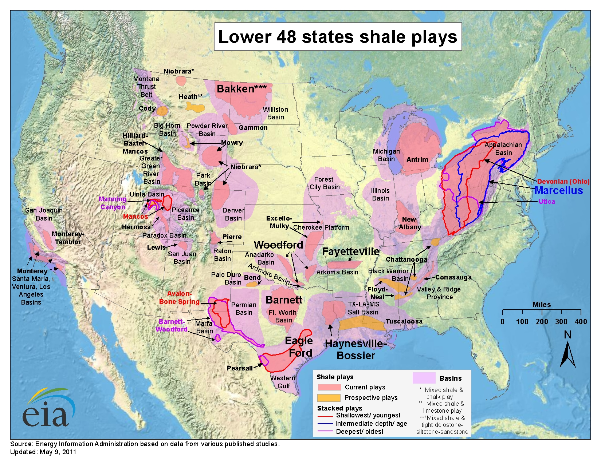
Notes:
From Gil Rogers’ presentation

Slide 4
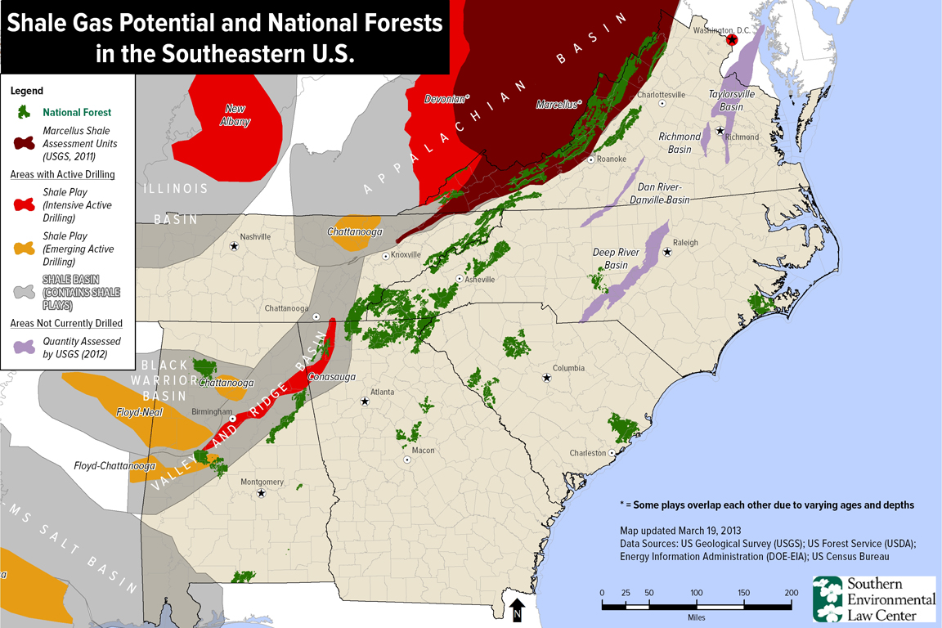
The Latest Drilling Boom
Notes:
From Gil Rogers’ presentation

Slide 5
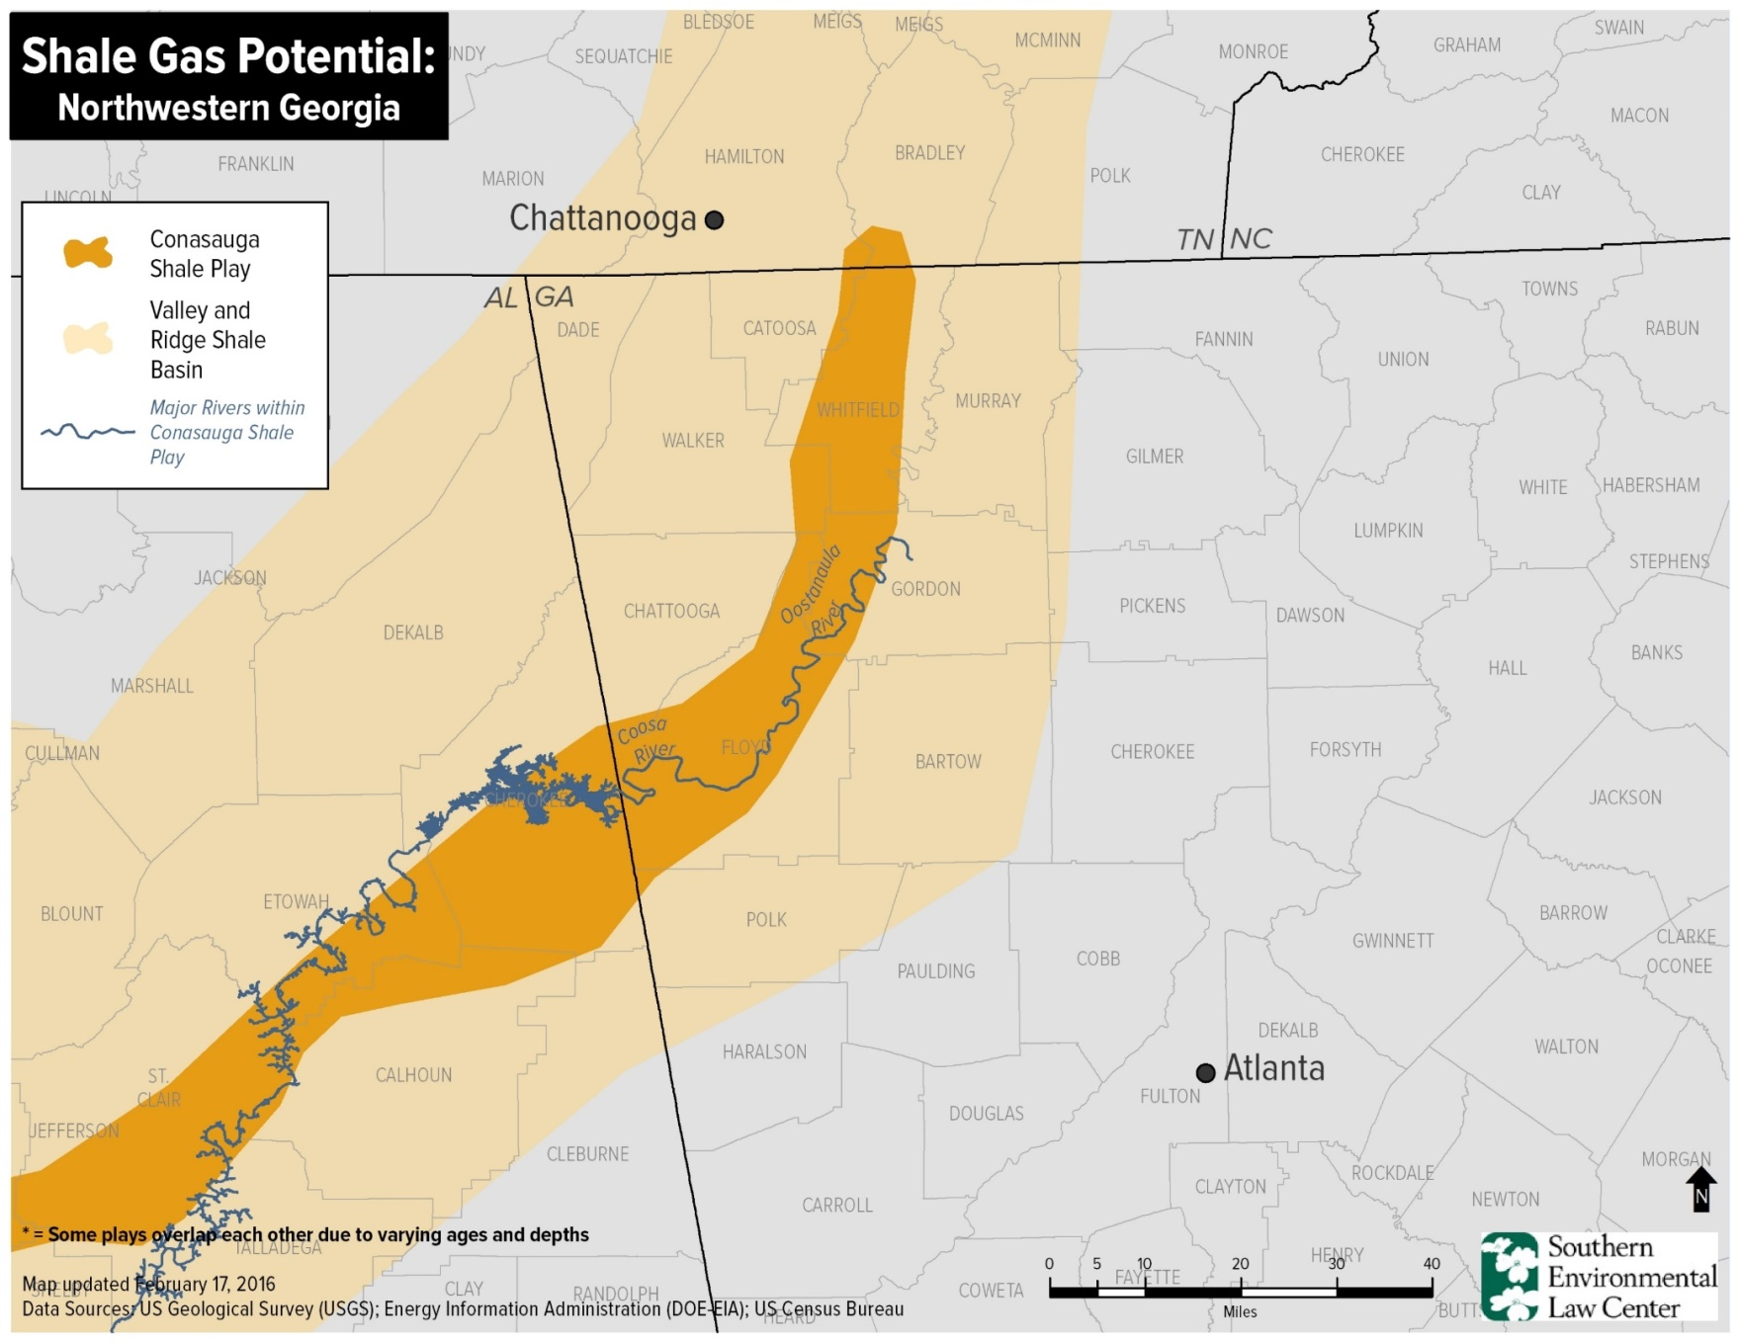
The Latest Drilling Boom
Low permeability formations are now being drilled economically
Notes:
From Gil Rogers’ presentation
Ridge and valley – proximity to Floyd co; from surface exposure to 500 ft thick

Slide 6
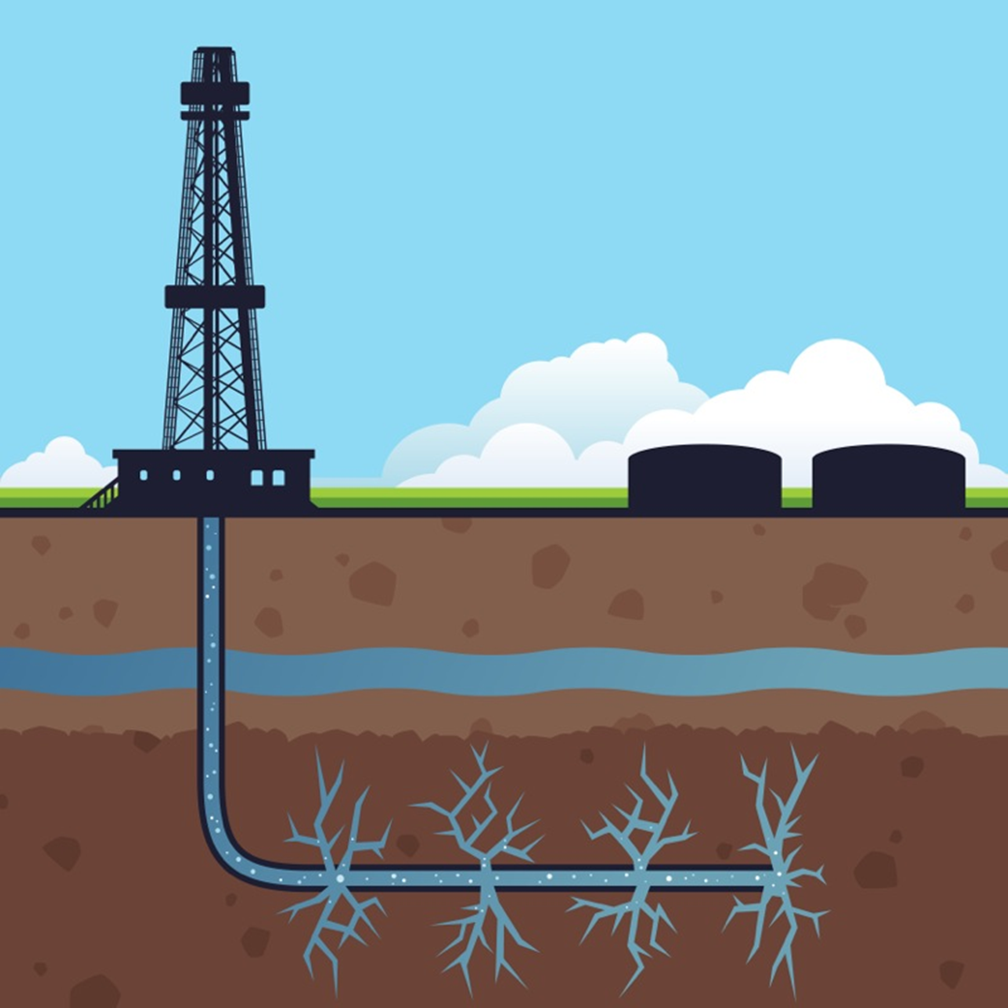
Fracking Process
Increases the permeability (ease of extraction) of low permeability rocks (shales) so oil and natural gas can be produced economically
Water, sand, and organic/inorganic chemical mixture (fracking fluid) is injected through a well drilled in a rock formation, under high but controlled pressure
Fracking fluid creates small cracks within (and fractures) the formation
Notes:
Explain process of fracking
Vertical then horizontal wells
Fracking fluid
Permeability and porosity of rock, specifically shale

Slide 7
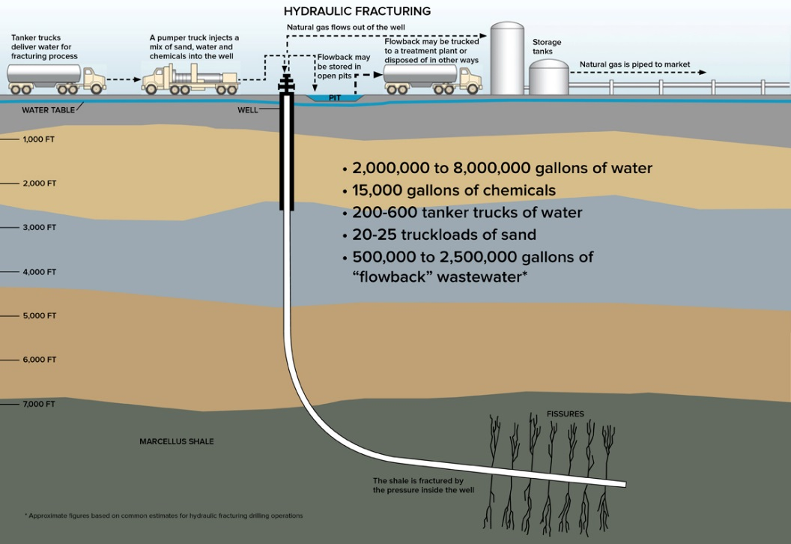
Fracking Process
Some of the fracking fluid, mixed with groundwater, returns to the surface along with the natural gas
Both fracking fluid and groundwater are collected in tanks or lined pits
GSA, 2015
Notes:
From Gil Rogers’ presentation; give reference GSA

Slide 8
Outlook on the US natural gas industry
Relatively new advancements in fracking technology allowed for turn around of declining oil and natural gas industry = drilling boom estimated to last until 2040 (Klein, 2014)
Outlook for the US as an international exporter of natural gas is highly positive (“Fracking Boost”, 2013; “Global Fracking”, 2014; Inman, 2014; Klein, 2014)
Conflicting research estimate domestic supplies to be much smaller than originally thought (Inman, 2014)
Notes:
From “Fracking: Fix it or Forget it?”; “The Fracking Fallacy”; “GSA Critical Issue: Hydraulic Fracturing”; “Fracking Boost”

Slide 9
Controversy surrounding “fracking”
Groundwater, surface water and soil contamination*
Toxicity of ingredients used in fracking fluids*
Water usage and treatment of wastewater*
Induced seismicity/earthquakes *
*GSA, 2015; “Fracking Challenges”, 2014; Chen et. al, 2014; Inman, 2014; Vengosh et.al, 2014; ”Fraught Fracking Future”, 2013
Notes:
“Hydraulic fracturing: paving the way for a sustainable future?”; “GSA Critical Issue: Hydraulic Fracturing”; “Fracking Challenges”; “Fraught Fracking Future”

Slide 10
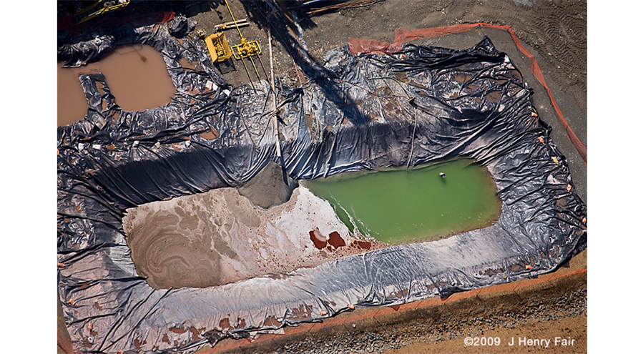
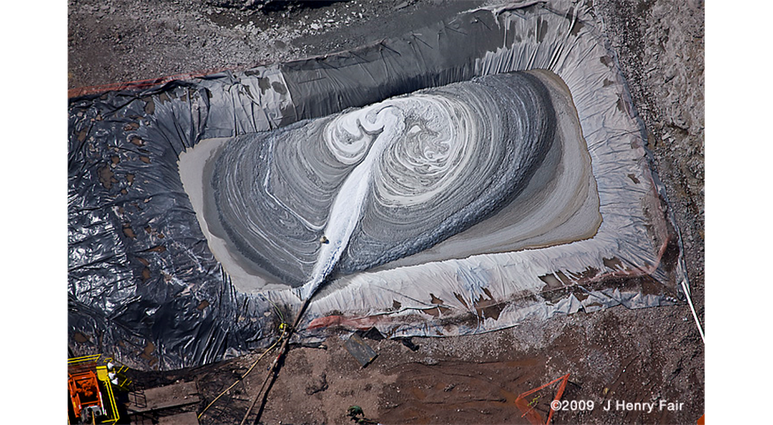
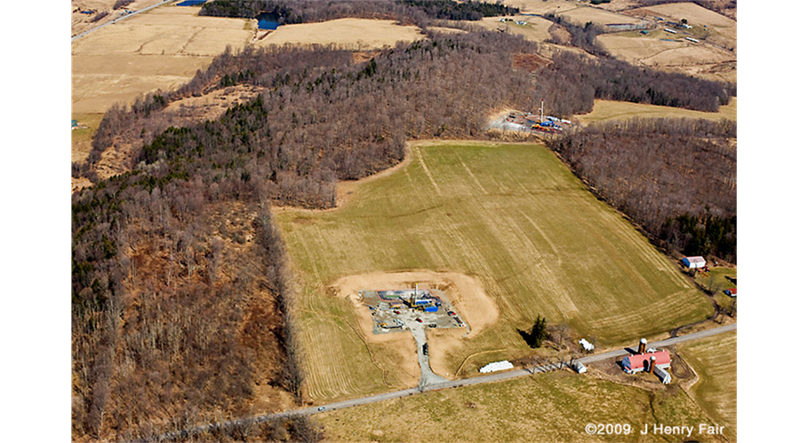
Issues and potential impacts for properties and communities
Proximity of fracking operations to homes and communities
Noise pollution and air emissions
Heavy truck traffic creates dust and impacts roads (implications for state and local tax revenue)
Property value concerns
Pipelines and pipeline corridors
Notes:
Needs 30 contiguous acres for well site

Slide 11
What has been done to minimize the impacts of oil and gas development?
Safe Drinking Water Act – SDWA (1974)
Clean Air Act – CAA (1955)
Clean Water Act – CWA (1972)
Resource Conservation and Recovery Act – RCRA (1976)
Comprehensive Environmental Response, Compensation and Liability Act - CERCLA (aka Superfund) (1980)
National Environmental Policy Act - NEPA (1970)
Notes:
From “GSA Critical Issue” Hydraulic Fracturing”; Gil Rogers’ presentation

Slide 12
State vs local oil and gas regulations
Regulations can protect groundwater, but does not address: noise, traffic, road damage, setbacks, hours of operations, gas flaring, etc
Georgia Oil and Gas and Deep Drilling Act of 1975: enacted long before modern fracking methods
Notes:
From Gil Rogers’ presentation

Slide 13
Examples of local and county regulations
Setback distances from homes and other buildings
Minimizing impact on roads
Fencing of well facilities
Road impact fees, well impact fees
Remediation post operation
Strain on local power sources
Memorandum of Understanding with individual operators
Establish baseline water quality data prior to drilling
Notes:
From Gil Rogers’ presentation

Slide 14
Questions or Concerns?
Contact Dr. Tamie Jovanelly at tjovanelly@berry.edu
(706) 238-5868

